Slide 1

Summer
Brief
William Foster

Slide 2
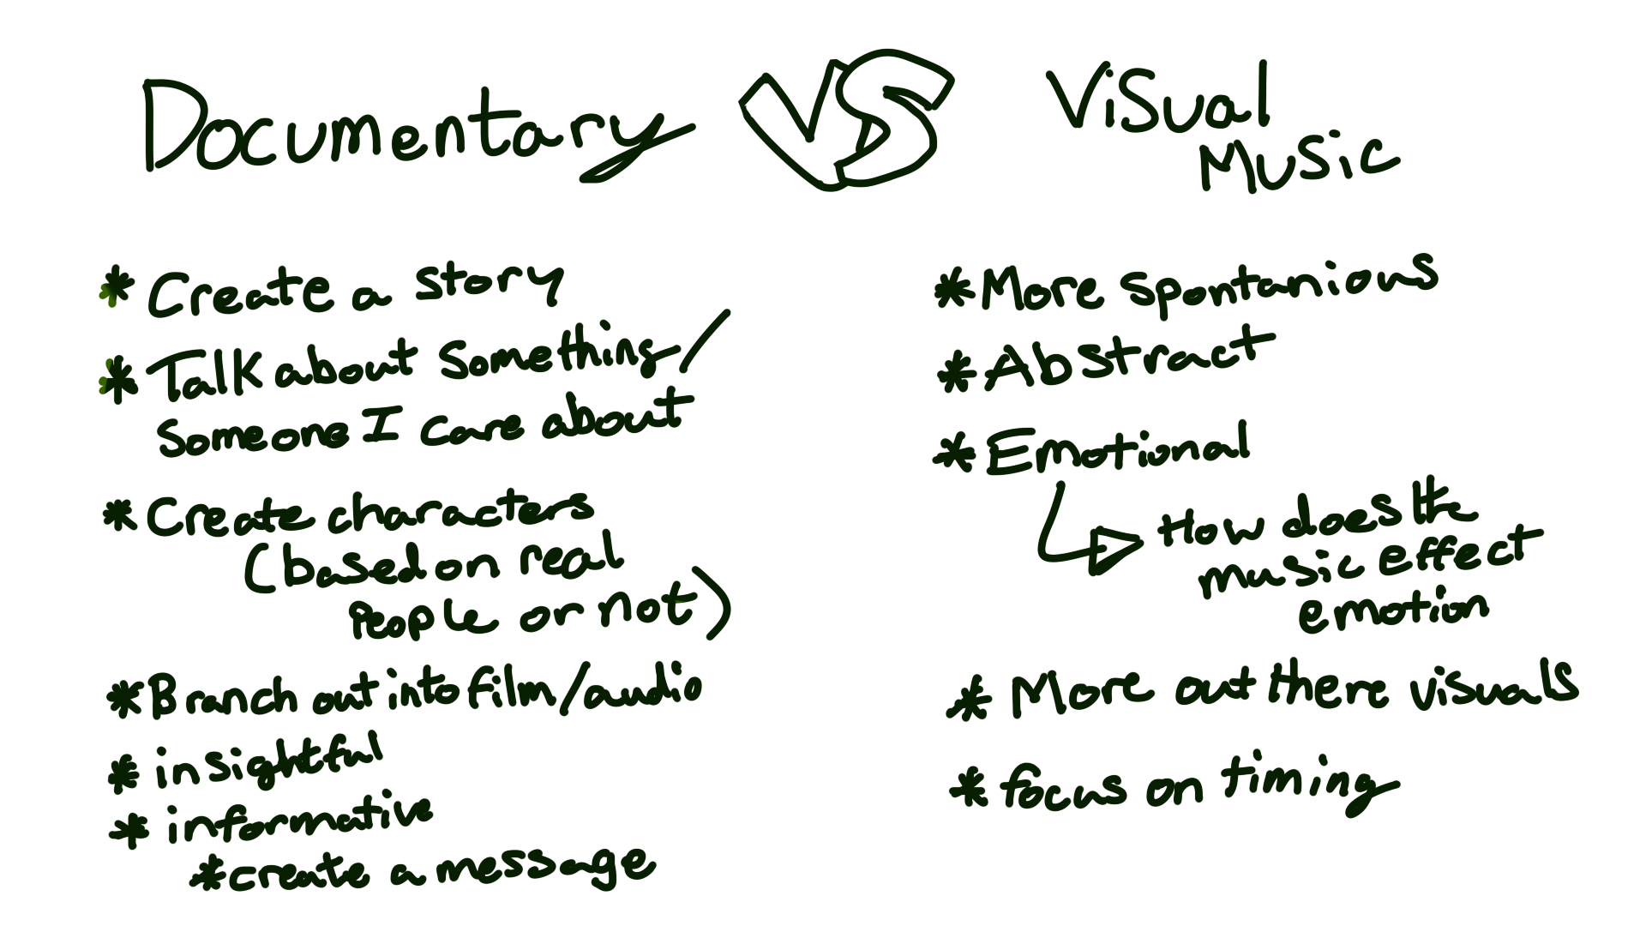

Slide 3
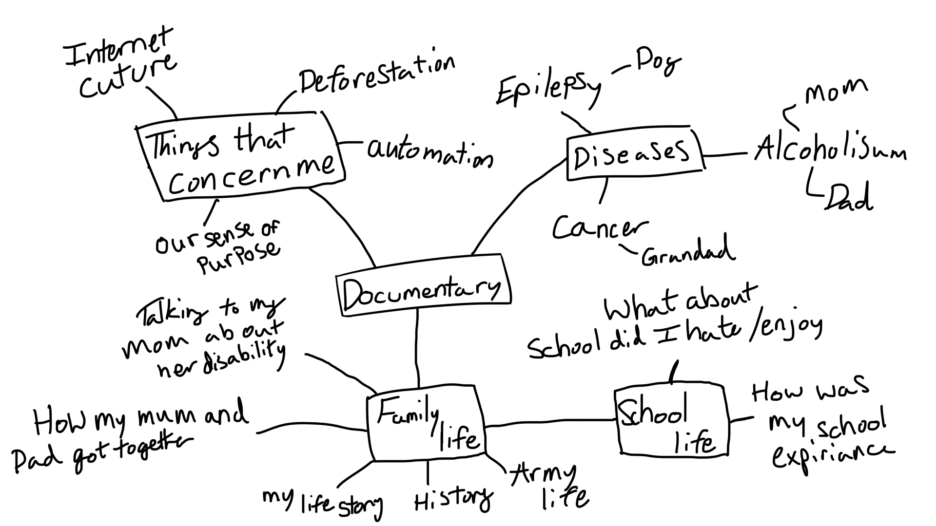

Slide 4
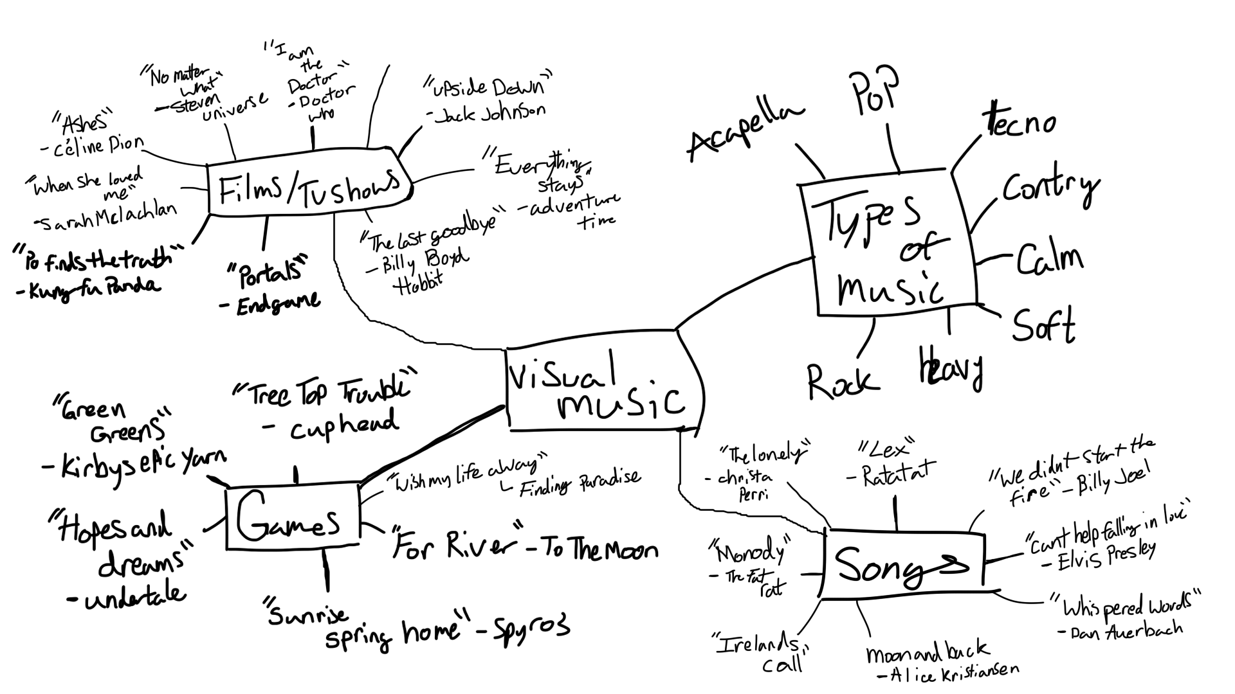

Slide 5
What Brief Have I Decided To Go With?
Both Briefs give plenty of opportunity for what I am looking for to improve my animations.
The documentary Brief would let me improve and experiment with my storytelling skills, such as working on creating a script, lip-syncing and improving my character designs and movement, this is something the documentary brief would excel at achieving for me.
The Visual Music Brief however would help me improve my timing and really make me push my creativity with syncing and moving with the music. This would also mean id be able to fully explore colour, shape and focus on the rhythm of the music for my animation to flourish.
Due to both Briefs Pros and Cons, I have decided to focus my efforts on the Visual Music Brief.
The reason for this is due to my last projects. Both of my Metamorphosis and Double act final animations I found to have really good shots and scenes but id be lying to myself if I didn’t notice some of those scenes being slow, to fast or lacking a snappy punch to the movements.
This is why I think working on animating on a beat I feel would help me focus more on the timing compared to my lack of understanding I kind of had with the first two briefs.

Slide 6
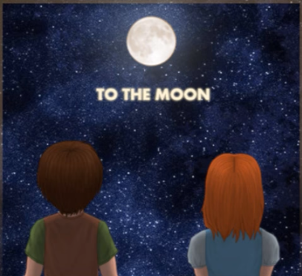
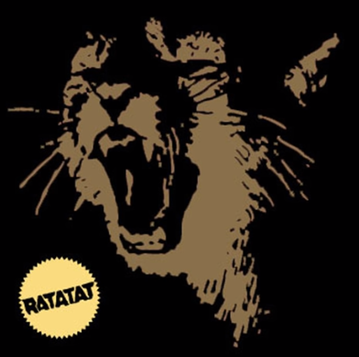
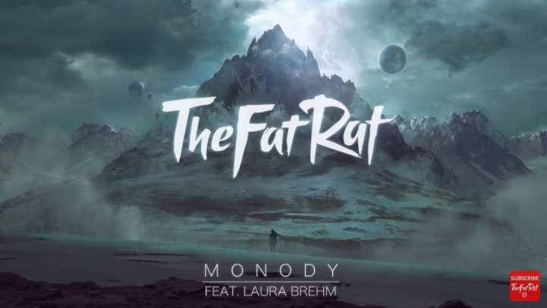
My 3 Music Choices
For River/To The Moon
Artist: Kan. R. Gao and Laura Shigihara
Music Type: Slow, Pleasant
This simple tune of music is relaxing and peaceful but at the same time its able to make you joyful sadness which is a juxtapose of sorts, but together actual creates a restful atmosphere
https://www.youtube.com/watch?v=LvEXqjnuQww
Lex
Artist: Ratatat
Music Type: Mystical, Dreamy
This song is like a futuristic dream sequence full of robotic sounds that give off a calming yet mechanic vibe. Compared to my first choice this song is less relaxing to listen to and more upbeat.
https://www.youtube.com/watch?v=48yR03AX75o
Music Type: Epic, Adventurous
The song is an avalanche of instruments and beats that it almost seems chaotic. But at the same time it feels like an adventure with each instrument representing a different location.
It’s the perfect song for a traveller
Monody
Artist: TheFatRat
https://www.youtube.com/watch?v=B7xai5u_tnk

Slide 7
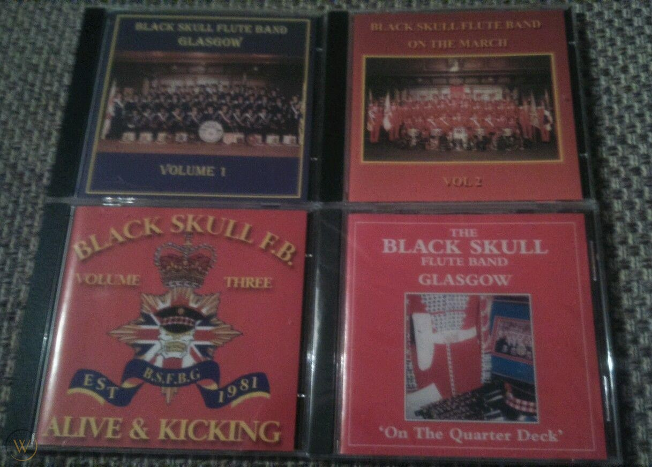
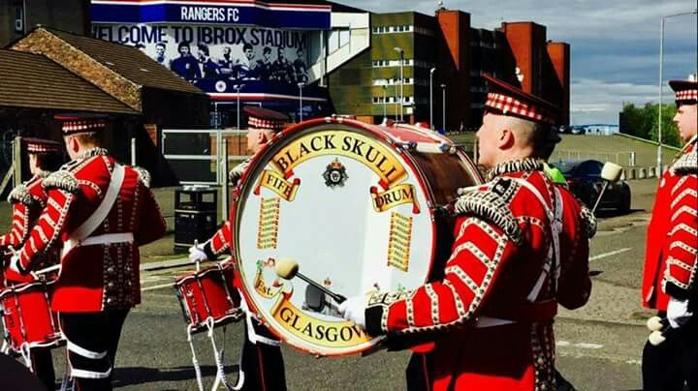
Honourable Mention
Black Skull Flute Band
Black Skull Flute Band is a band that celebrates the annual Ulster Holiday of The Twelfth.
The Twelfth, also named the Glorious Twelfth or Orangeman’s Day. Is an Ulster protestant Celebration held on the 12th July.
The Twelfth is celebrated mainly in Northern Ireland, where it’s a public Holiday.
The Twelfth is to celebrate the Glorious Revolution (1688) at the Battle of the Boyne (1690) Where the Protestant King William of Orange ( William III) won the Battle of the Boyne over the Catholic King James II.
I wanted to have this as part of my research because of how its part of my history and this is the only real part of my family history that has stayed with me thanks to my Mum.
https://www.youtube.com/watch?v=s2TWV9IRRMk&list=PLZpeneSHjlRMJulP5zTxG8lRBDhTFY3v9&index=2
https://www.youtube.com/watch?v=N6QpCagr4FY&list=PLZpeneSHjlRMJulP5zTxG8lRBDhTFY3v9&index=1

Slide 8
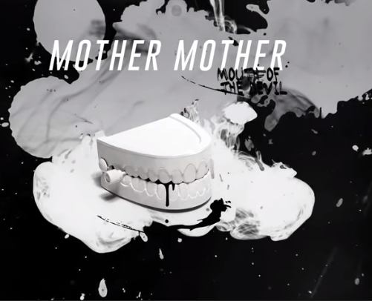
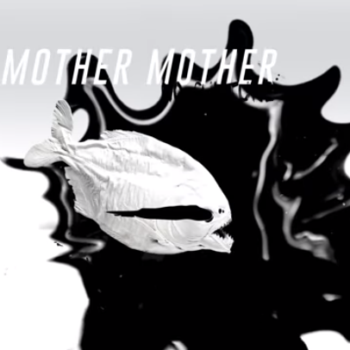
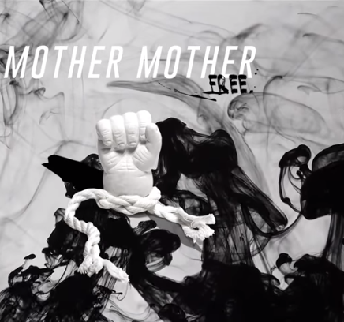
Mother Mother
There Music videos really caught my eye, due to how visually pleasing they were.
Each video has a different technique but each stick to a black and white colour scheme.
They use ways such as smoke, Paint and Dye in water really helps create some really astounding visuals.
After listening to some of there songs I’m now a fan of there songs “No Culture” and “Back in School”
https://www.youtube.com/watch?v=Ar7FBo9hV9w&list=PLZpeneSHjlRMJulP5zTxG8lRBDhTFY3v9&index=4

Slide 9

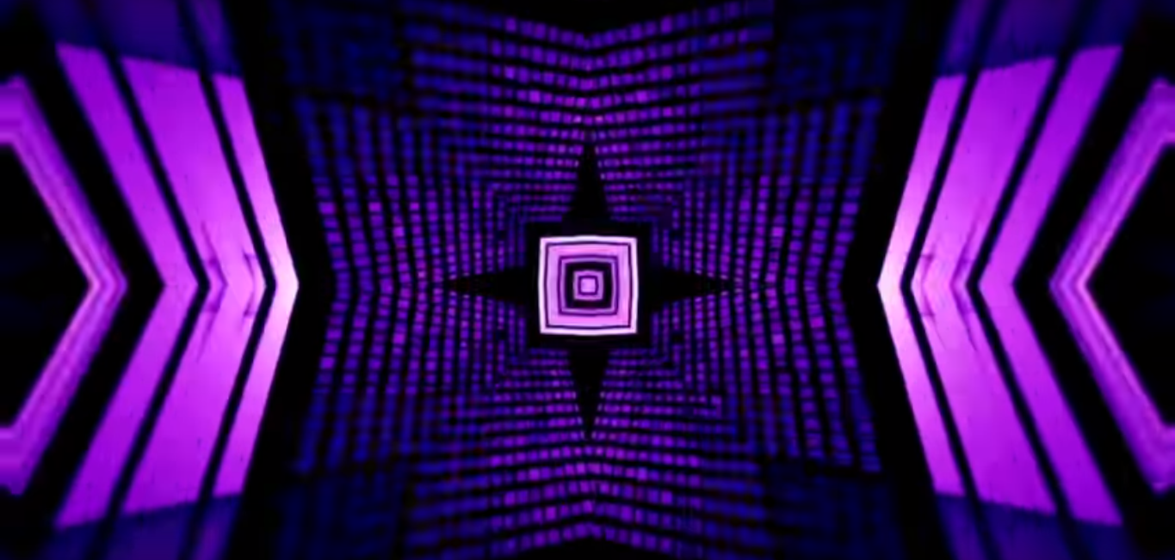
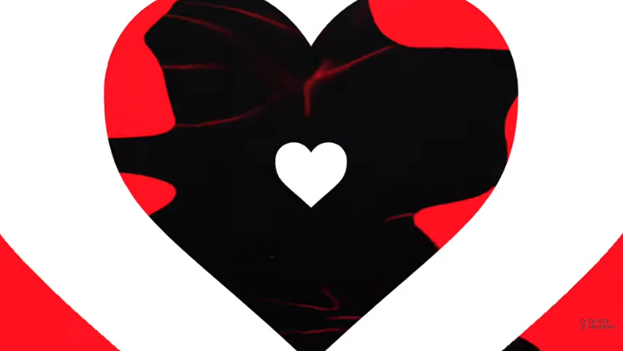
Visually interesting Music videos
https://www.youtube.com/watch?v=kfHutj2jU5I&list=PLZpeneSHjlRMJulP5zTxG8lRBDhTFY3v9&index=15
Piero Pirupa – Braindead
Uses lines and A black and white colour scheme to make the movements pop
https://www.youtube.com/watch?v=-kLvsKZMLh4&list=PLZpeneSHjlRMJulP5zTxG8lRBDhTFY3v9&index=16
Rebuke - Along Came Polly
Lovely visuals of Purples, whites and blues, but the flashes are almost Epilepsy inducing.
https://www.youtube.com/watch?v=cdNgo-E95f0&list=PLZpeneSHjlRMJulP5zTxG8lRBDhTFY3v9&index=25&t=0s
Riton x Oliver Heldens - Turn Me On ft. Vula
The use of bold colours of Red, White and Black make a distanced backdrop for the music being played.

Slide 10
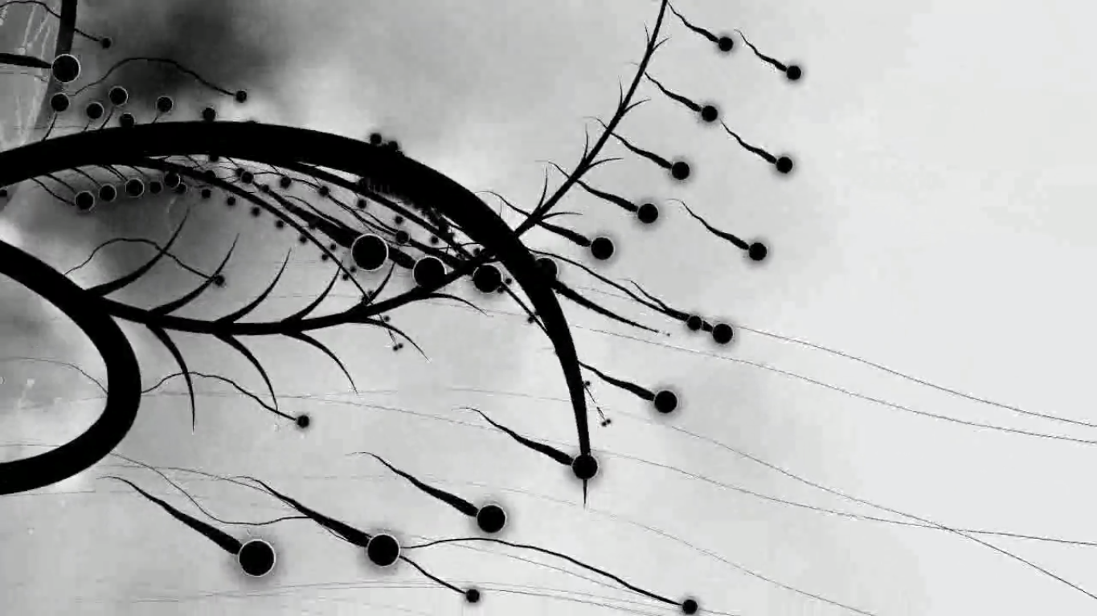
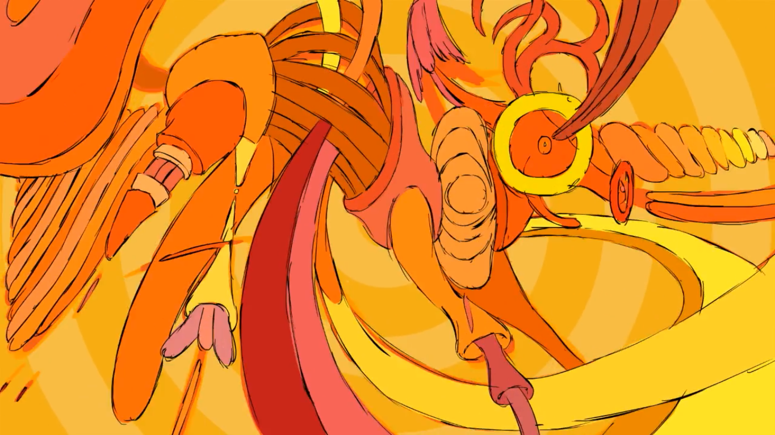
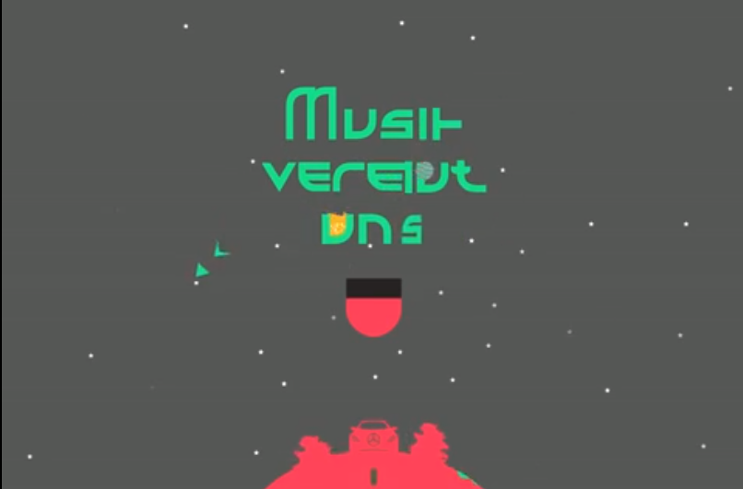
https://vimeo.com/1593564
Music Is Math
The use of Black and white contrasting together as well as the animation appearing like a plant being grown and its seeds being spread and growing is a great looking animation.
https://vimeo.com/12487929
Blockhead - The Music Scene
The bright and dim colours contrasting with one another, as well as the chaotic way the animation is used but still keep in touch with the beat is a wonderful looking animation
https://vimeo.com/34030984
Music makes one
Its sort and sweet and the animation fully commits to sticking to the music and it works wonderfully.

