Slide 1
Field: Figurative Modelling
By William Foster

Slide 2
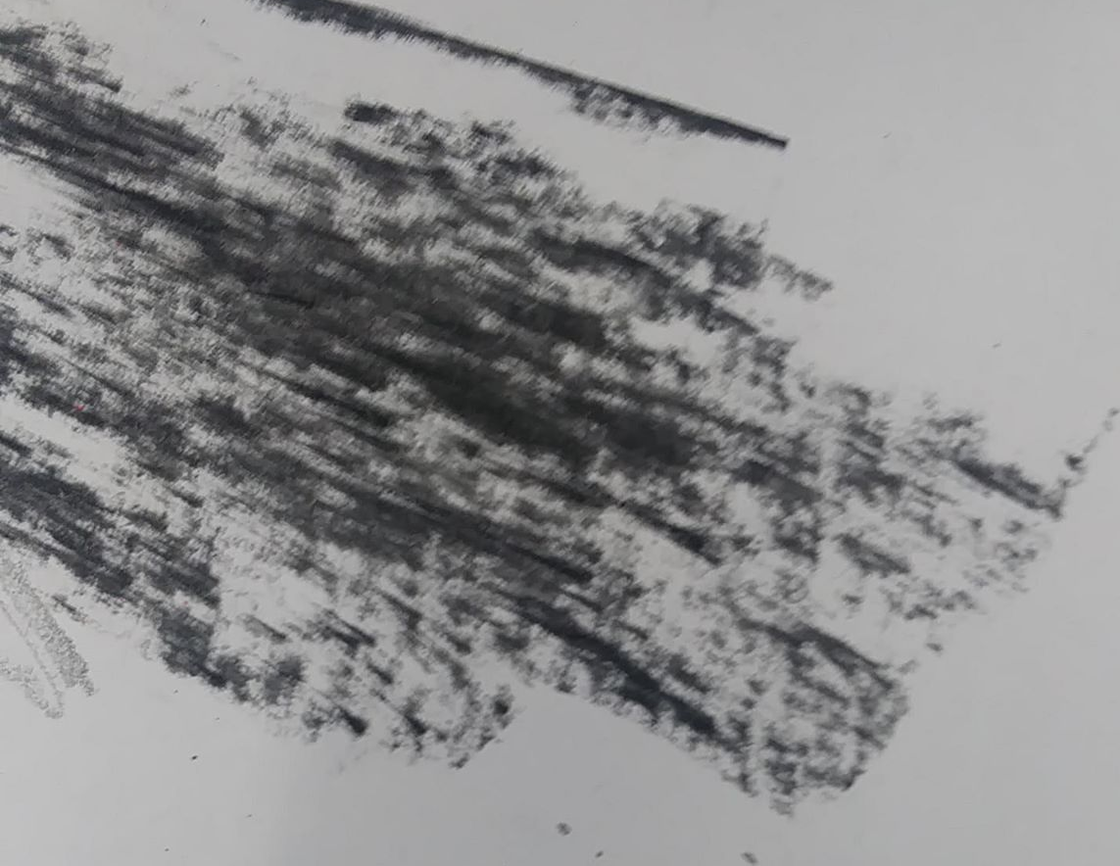
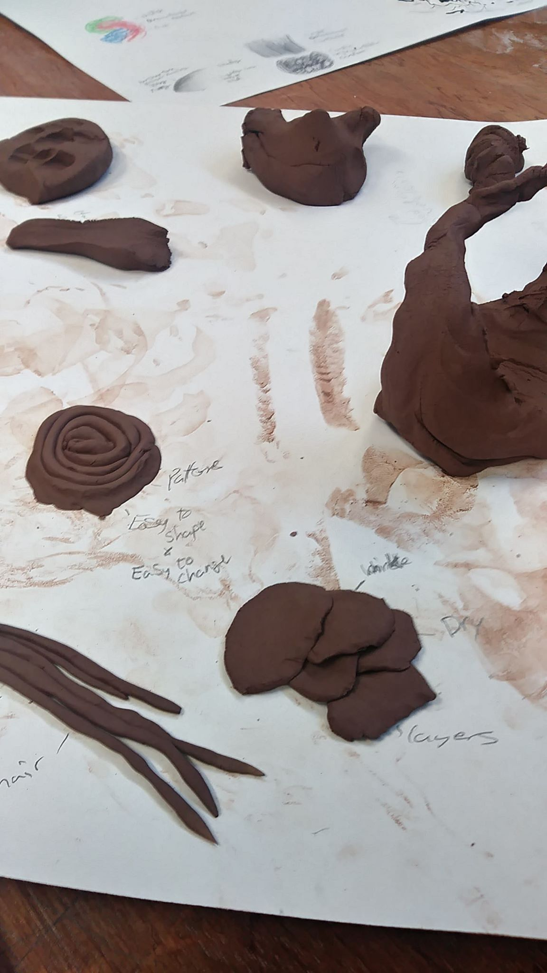
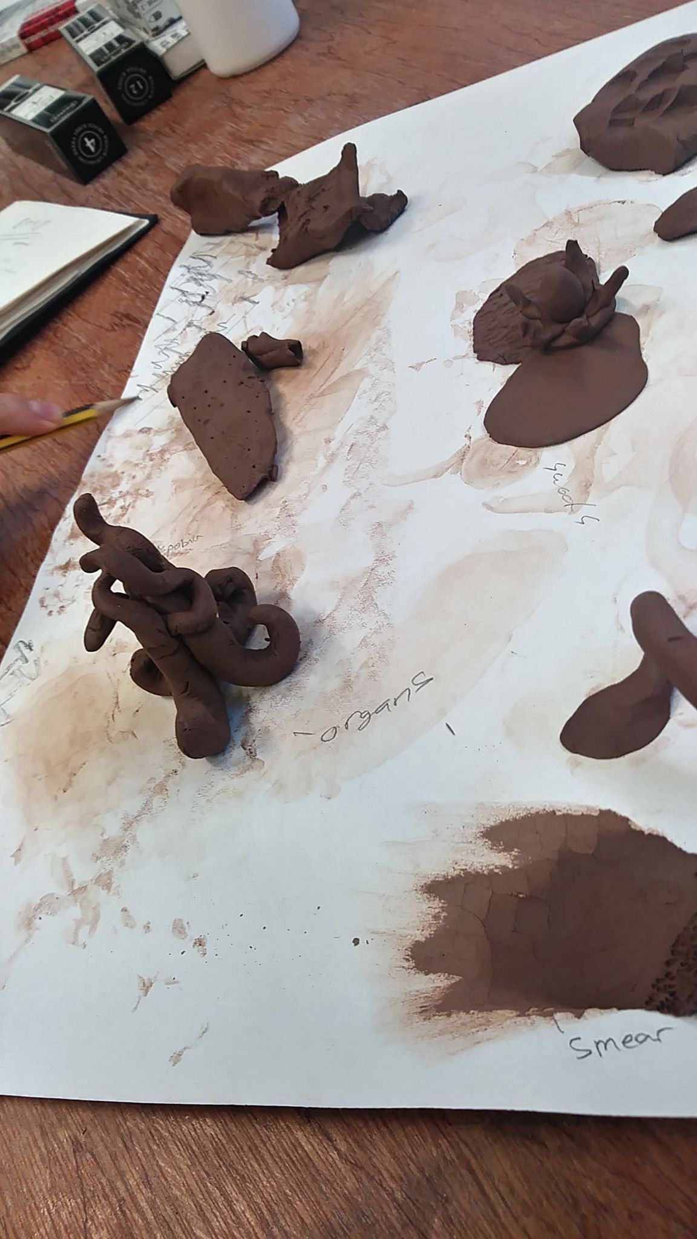
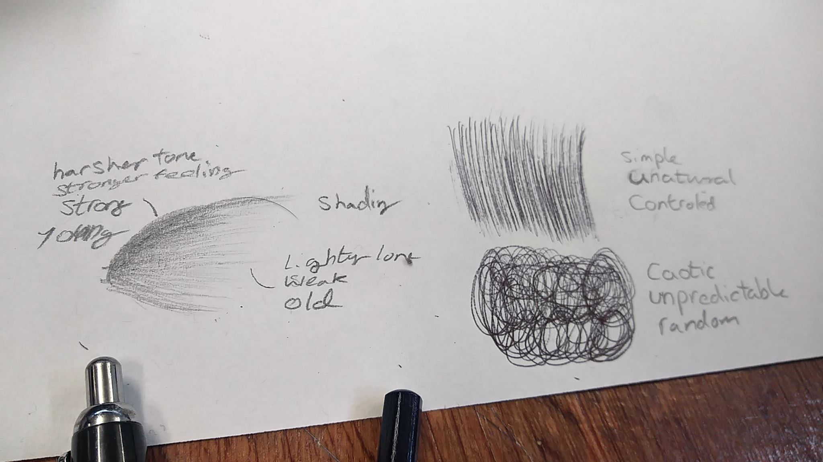
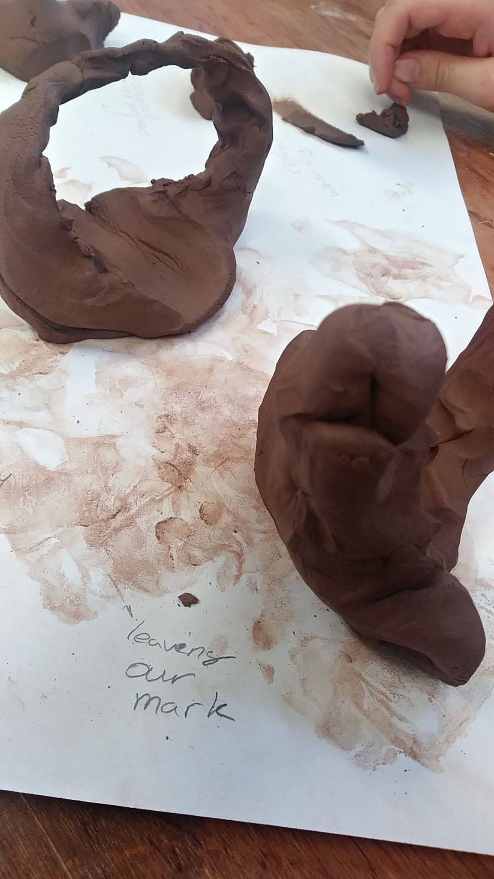
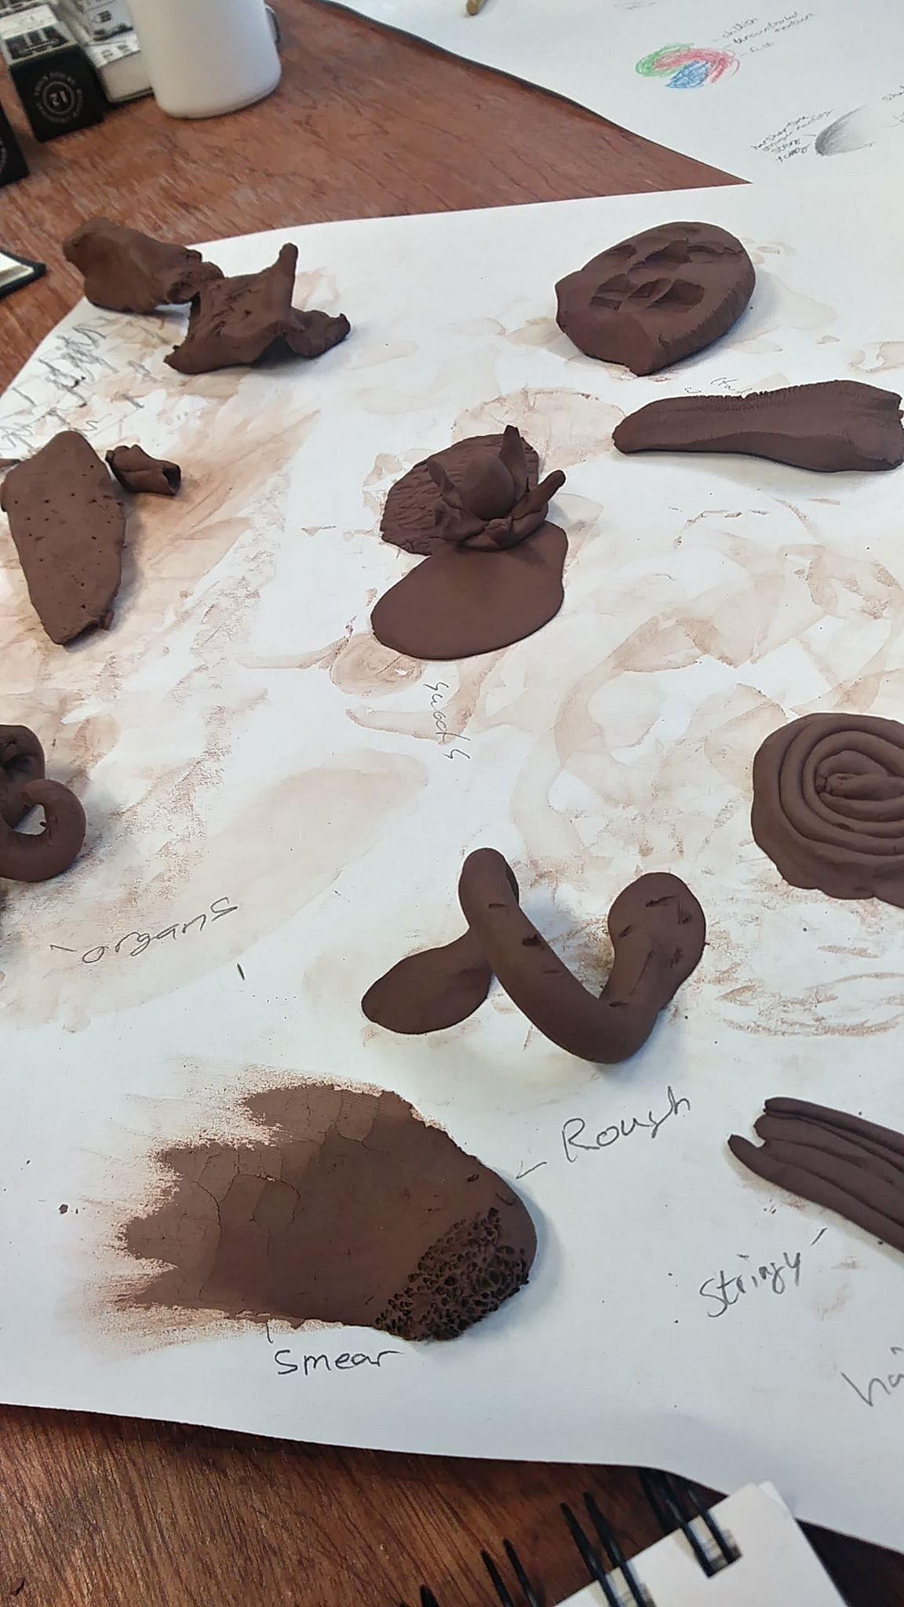
Mark Making
I really enjoyed creating different textures with clay, pens, pencils and Paint. noticing little details you wouldn't have if you didn't focus on looking for those textures was fun for me to notice.
One of those textures that i noticed would have to be the unintentional marks from the clay that would stain the paper we used. I noticed those stains and it made me think of it as we always leave our mark on people even if it was unintended, how you acted and what you did with them leaves a mark.

Slide 3
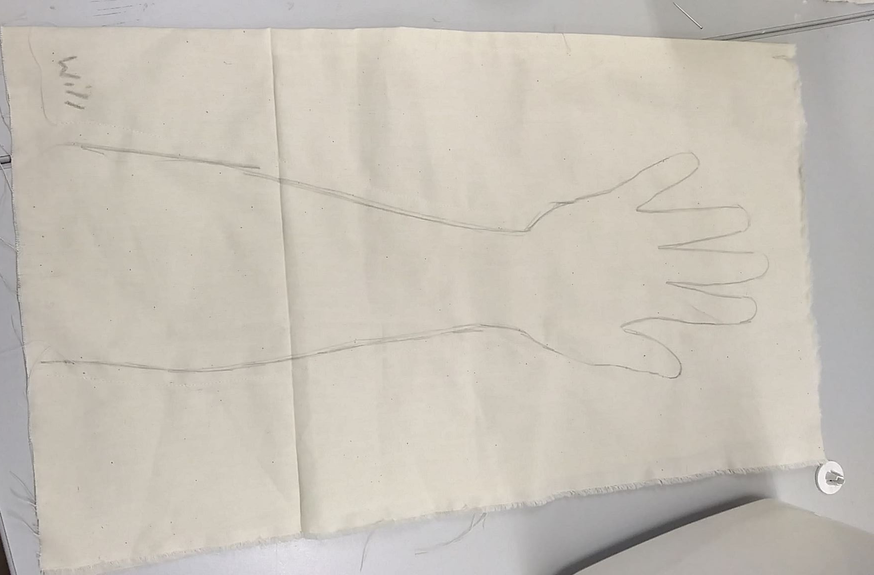
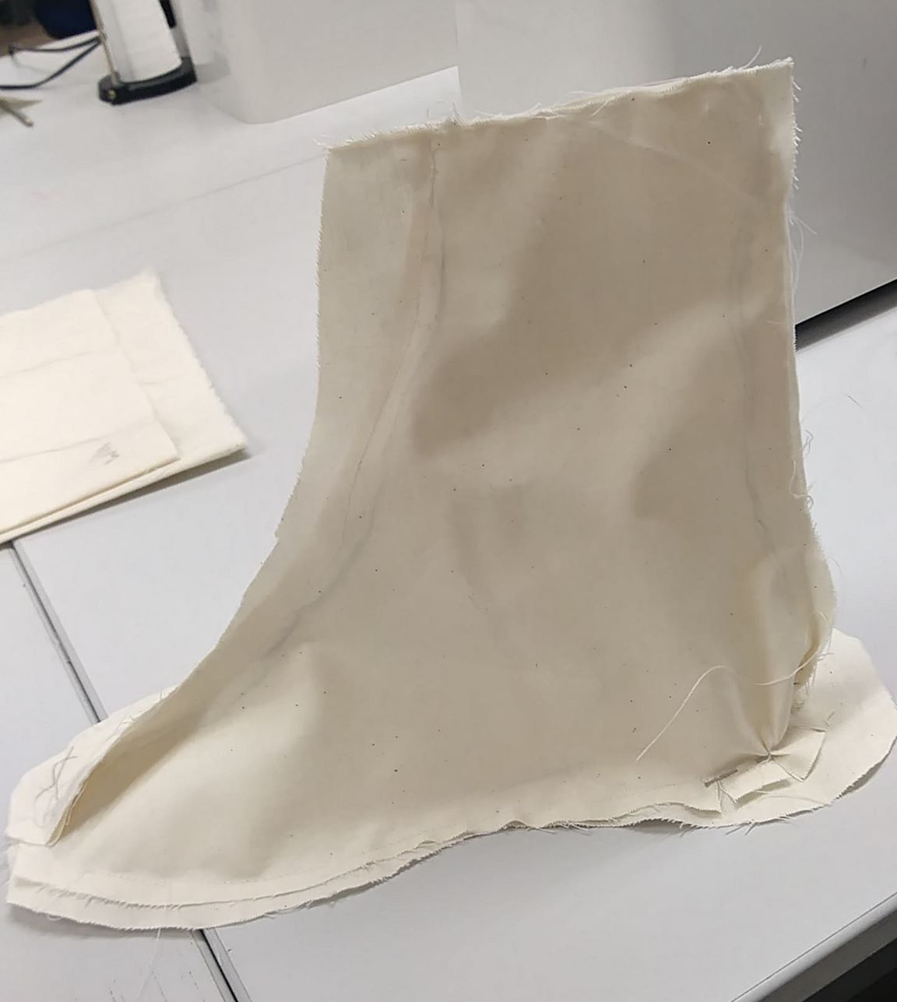
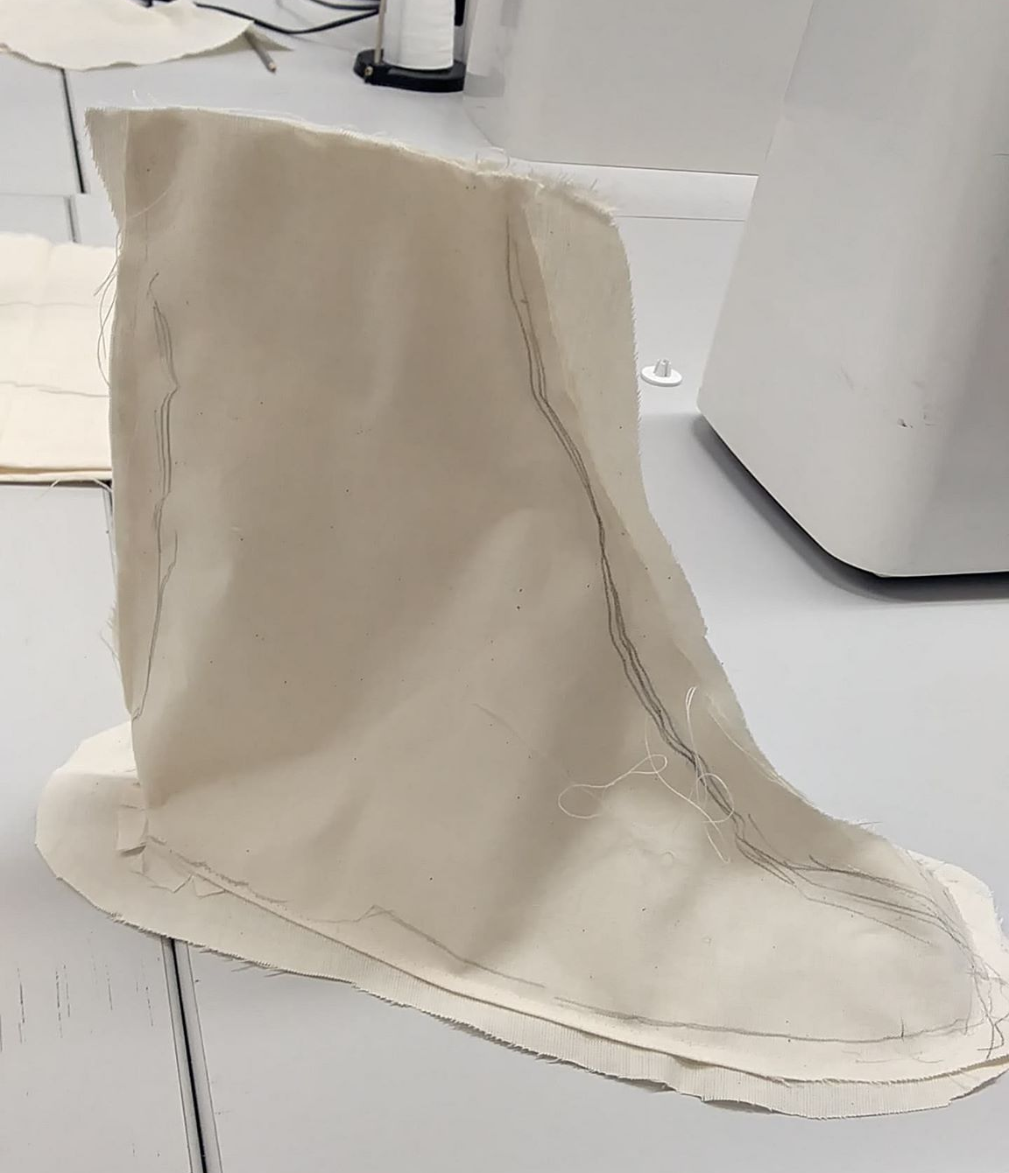
Sewing Arm and Foot
For a first time effort with sewing i felt that i did a pretty good job with it. being able to use a sewing machine was complex but fun to learn how to use. this was then filled with plaster. I found that adding the plaster was both fun but a tad stressful since i wasn't quite used to using that type of material and the timeframe to make sure it doesn't harden before i could finish.
Just like the Arm I'm happy with how I've sort of got the hang of sewing, especially now since I tried to create a more 3D foot.

Slide 4
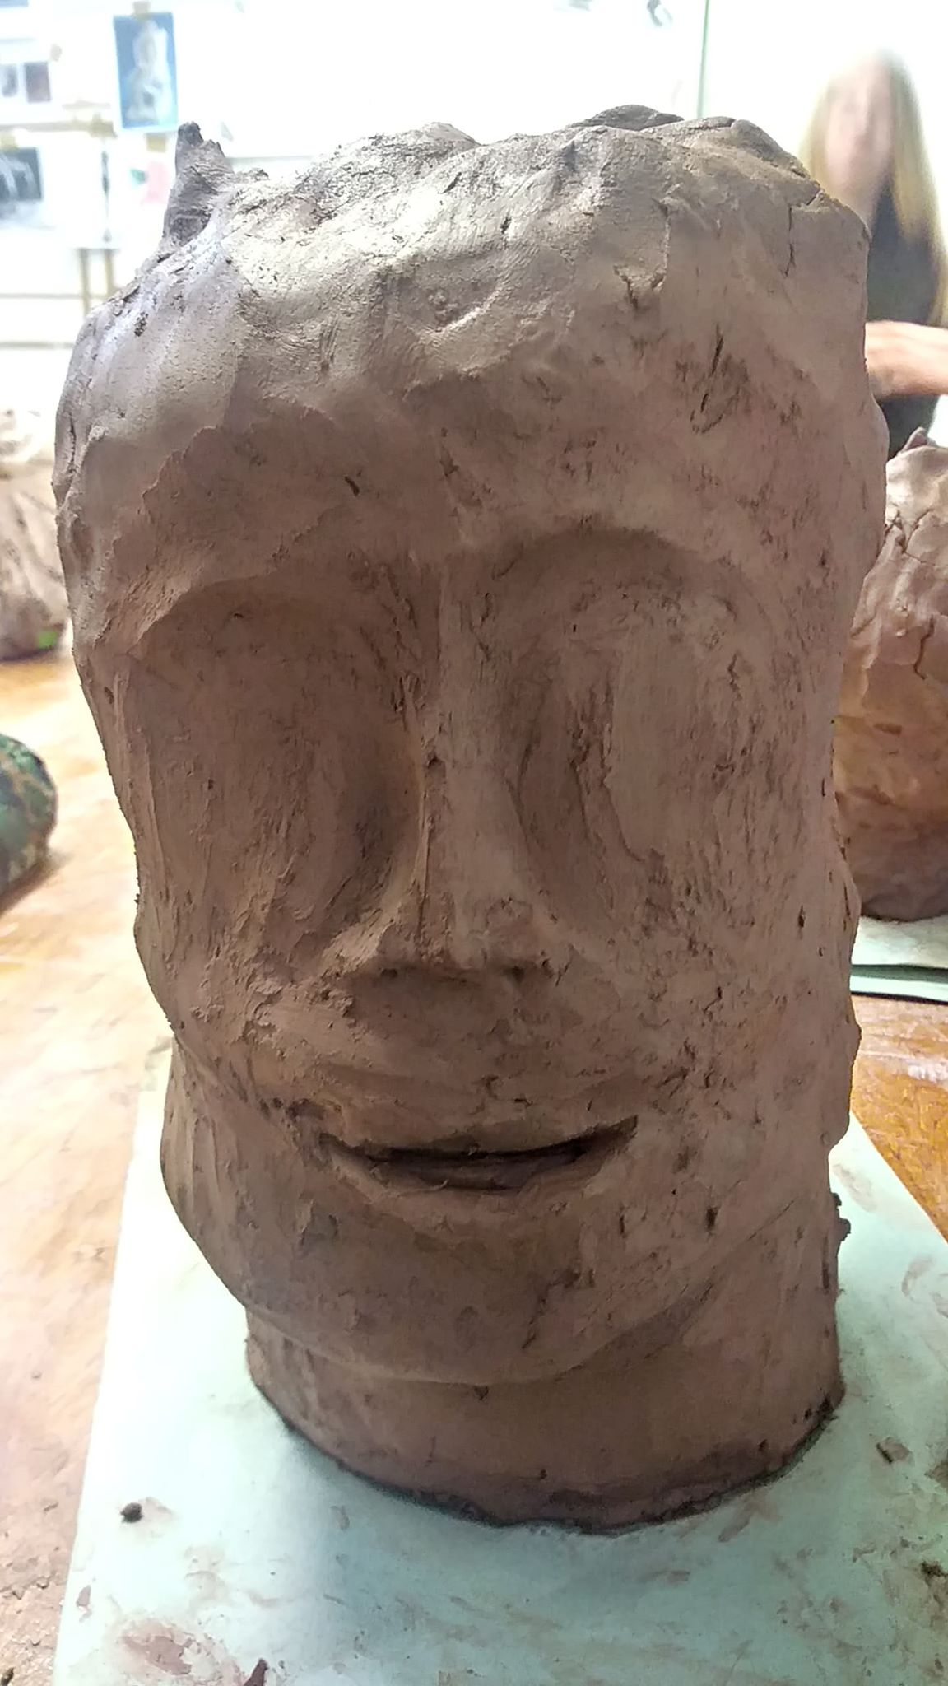
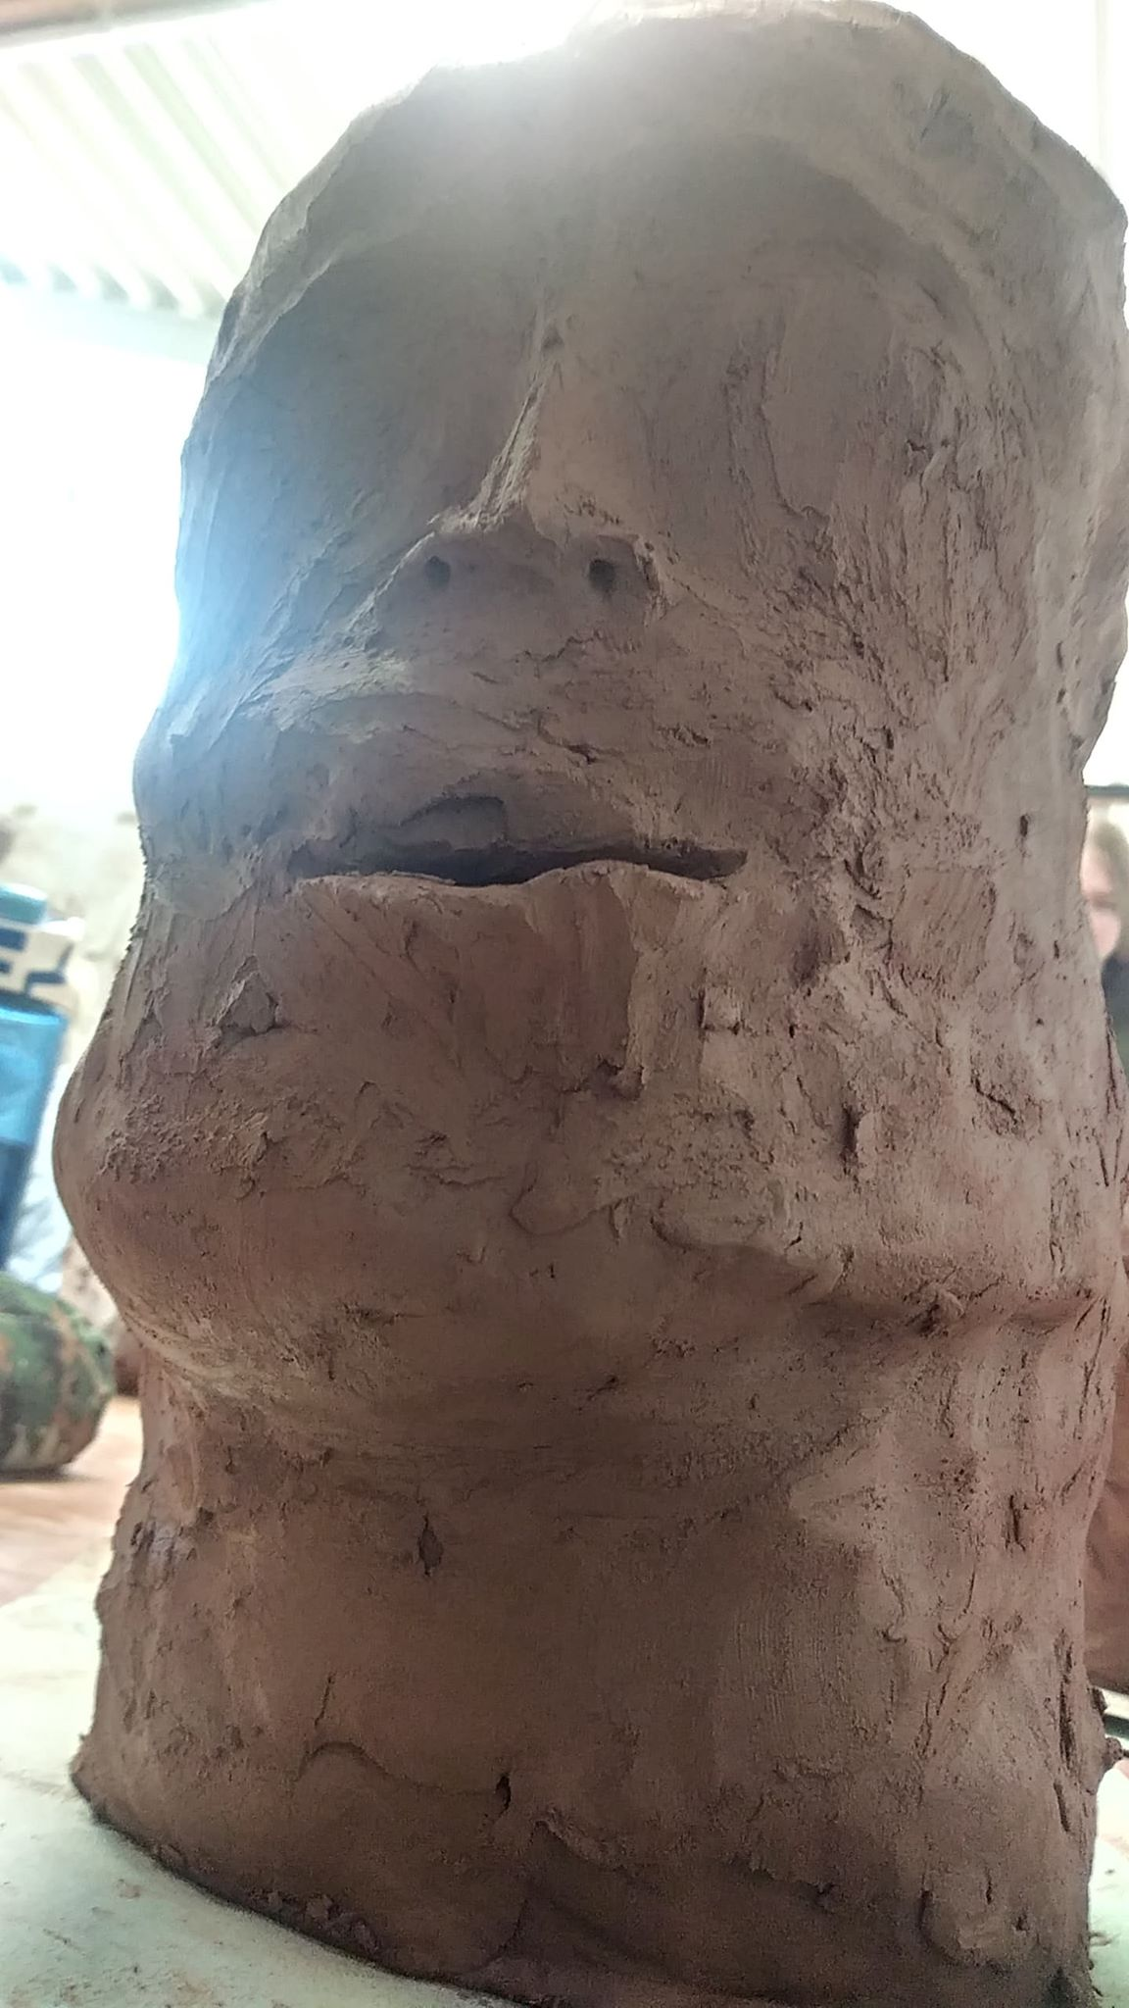
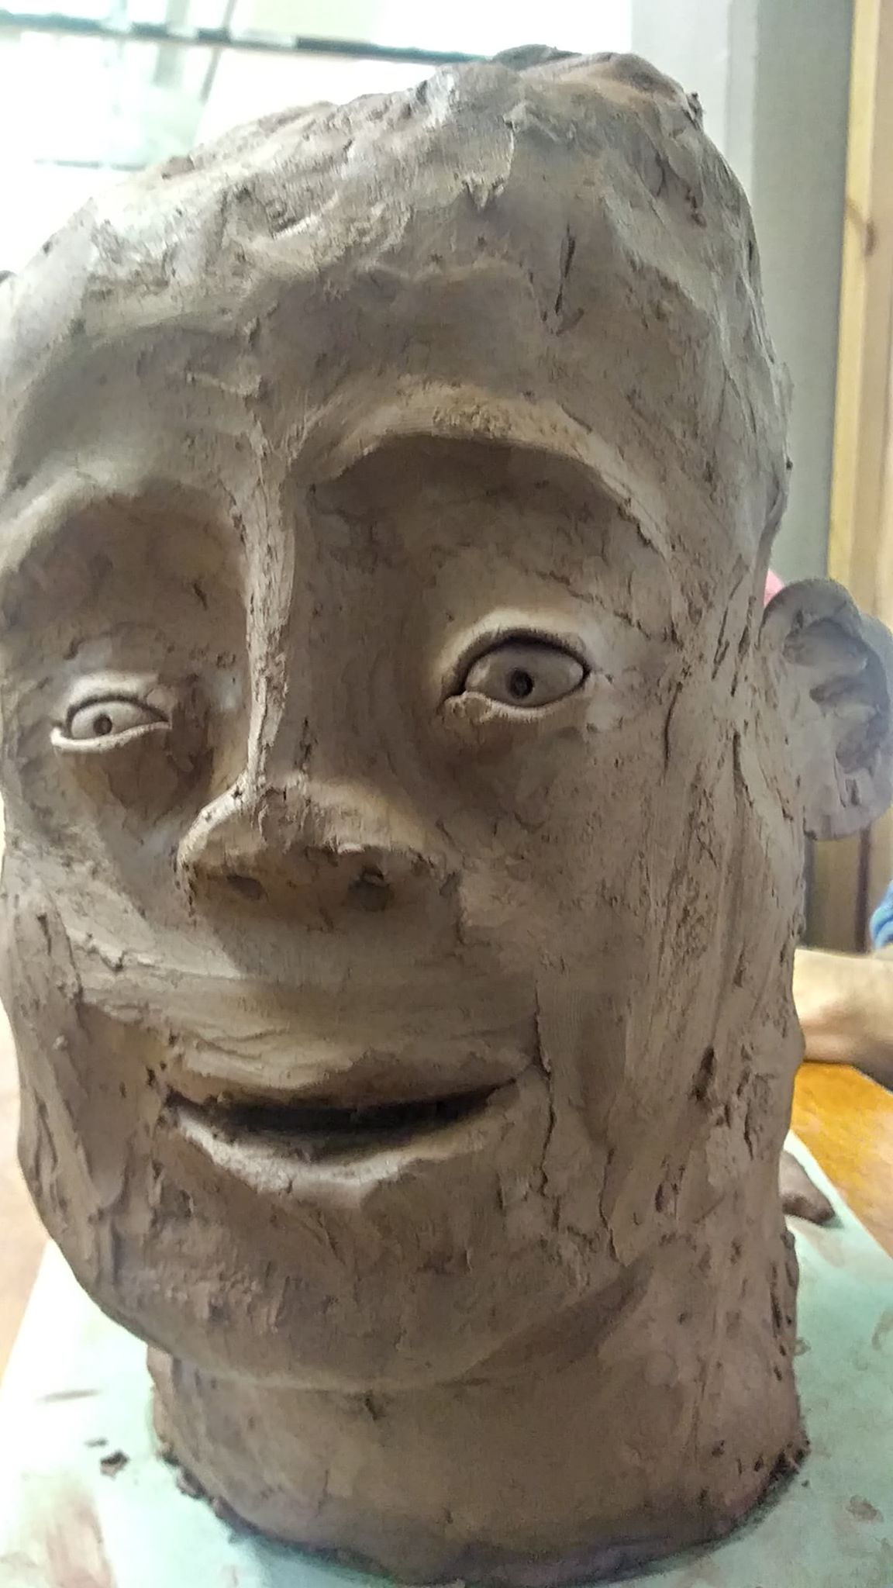
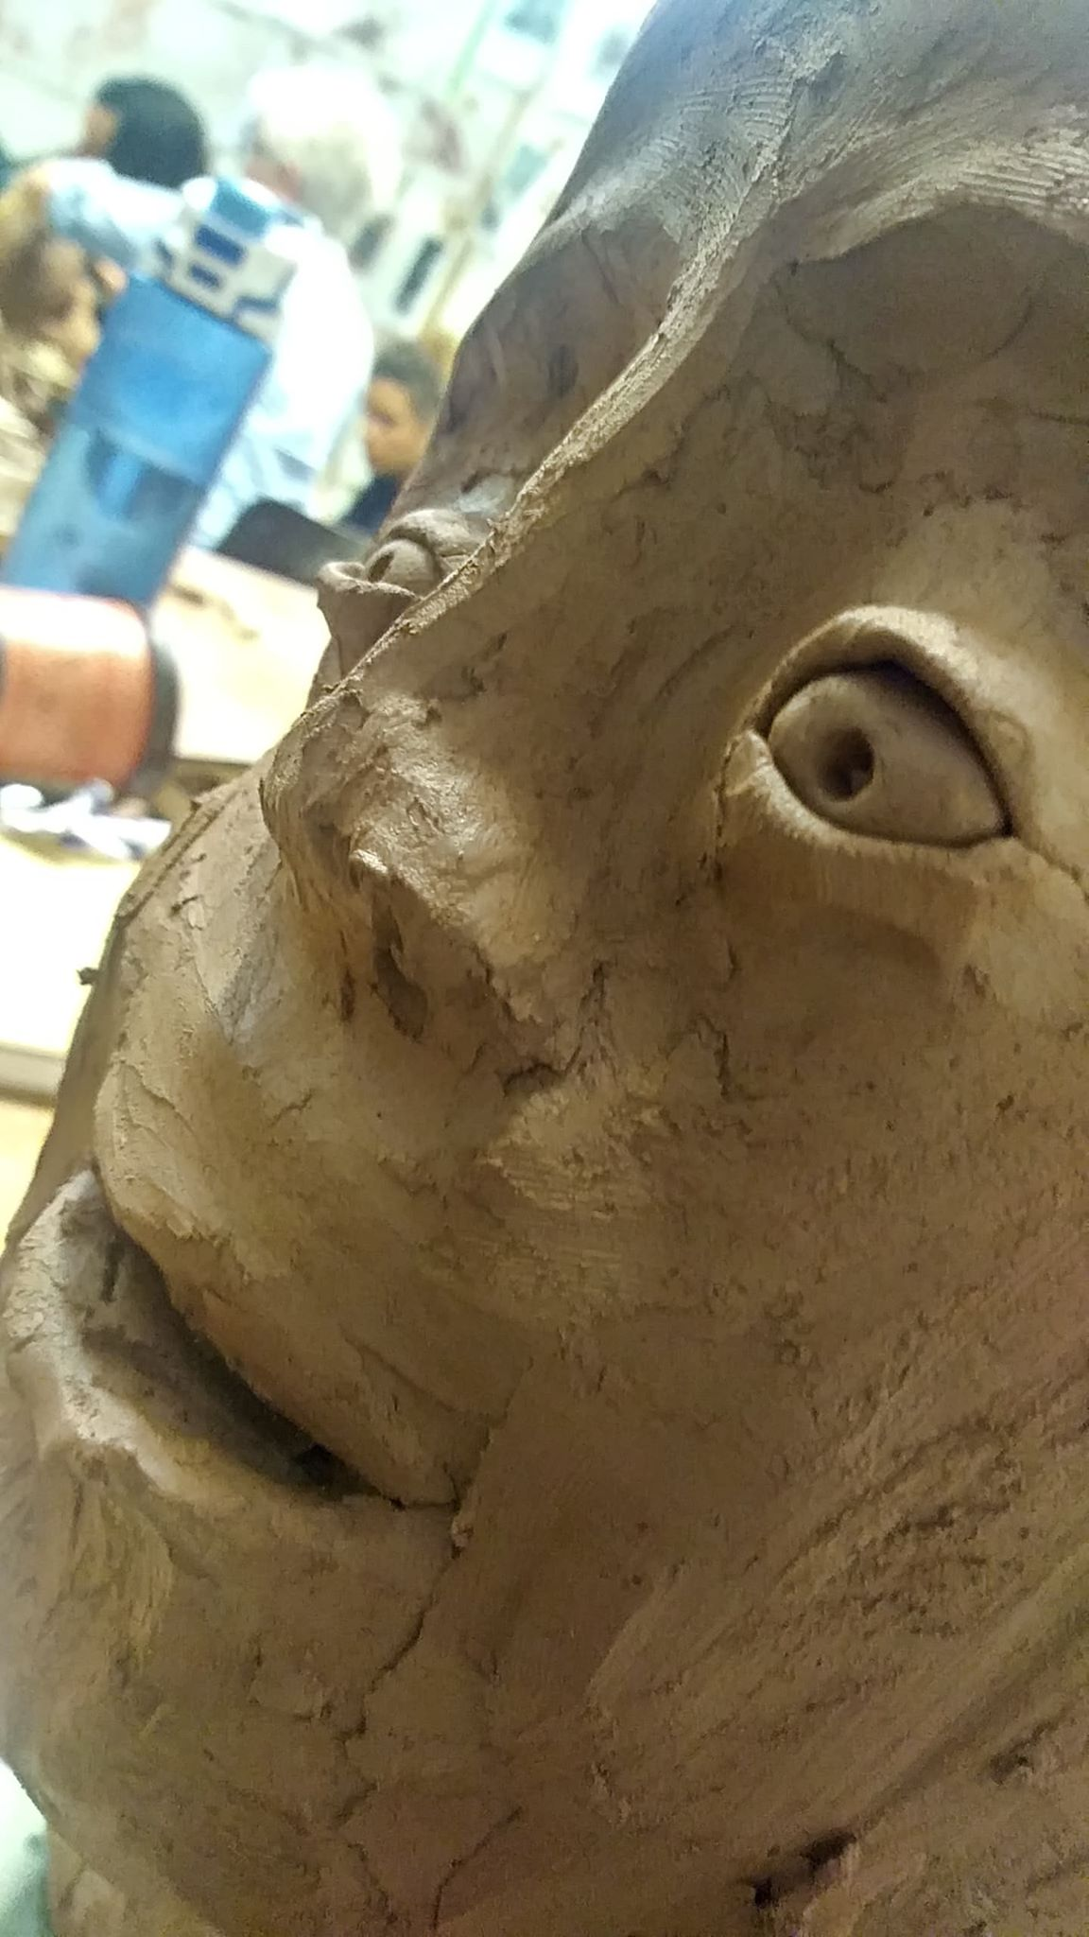
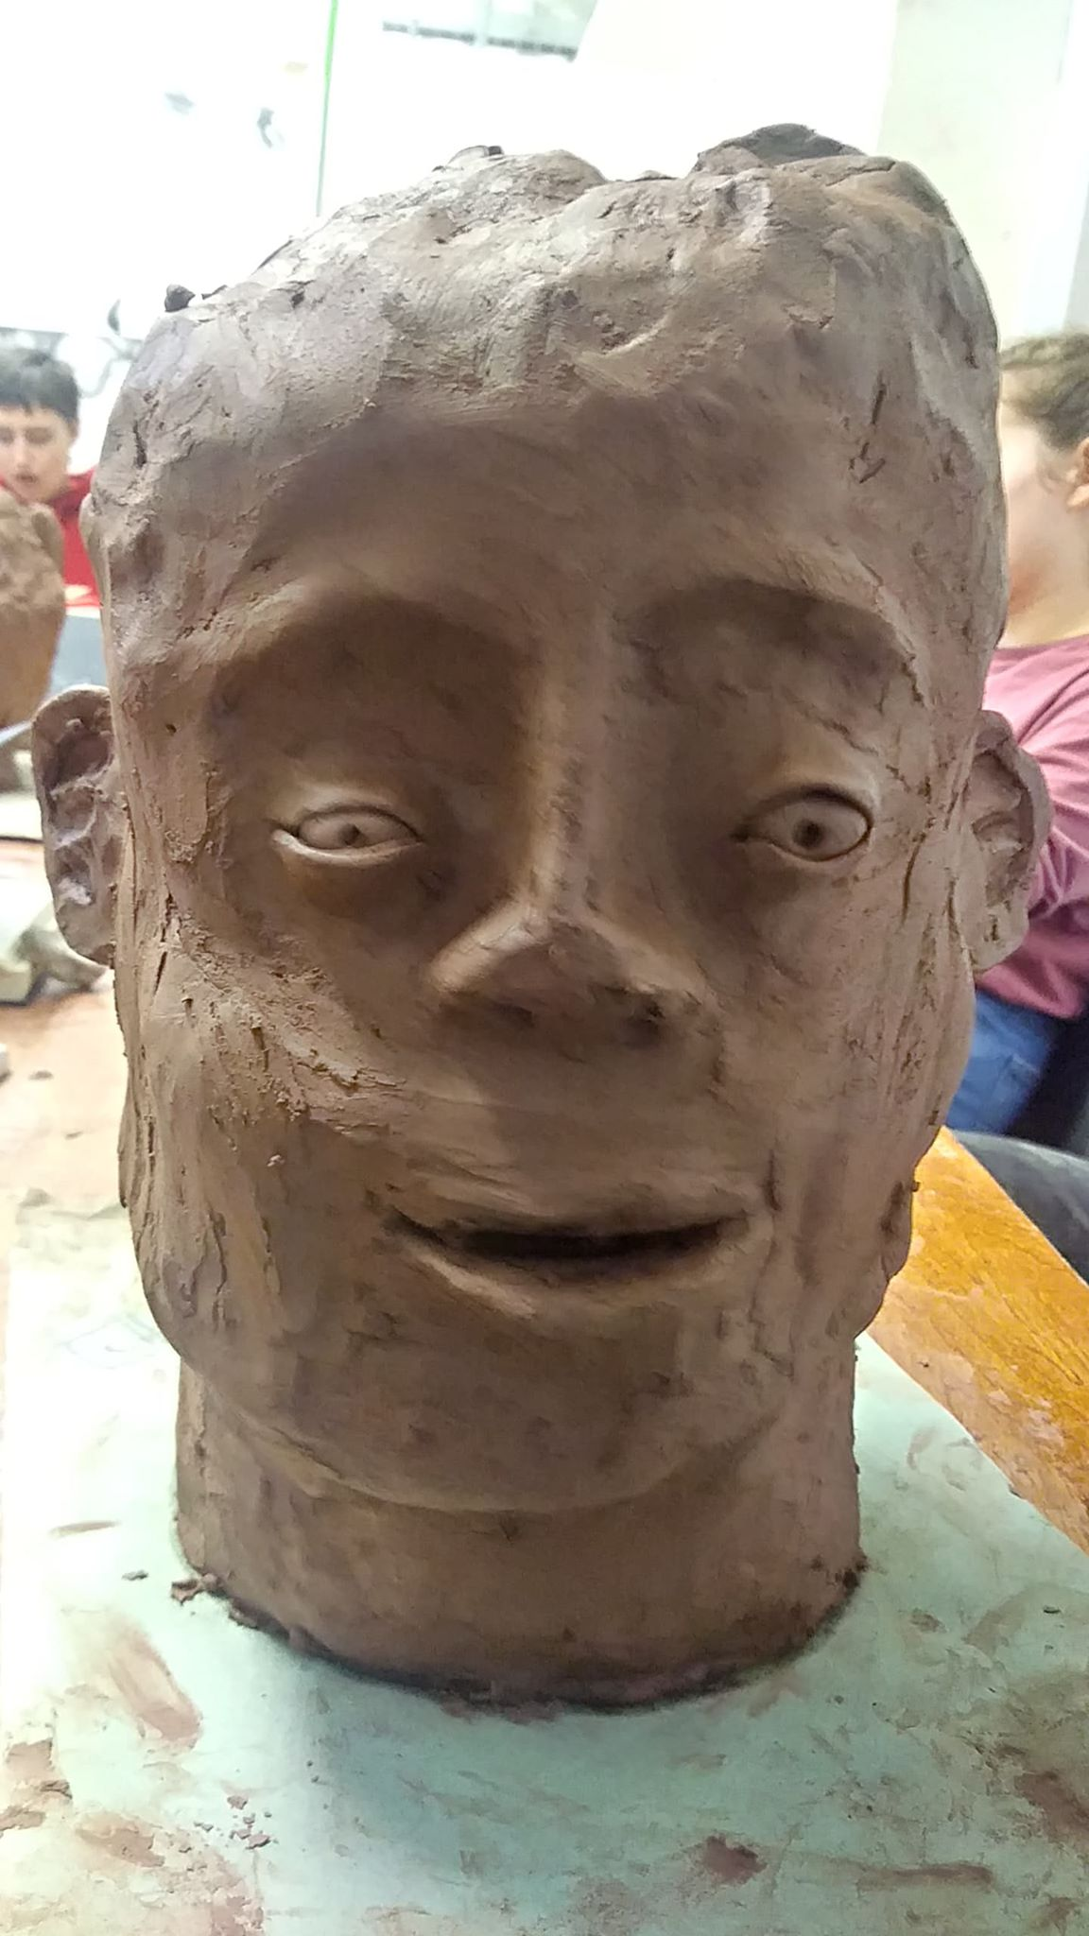
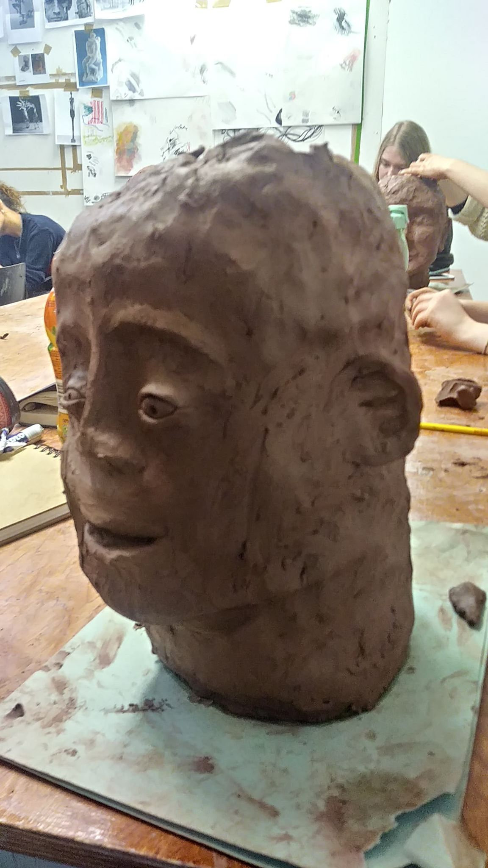
Clay Head
Firstly I wish I took more photos of before I got around to the general head shape I made.
But other than that i am happy with what i have created. getting the head to appear humonesque as well as putting in the facial features correctly but somehow makes the head appear not as human as i wanted and more like something trying to replicate a human and doing a horrible job in doing so.

Slide 5
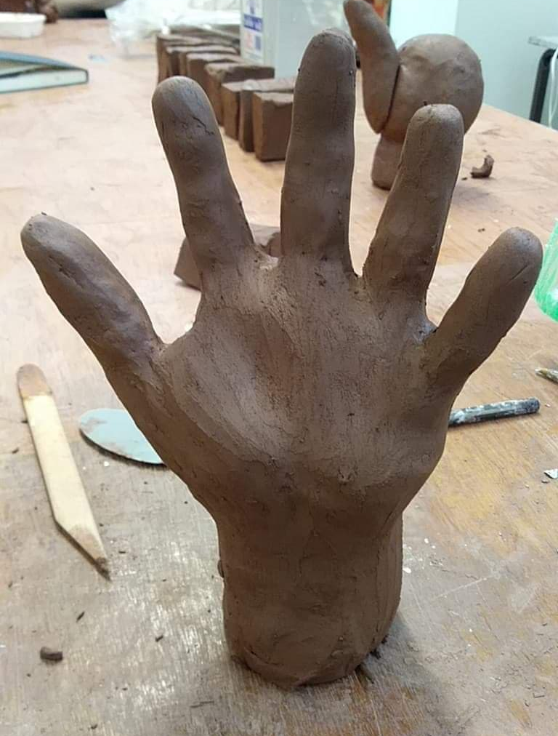
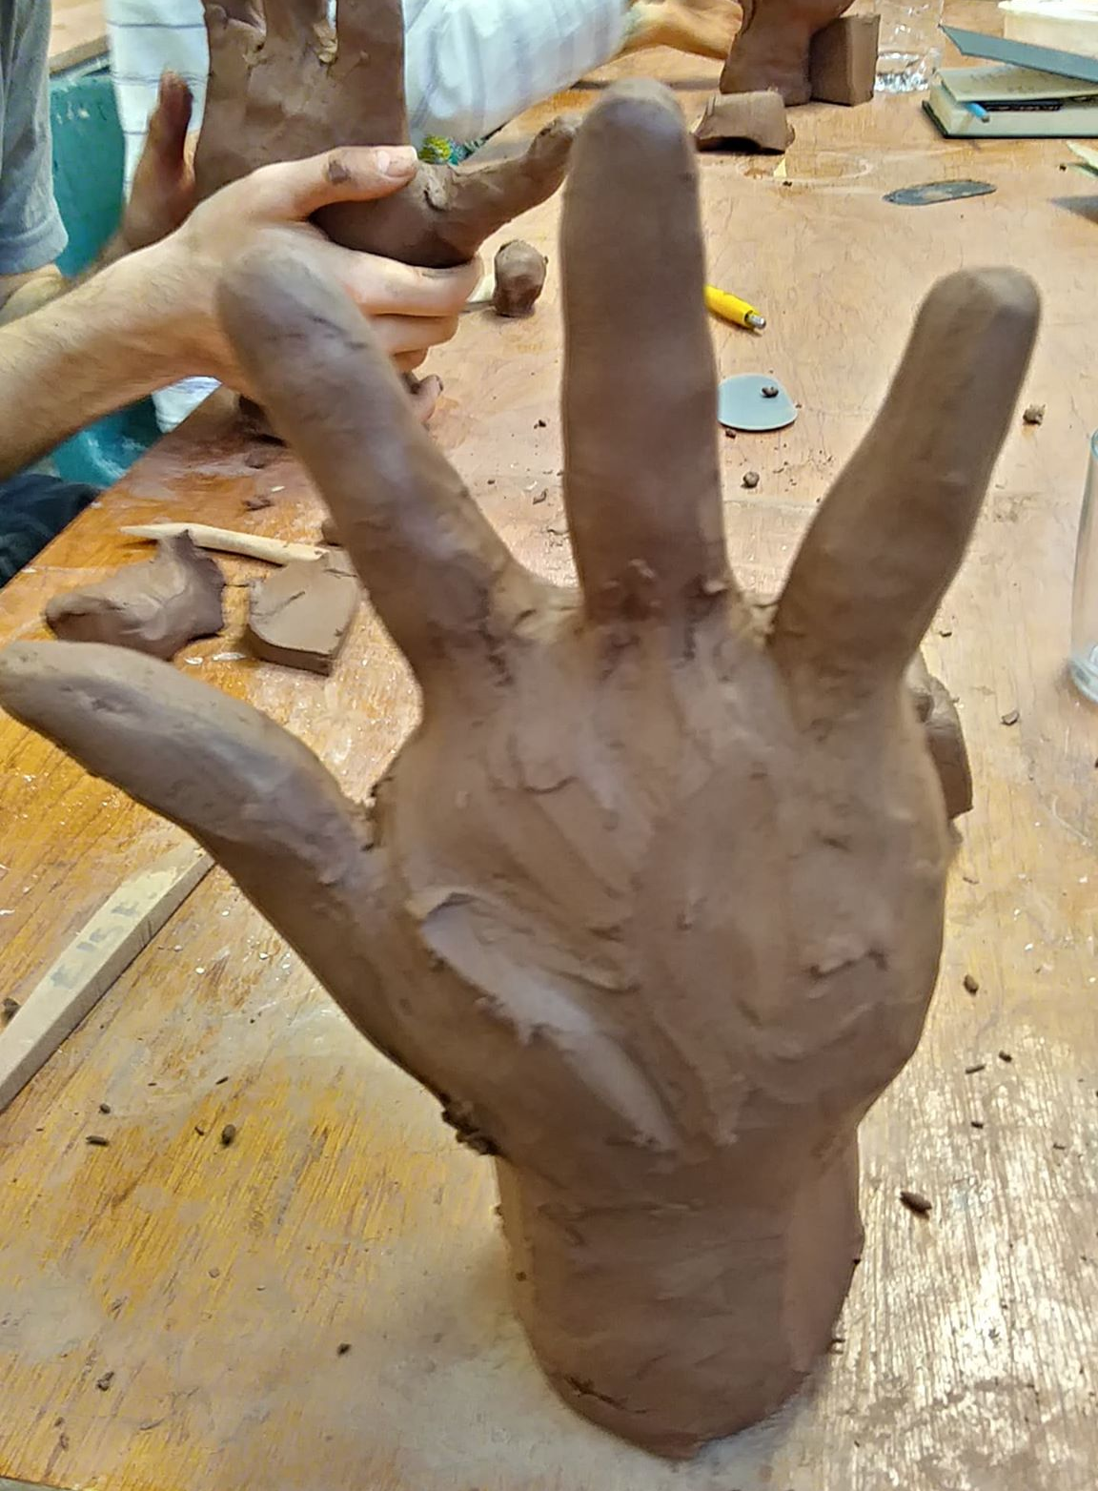
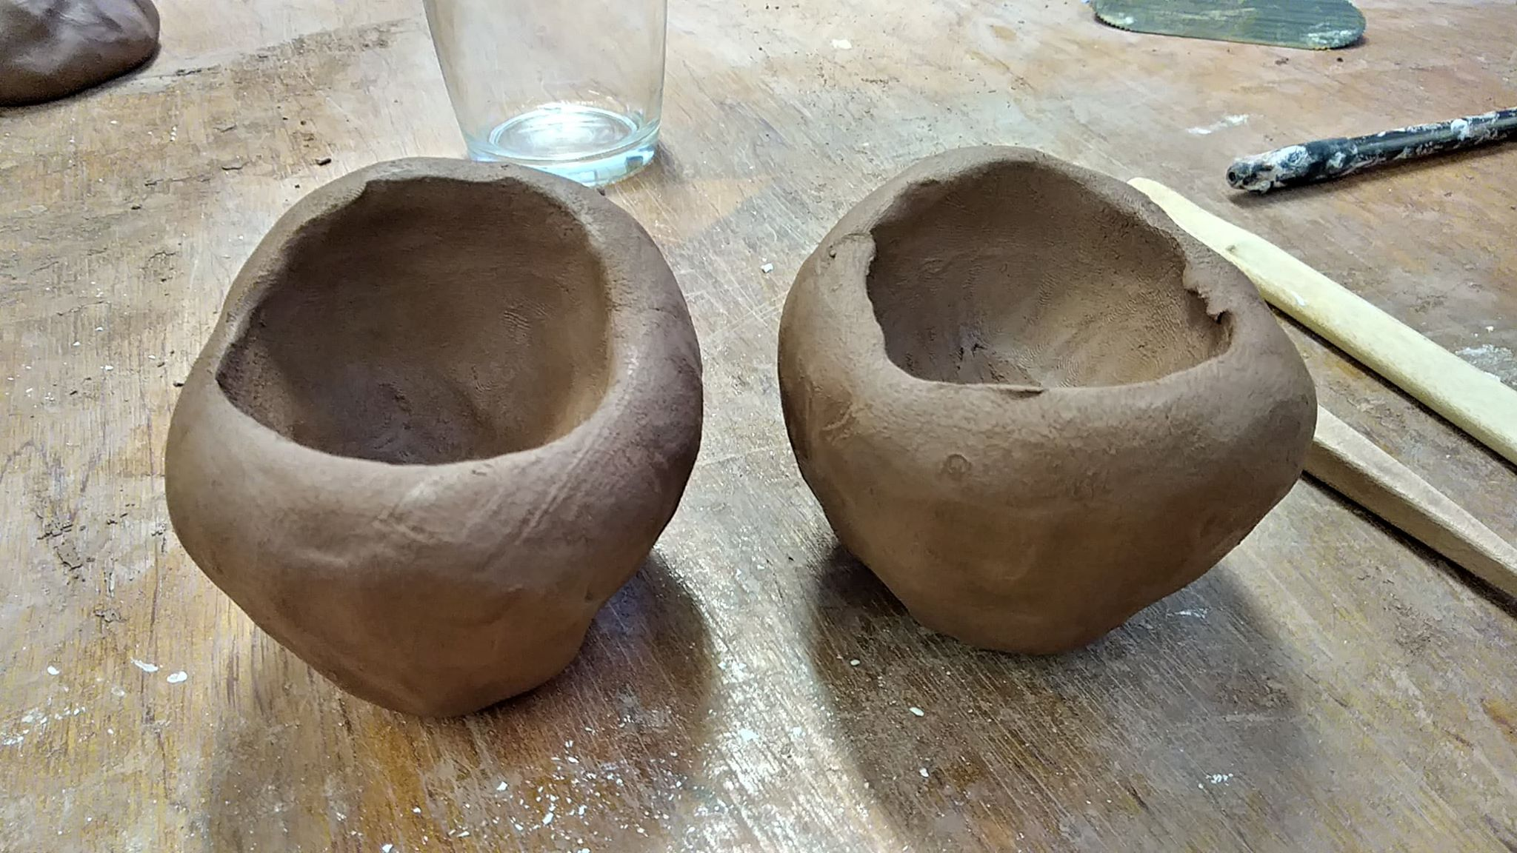
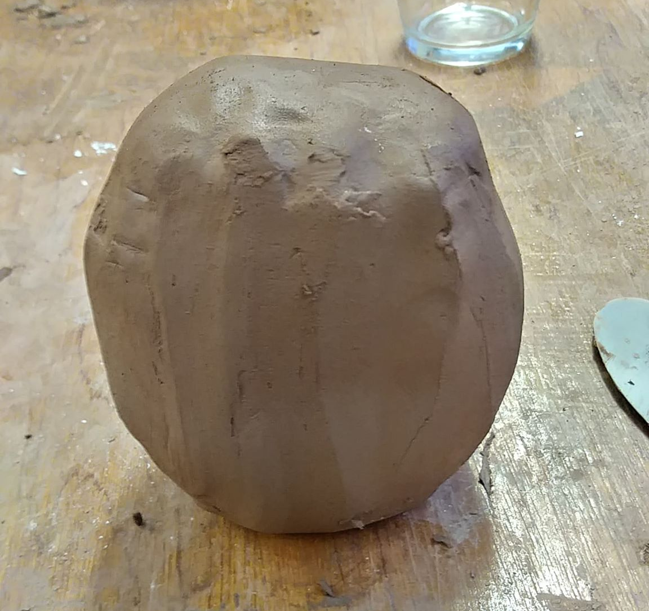
Clay Hand
Honesty i cant even believe how well i managed to create a hand. Normally when i draw hands i cant seems to make them look like them, but with clay somehow it was way easier. For a first attempt i think i hit it out of the ball park. if i can replicate this in my animation work id love to make an animation with clay hands.

Slide 6
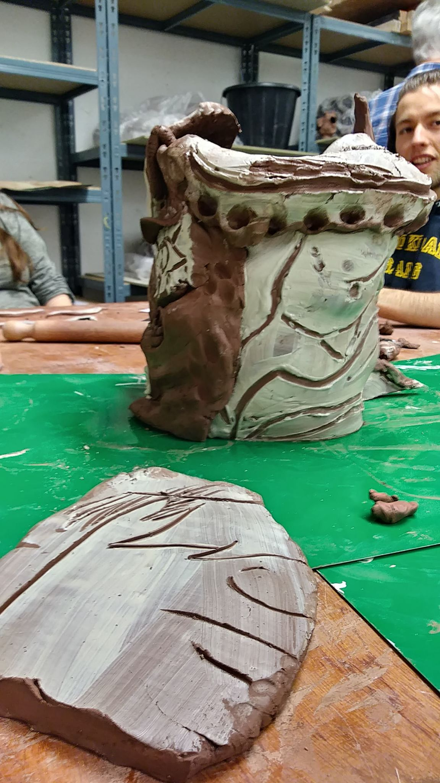
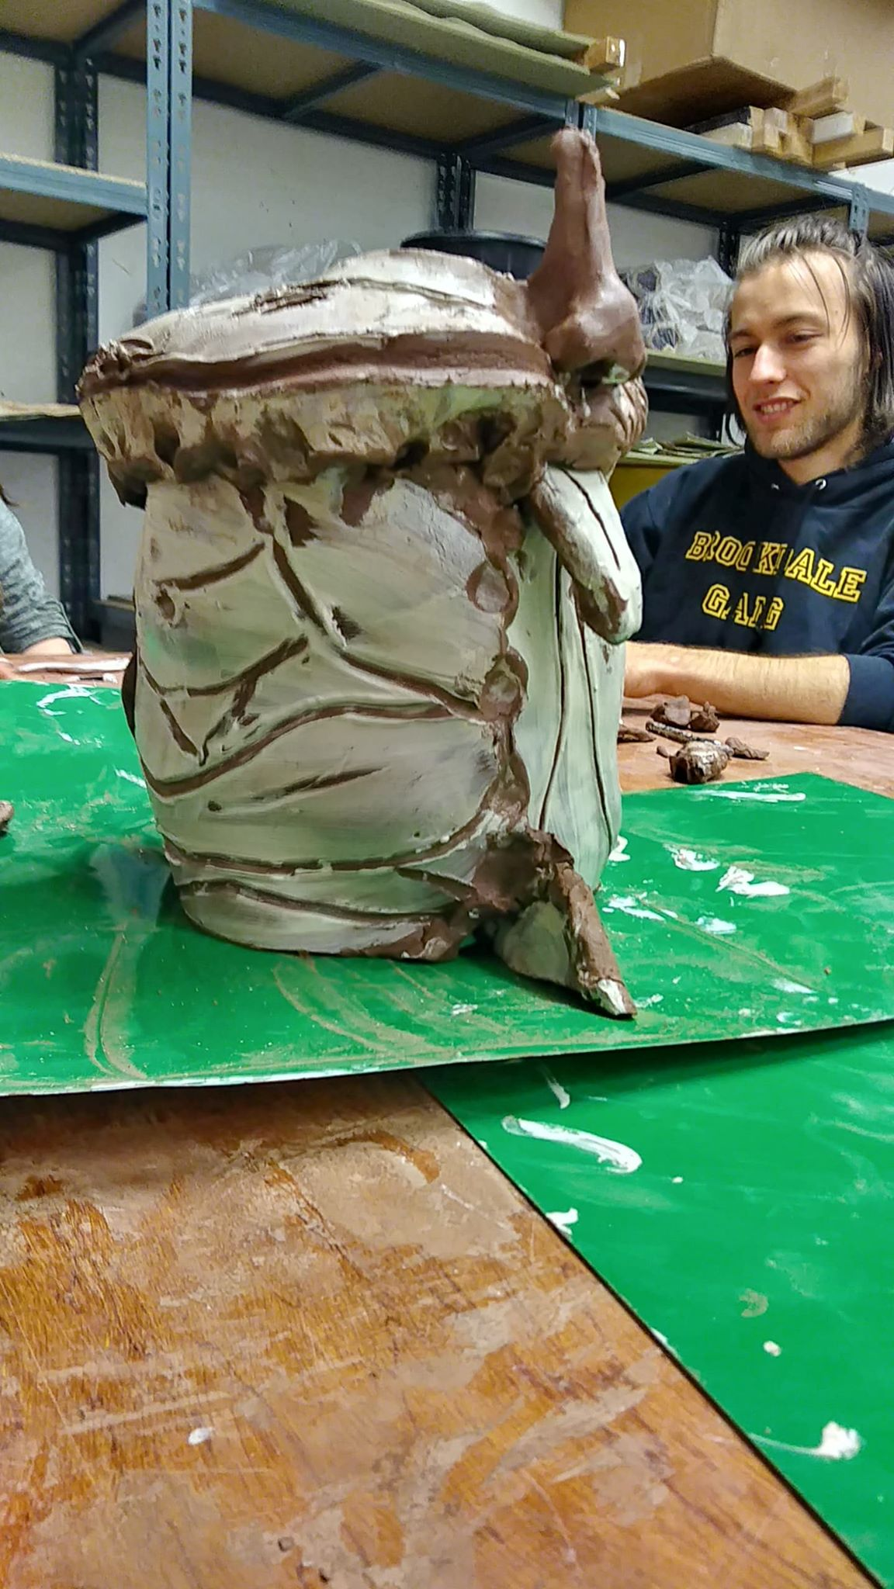
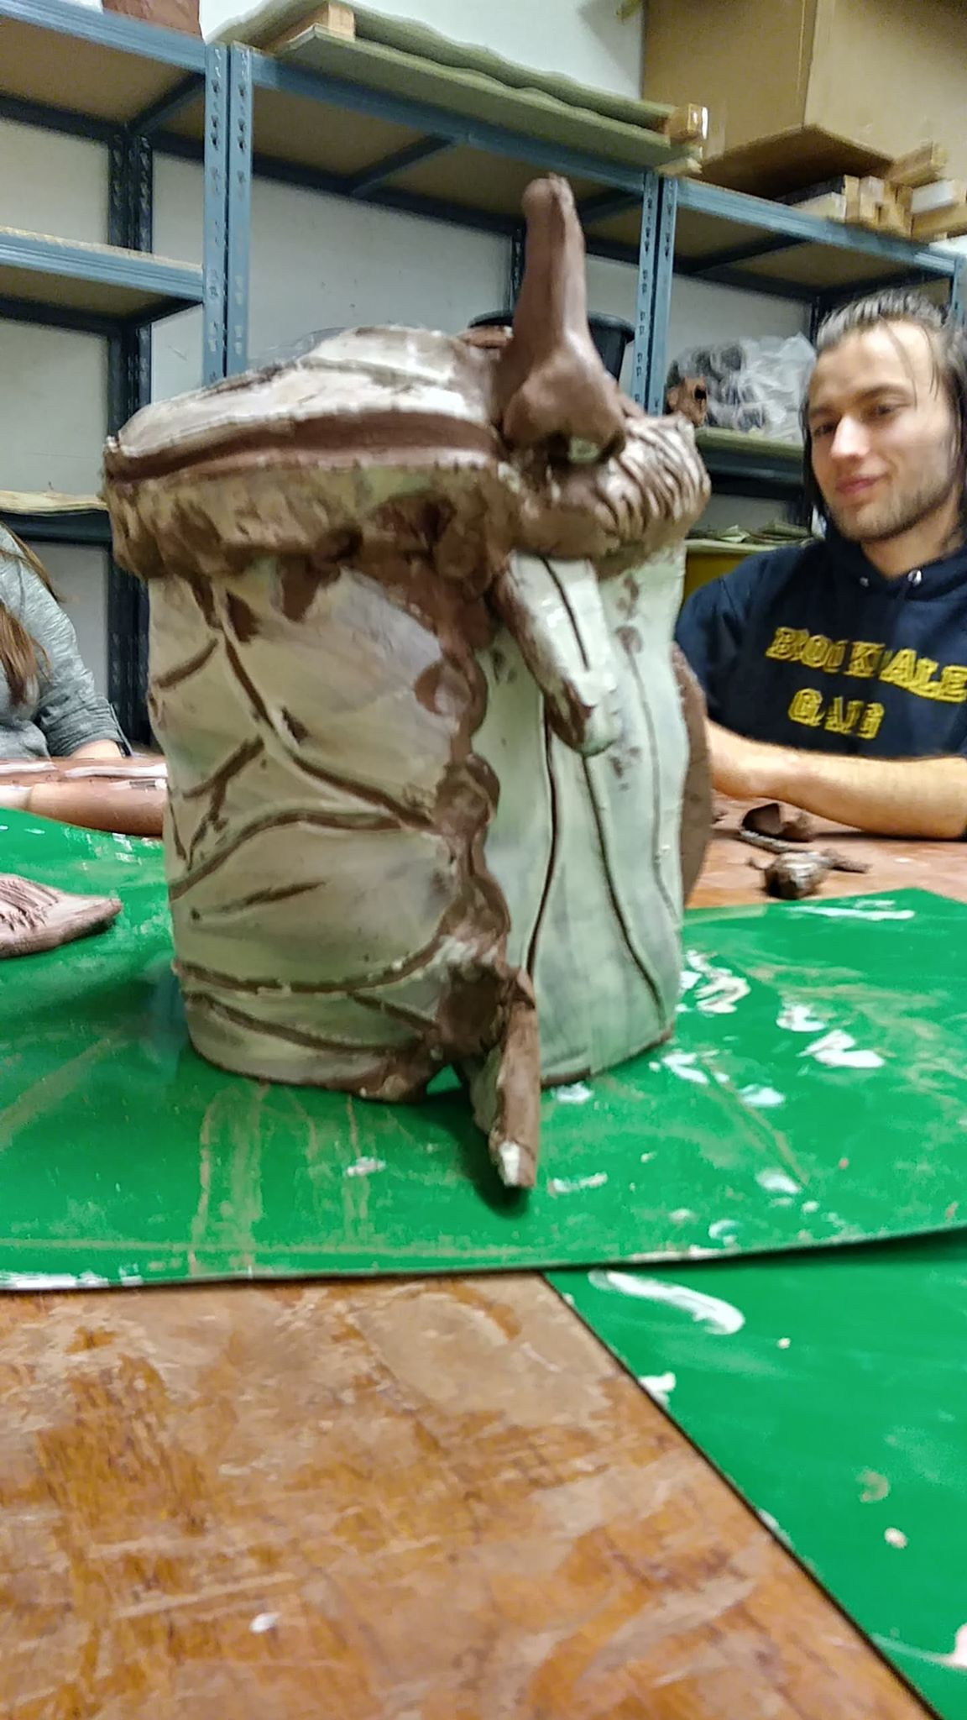
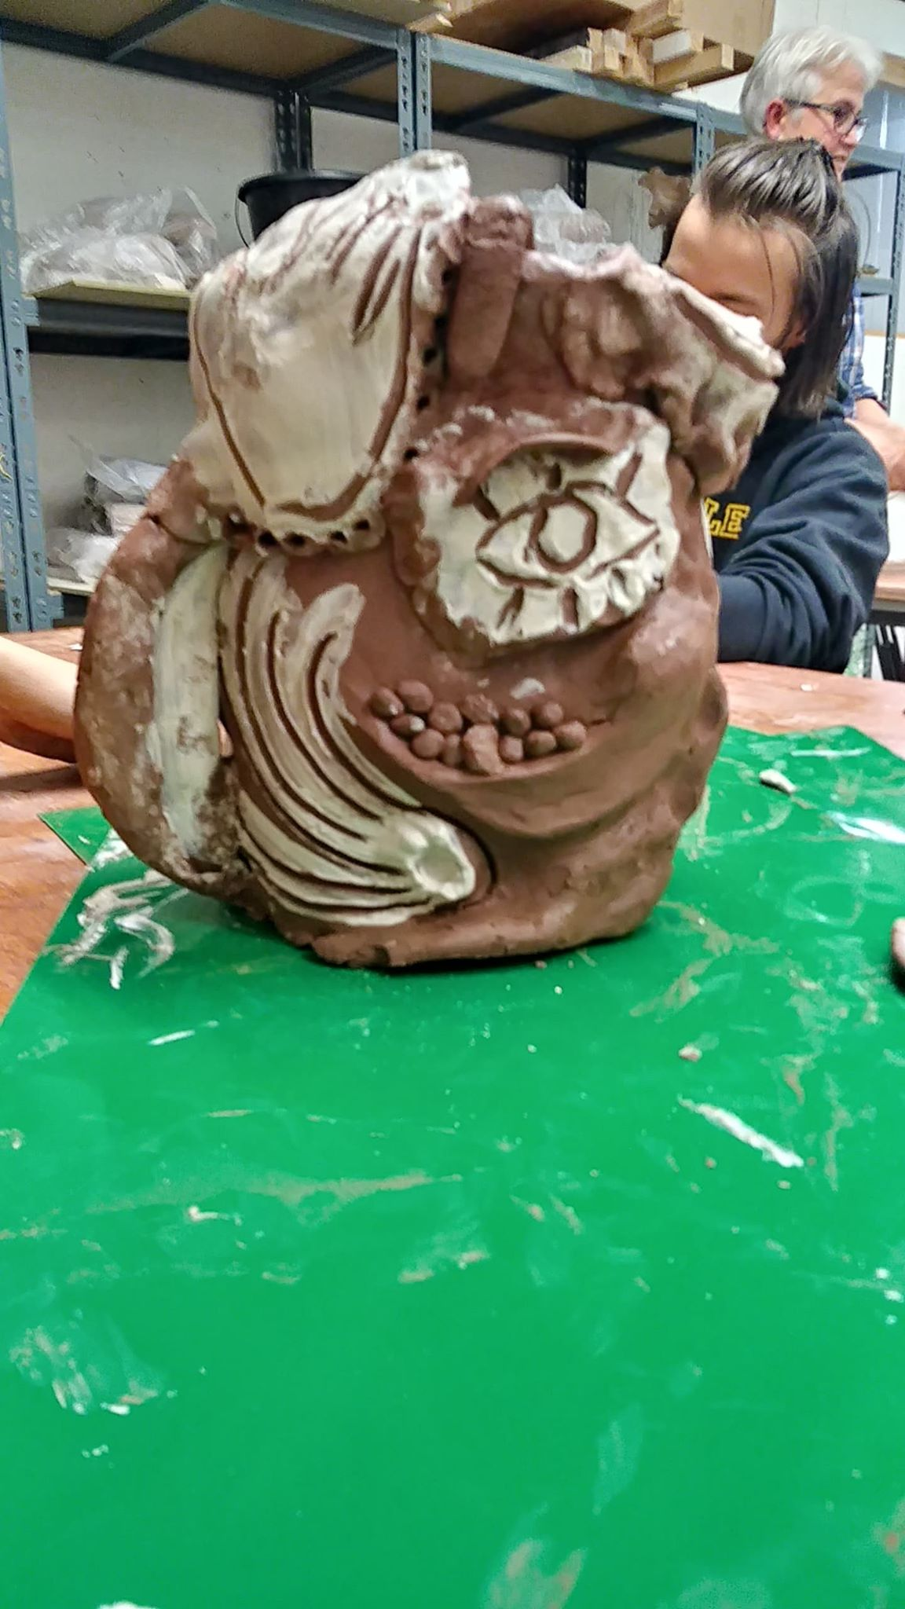
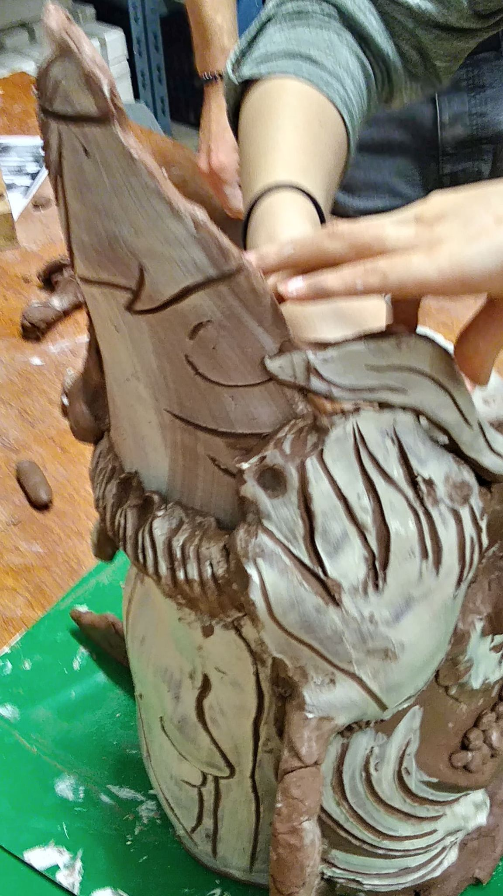
Slab and Slip Mug
The slap work i found to be a bit too abstract for my liking. i felt that it was a little confusing and that putting them all together a little randomly made the object look like a bit of a mess. But the positives i found when doing this was working in a team and talking to each other about what to add and where to add our different slabs. as much as it is nice to work alone on my own artistic works its also a wonderful to just chat with and gain ideas from others and was a nice change.

Slide 7
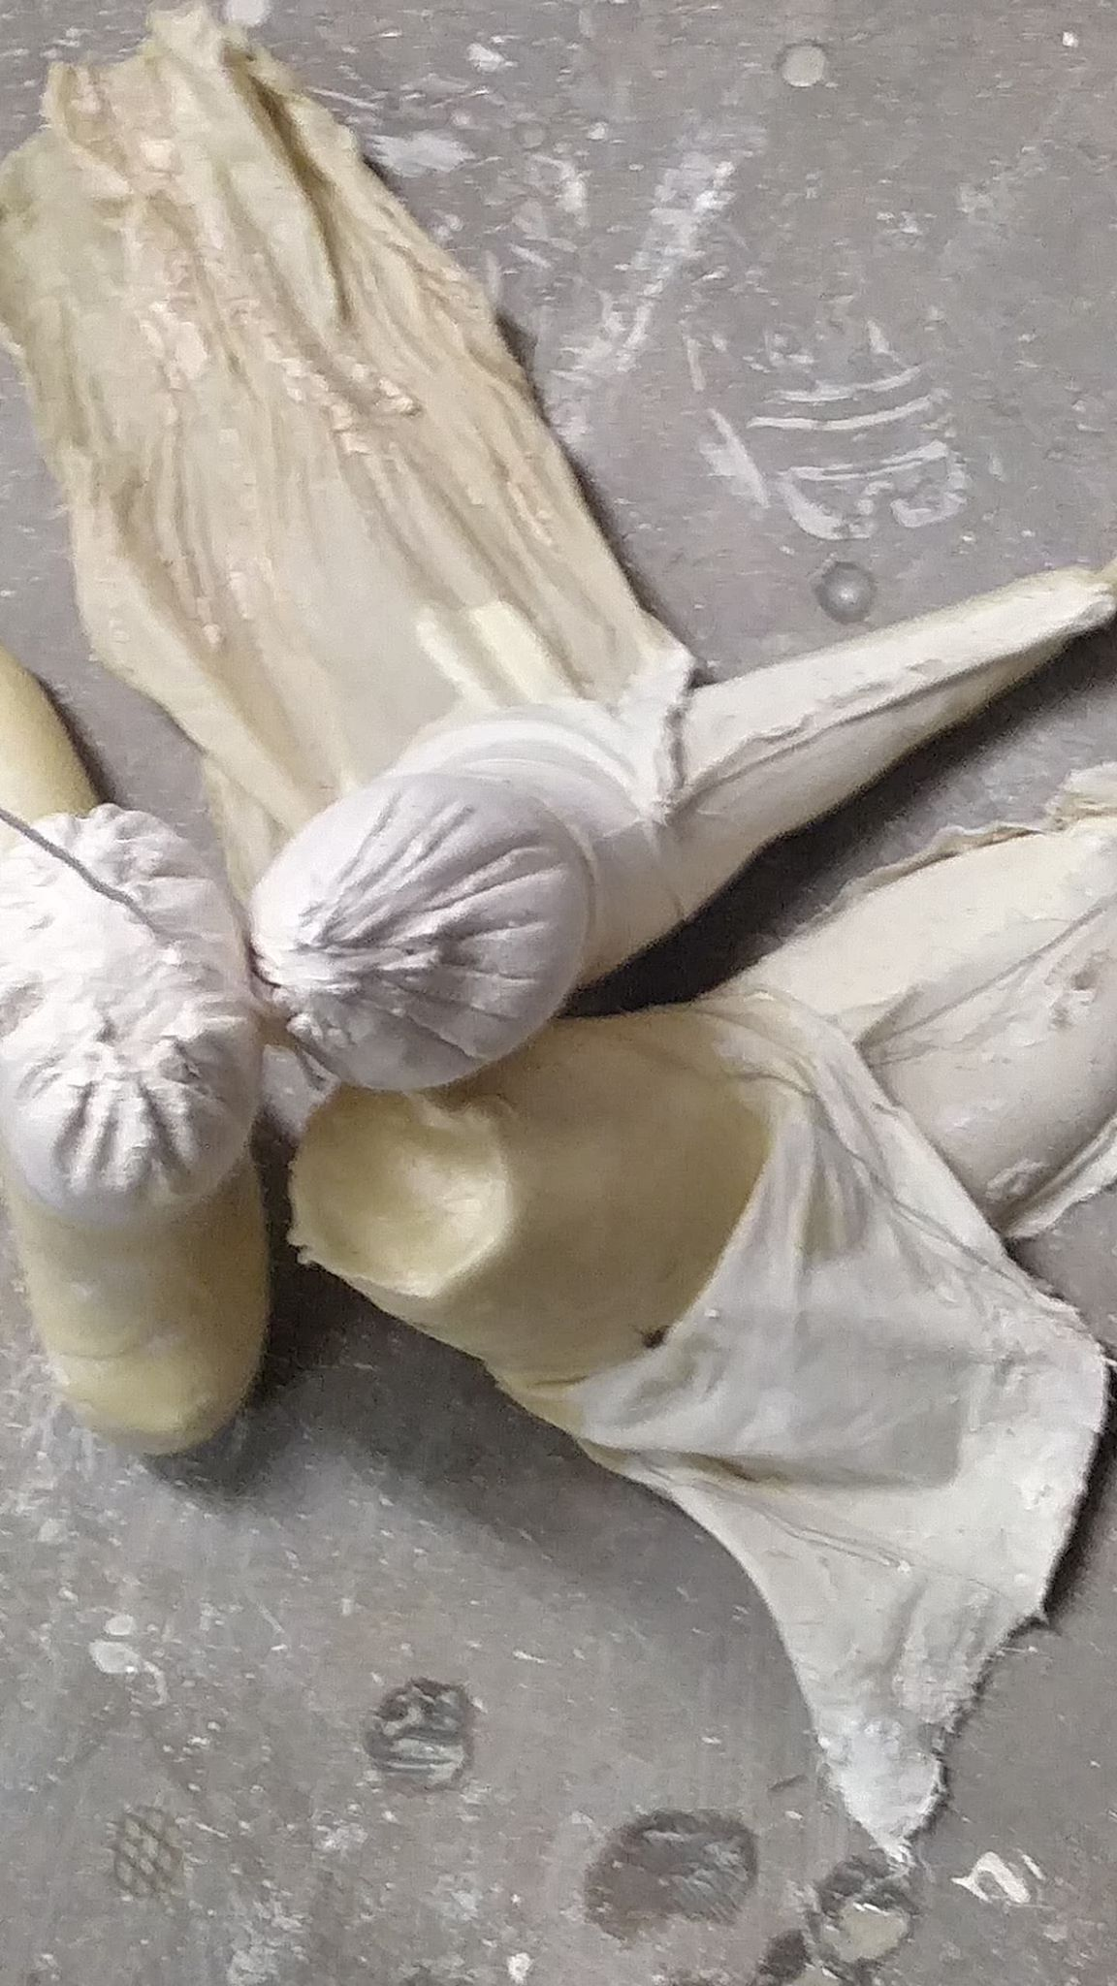
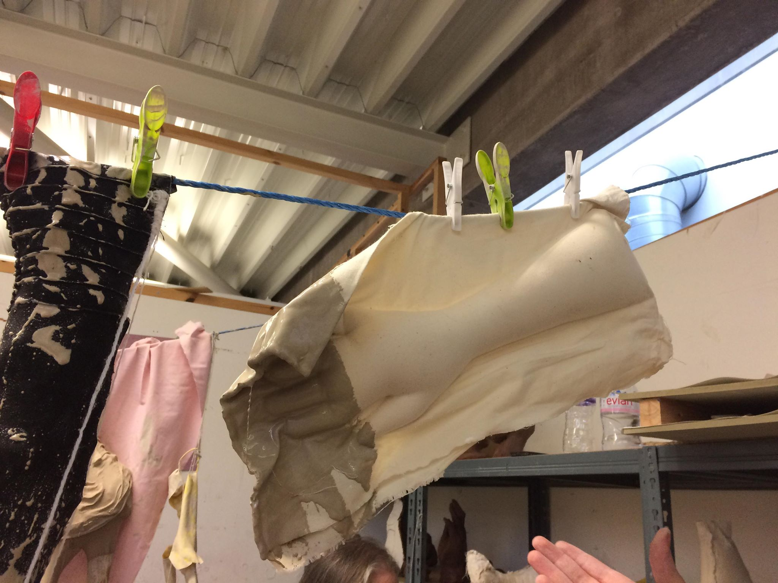
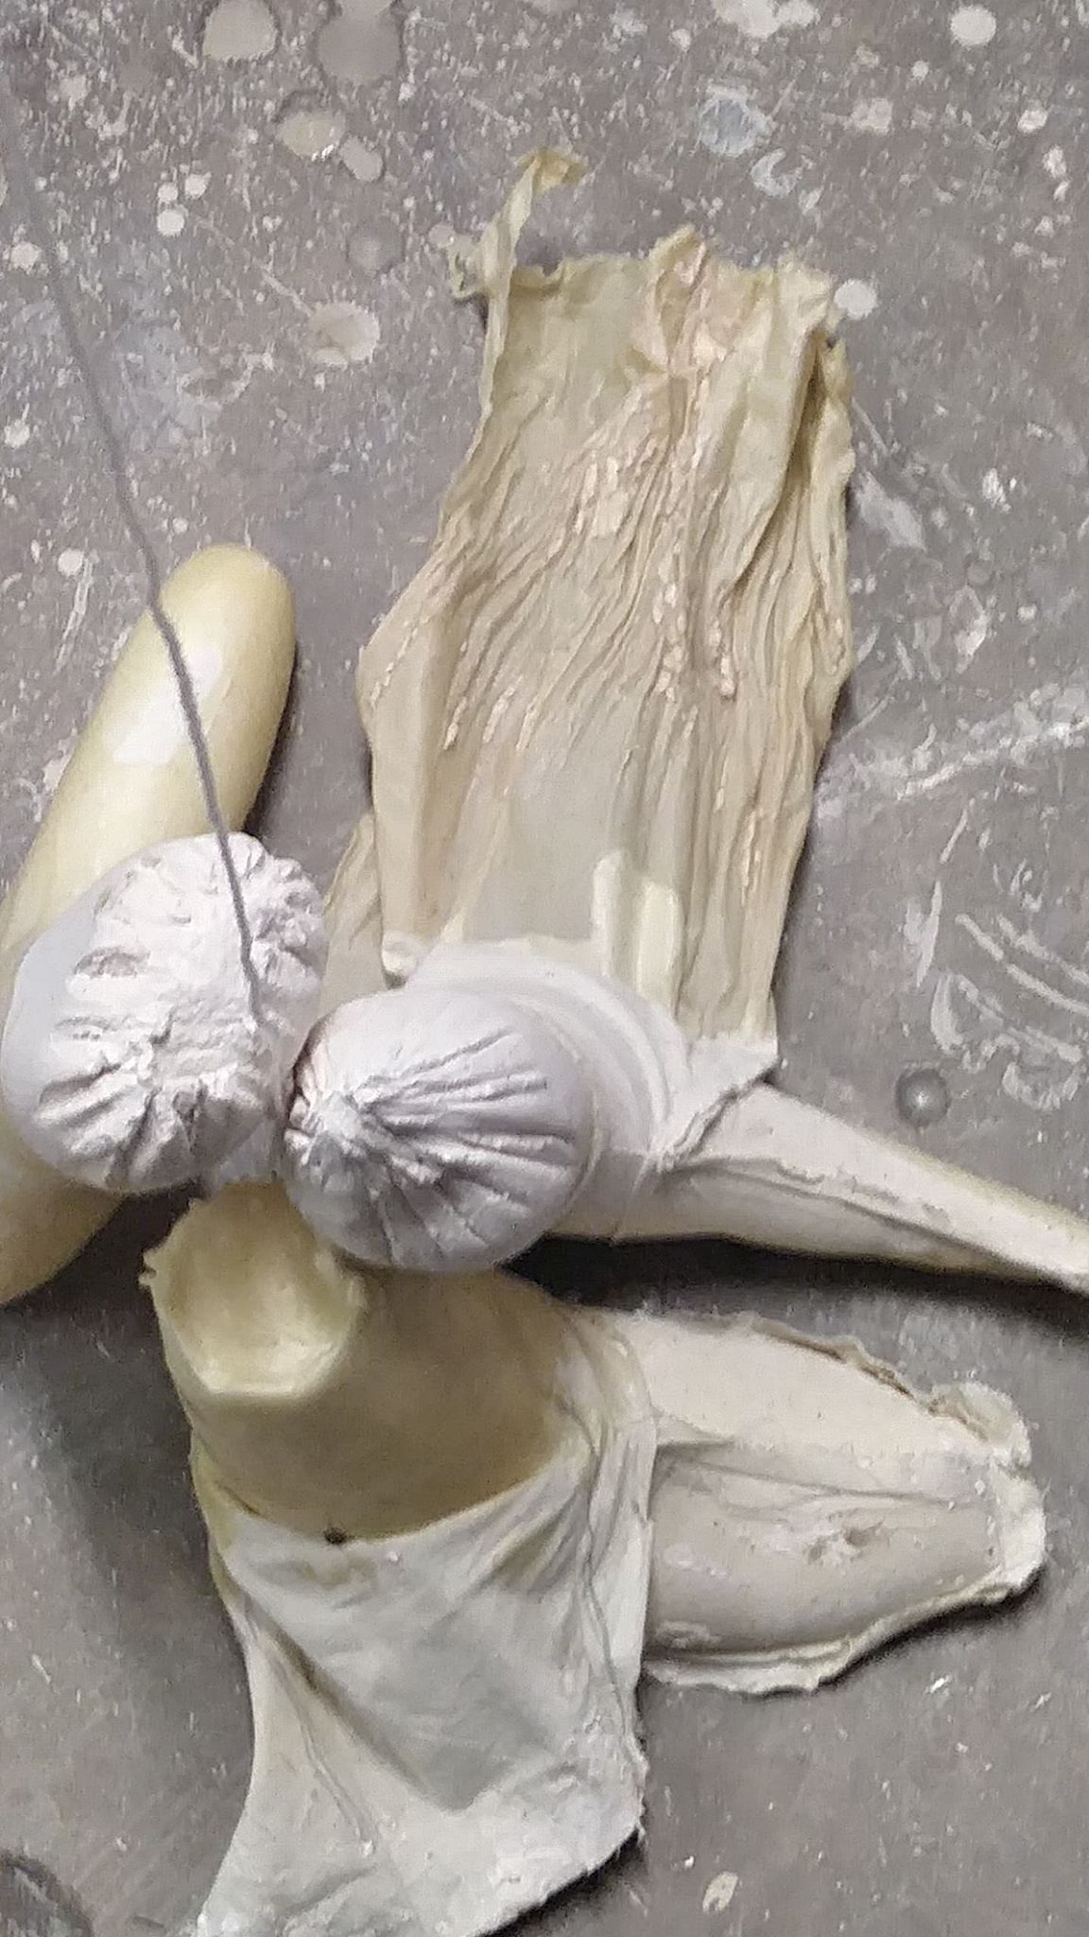
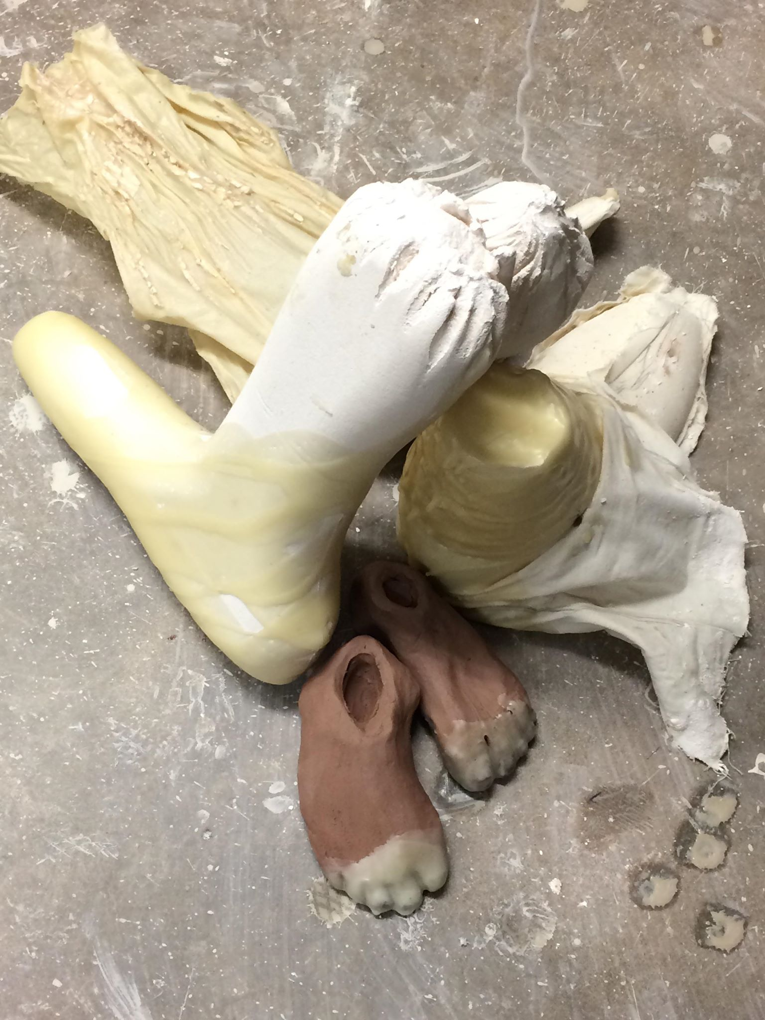
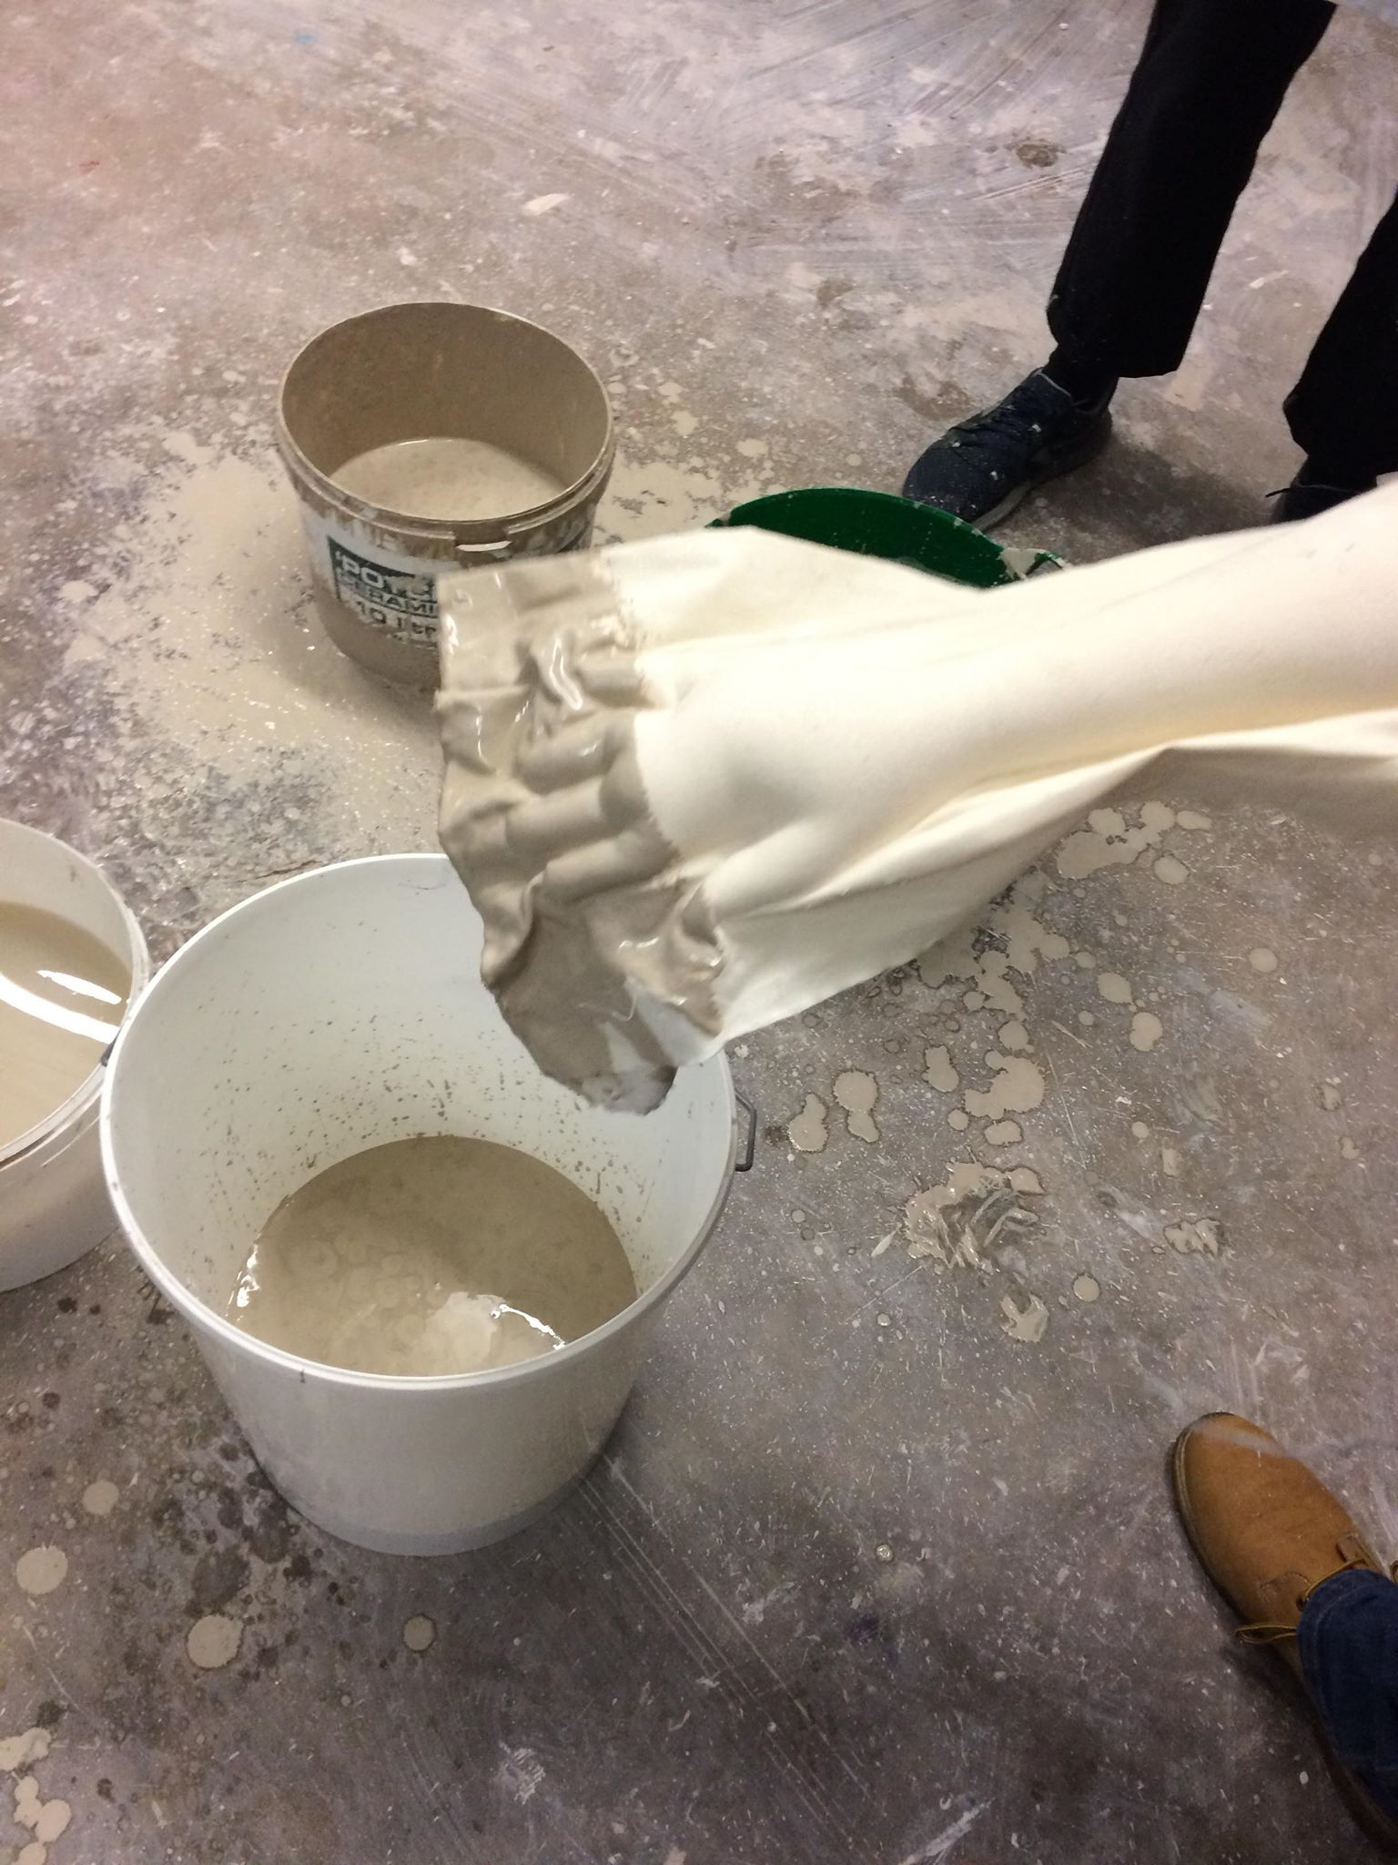
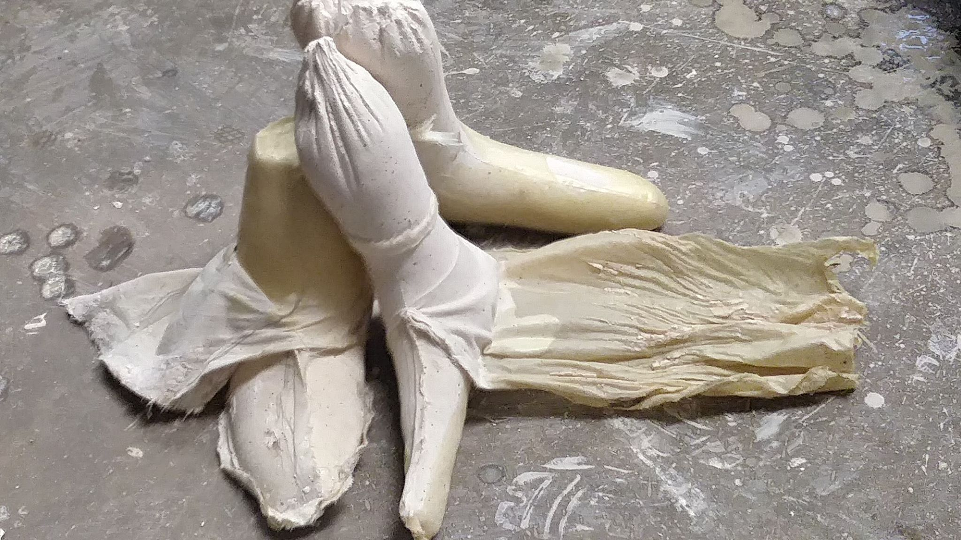
Final (Bringing Objects Together)
The final group work i found to be really fun, being able to work as a group and use our items that we made throughout out time in field was an interesting exercise.
One of my favourites was the Black glove I noticed from the start and I thought to myself “ I have to dunk that" so after I went ahead and dunked the glove into the mix and I hung it up it gave off a really nice patchy effect, like a Rorschach test on an arm. Plus having all the white be mostly located on the lower part of the arm while the top being black its like a juxtaposition of heaven and hell where we've always thought up being light while down being dark.

Slide 8
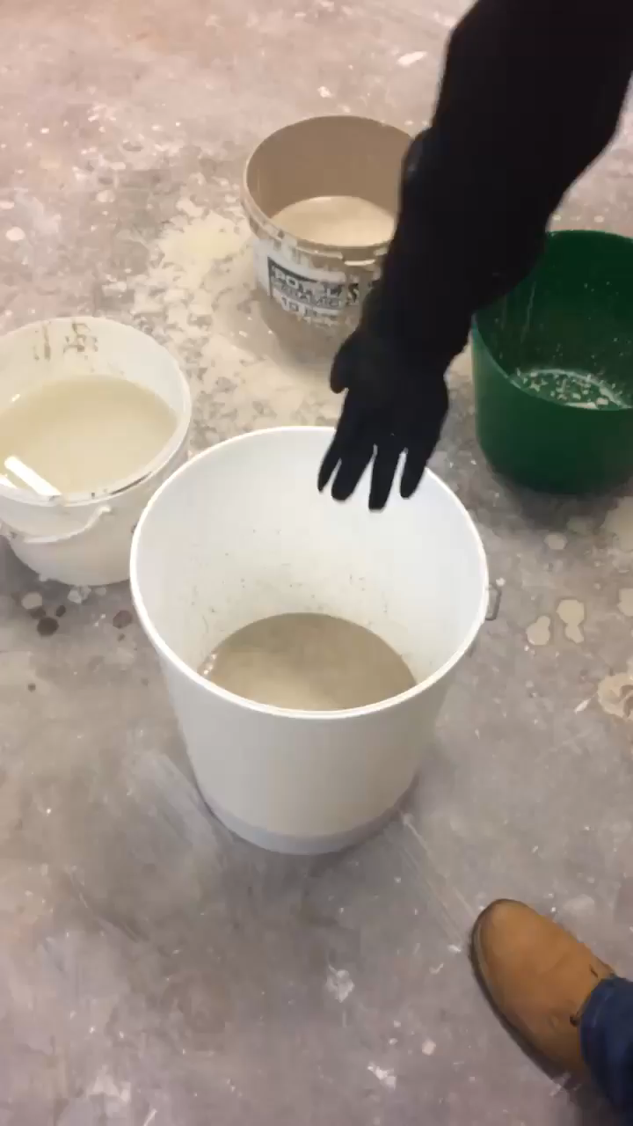
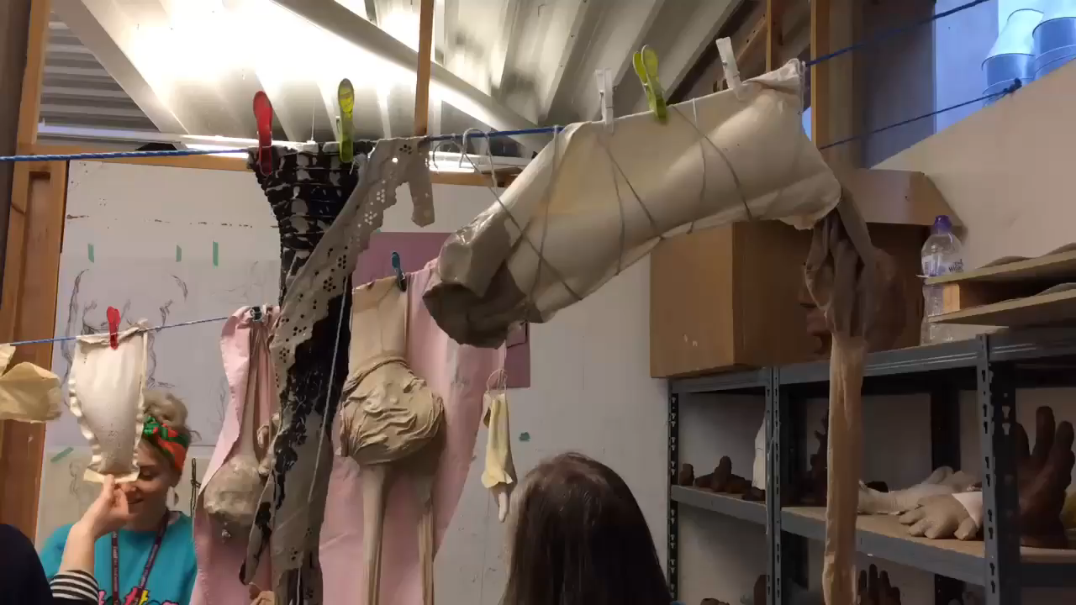
Final Videos

Slide 9
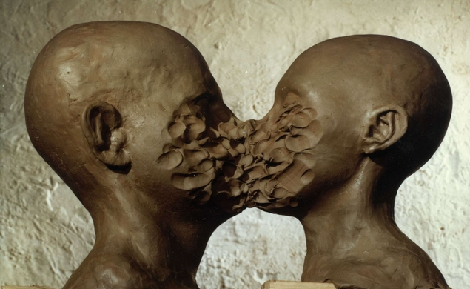
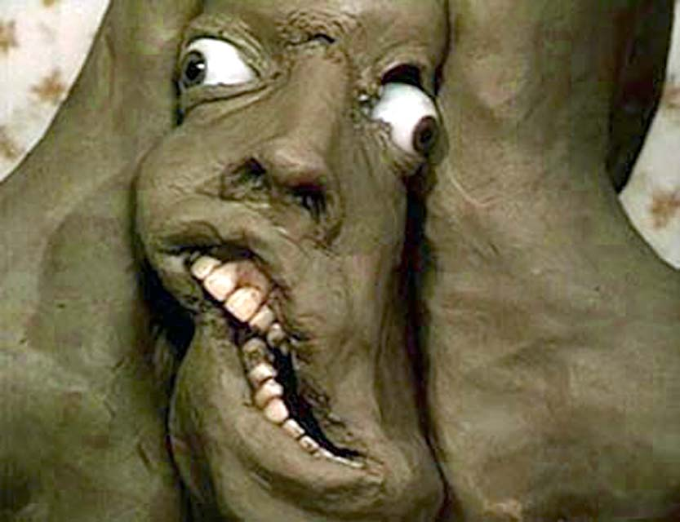
Jan Švankmajer
Dimensions of Dialogue
https://www.youtube.com/watch?v=L-gGpWpra-g
Svankmajer is one of those animators that is able to capture the human figure to only destroy that relatability to force the uncanny to be pushed out with or without the viewers permission.
Darkness, Light, Darkness
https://www.youtube.com/watch?v=1THMc9g5SaU

Slide 10

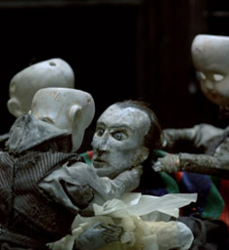
Quay Brothers
https://www.youtube.com/watch?v=nW3dW4yMLfE
The Quay Brothers through the act of music and lighting are able to really make there scenes off-putting.
Like Svankmajer they’re able to take something typically normal to then be used to become uncanny and off-putting.

