Slide 1
Self-Led Project
William Foster

Slide 2
Horror Monsters
I want to be able to create monster designs that would then be used within short animated storys ether in 2D or 3D.
Due to my love for horror and animation I wanted to merge these together to test my knowledge in both subjects.
With my past work I noticed a relation to my Character designs leaning towards monster than man which I wanted to press further into and create even more bizarre and creepy designs.
I also wanted to explore my storyboarding skills since during the double act work I thoroughly enjoyed creating a story and feel that exploring that even deeper with horror as my focus will be really enjoyable to try out.

Slide 3
What is a monster?
Noun
A legendary animal combining features of animal and human form or having the forms of various animals in combination.
Any creature so ugly or monstrous as to frighten people.
Any animal or human grotesquely deviating from the normal shape, behaviour or character.
A person who excites horror by wickedness, cruelty, etc
Any animal or thing huge in size.

Slide 4
What I think Makes something scary?
The main factor that makes something truly scary and monstrous is taking something normal and making it unnatural. This can be extending features or removing parts to make them less human. Or taking something unnatural and bringing it into the real world.
The reason for something to scare someone is keeping things within the realm of reality but keeping things within a realm of the unknown.
The reason for this is that if something horrible happens to someone we empathise and feel that we’d be scared if that happened to us.
One thing to watch out for is if we learn or know to much about what is after us they wont become scary anymore.
Many horror films fail with doing this through over explaining the monster or they make sequels that makes the monster more prominent.

Slide 5
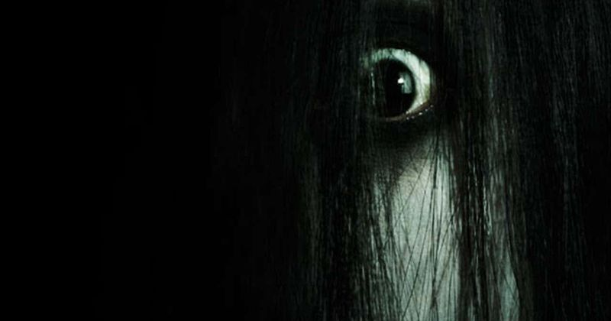
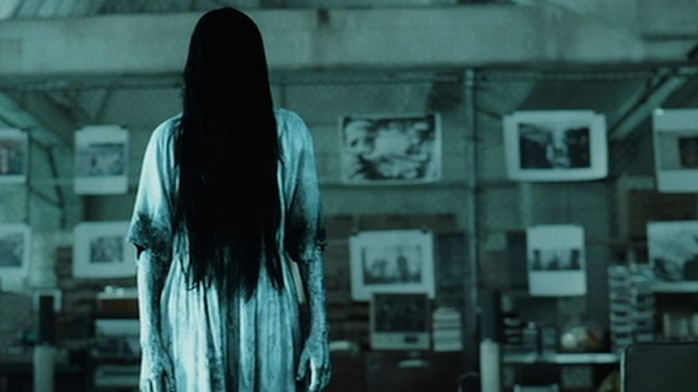
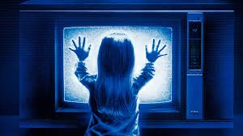
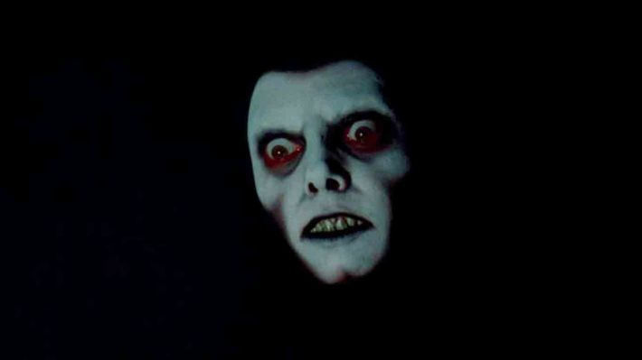
Paranormal Horror 1/3
Film references:
Poltergeist
The Ring
The Exorcist
The Shining
The Evil Dead
The Oman
The Grudge
It Follows
MAMA
Ghosts are often thought to be deceased people looking for vengeance, or imprisoned on earth for bad things they did during life. The appearance of a ghost has often been regarded as an omen or portent of death.

Slide 6
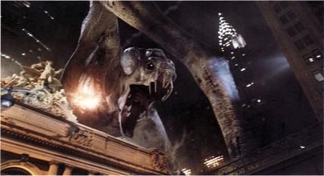
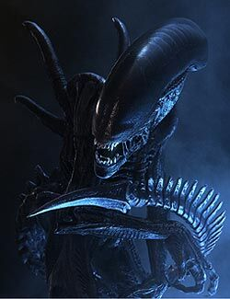
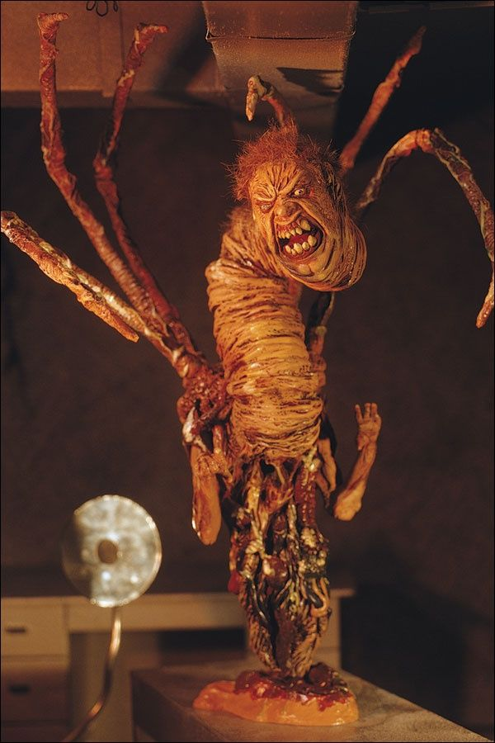
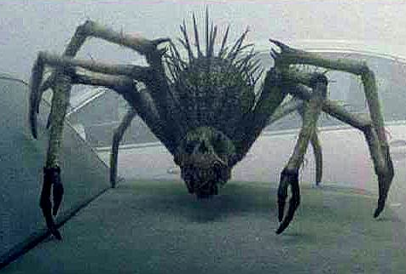
Creature Horror 2/3
Creature references:
Annihilation
Jaws
The Blob
Cloverfield
Alien
The Thing
The Mist
These Animal like Creatures instincts are to kill by hunting, eating or overpowering their pray. These appear to be more animalistic and less likely to be bargained with.

Slide 7
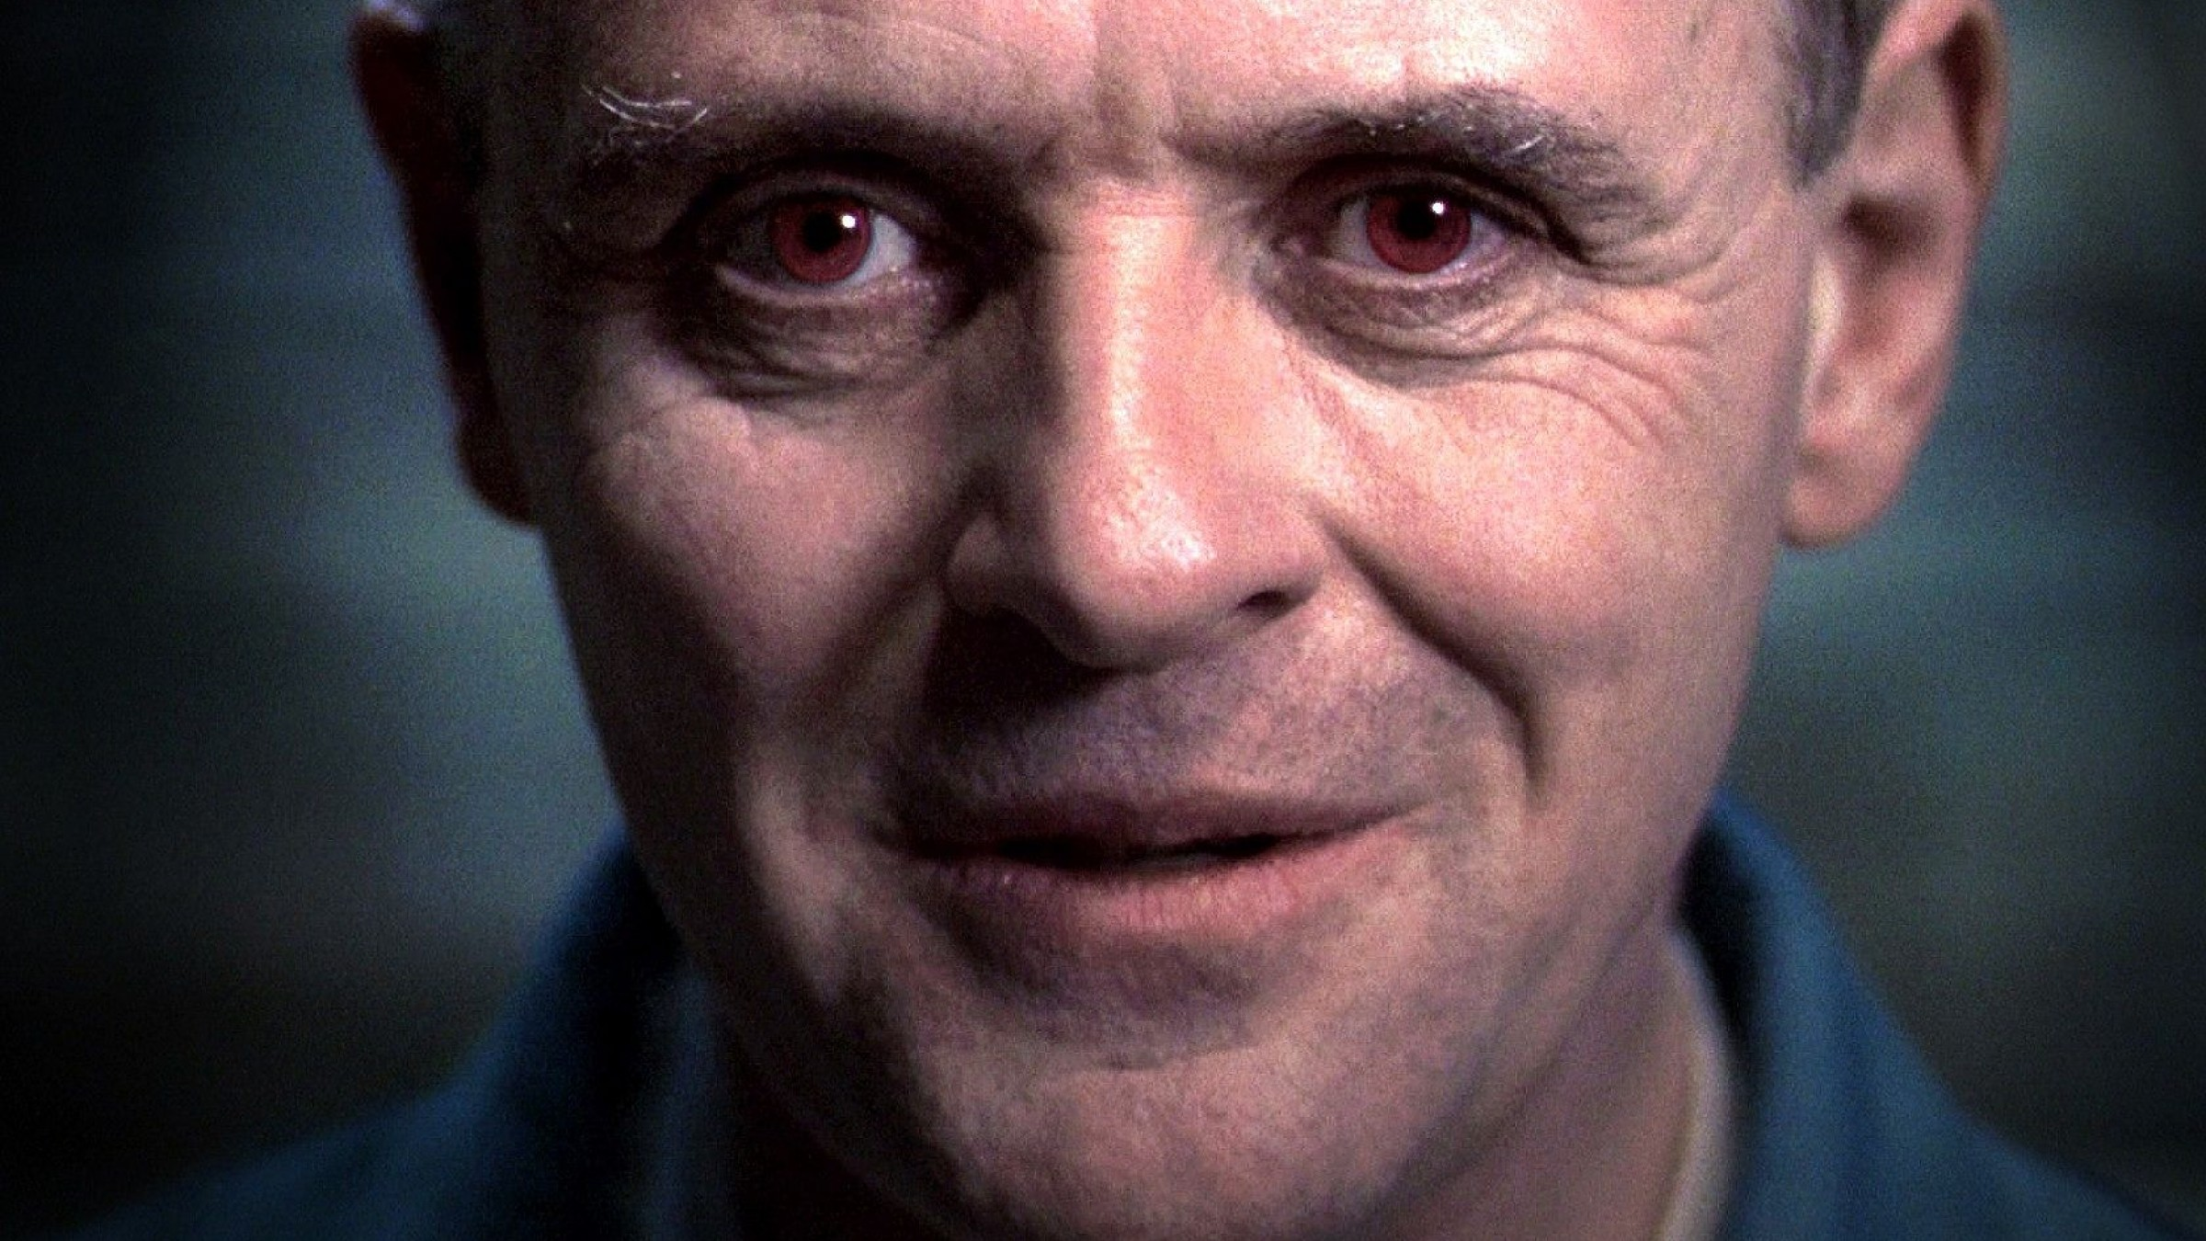
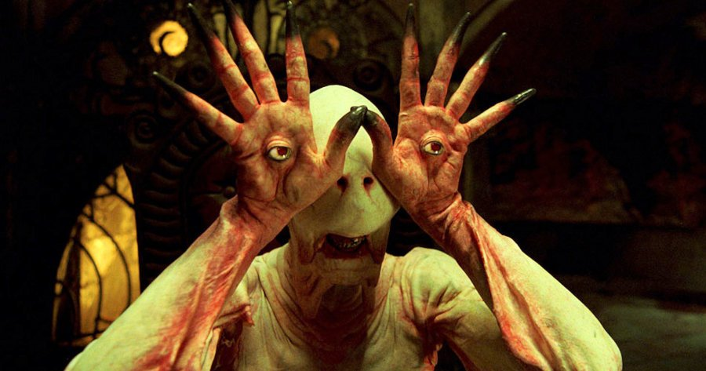
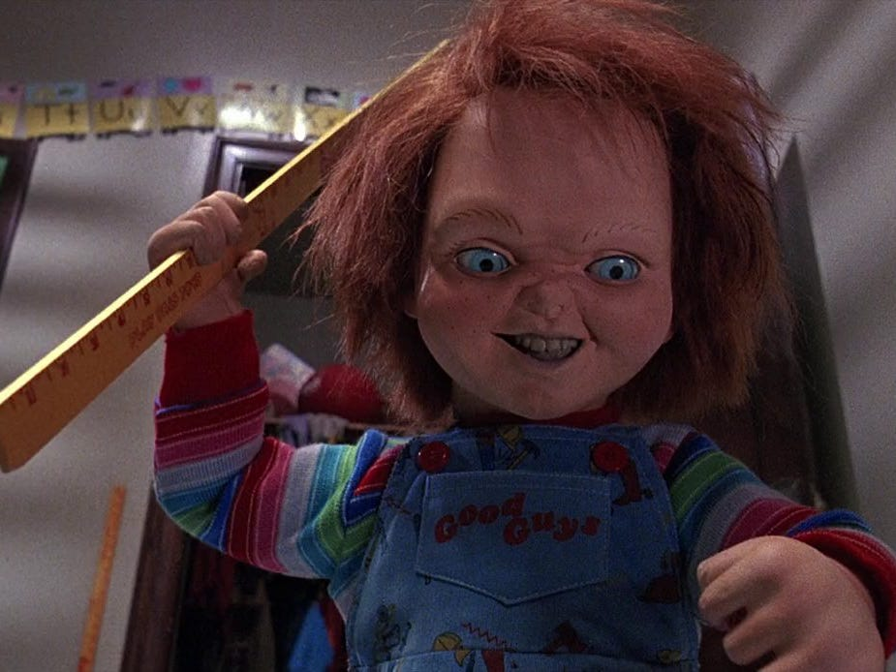
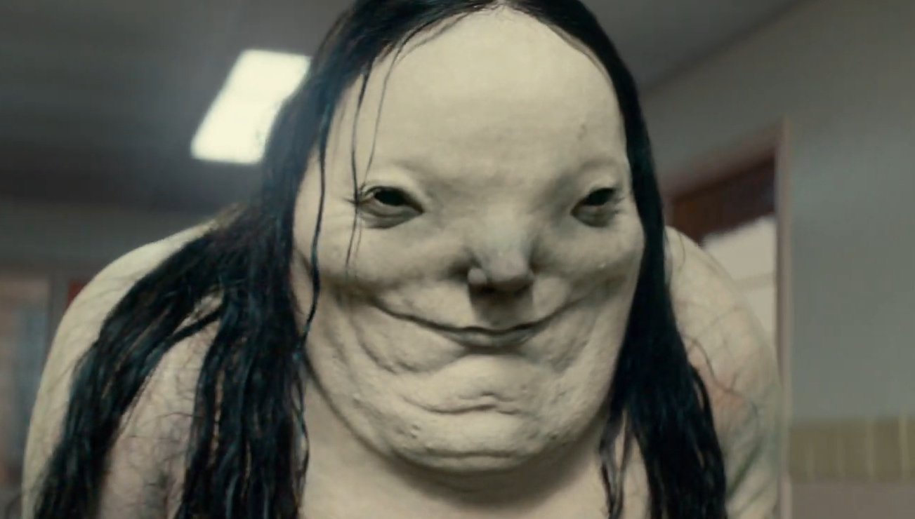
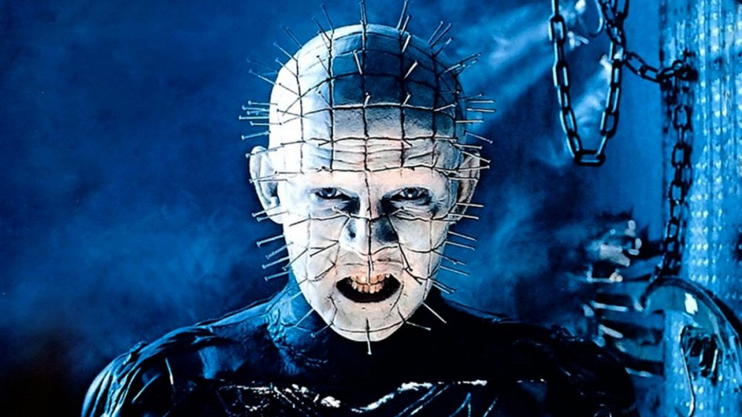
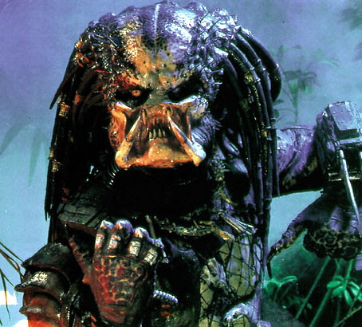
Human like Horror 3/3
Human like References:
Predator
Childs Play
Pans Labyrinth
Nightmare On Elm Street
Hellraiser
Silence Of The Lambs
Scary Stories To Tell In The Dark
Friday the 13th
The human like monsters are the most versatile out of the 3, due to there higher level of intelligence its harder to outsmart them compared to creatures. Even though they may appear somewhat human they act almost nothing like them ether from there appearance vastly being different or the way they act feels unhuman and unnatural

Slide 8
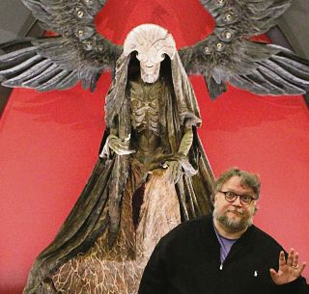
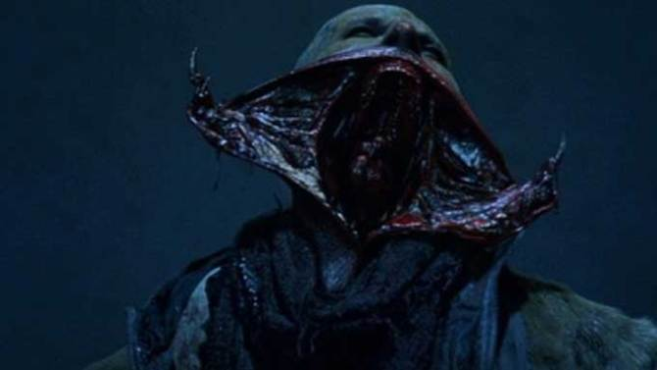
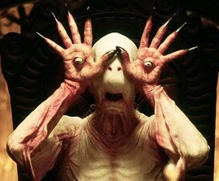
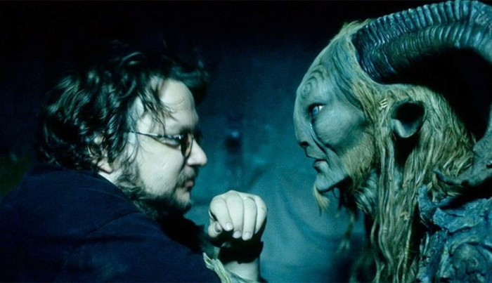
Inspirations 1/3
Guillermo Del Toro – Director, Screenwriter
Notable Films and monsters
Pans Labyrinth – Faun and Pale Man
Hellboy 2 – The angel Of Death
The shape of water - the Amphibian Man
Blade - Vampires

Slide 9
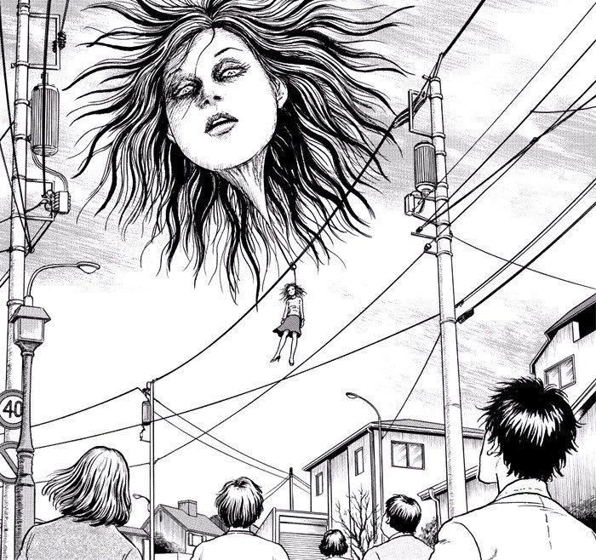
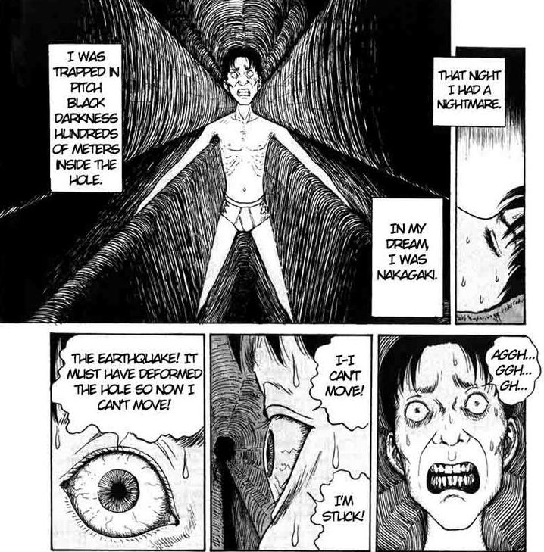
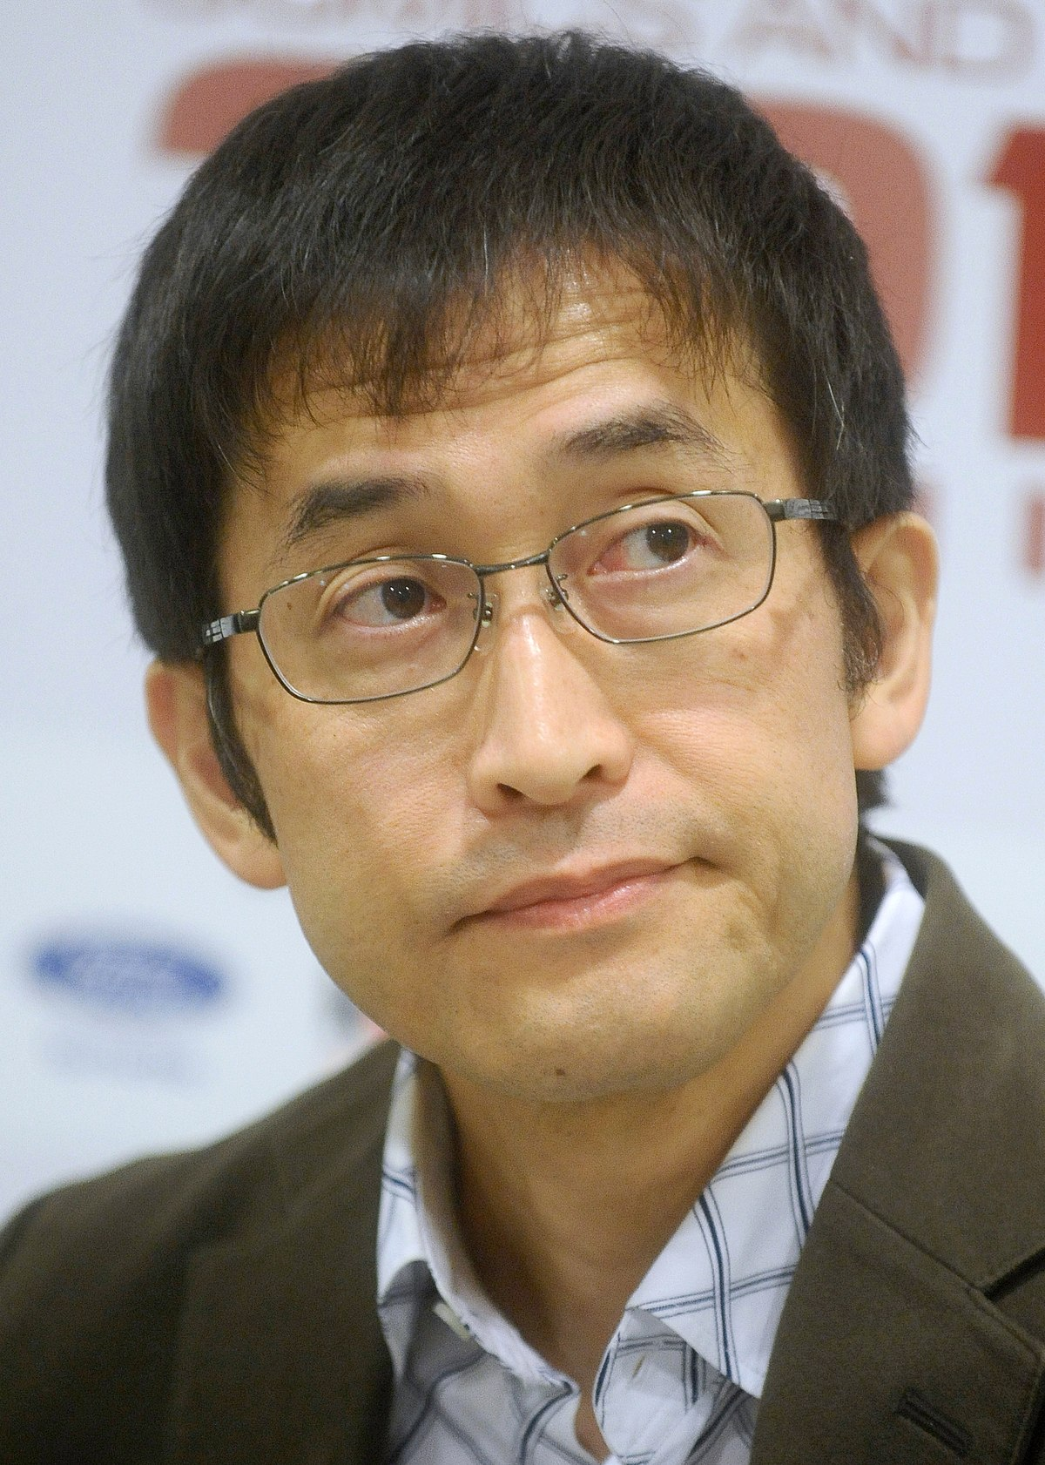
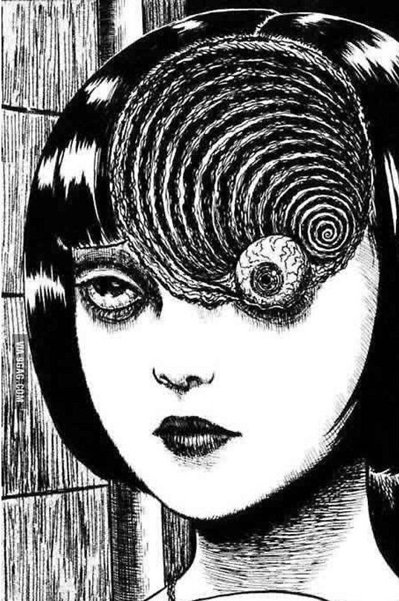
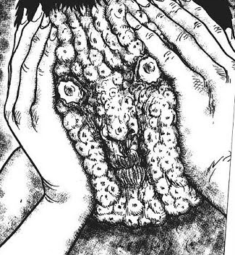
Inspirations 2/3
Junji Ito – Manga Writer, Artist
Names of some of his manga and themes:
Hanging Balloons – Turning something not scary into something horrifying
The Enigma of Amigara Fault – Claustrophobia, Phycological, body horror
Glyceride – Body horror, disgusting the audience.
Uzumaki – Unknown Entity, Force of nature.

Slide 10
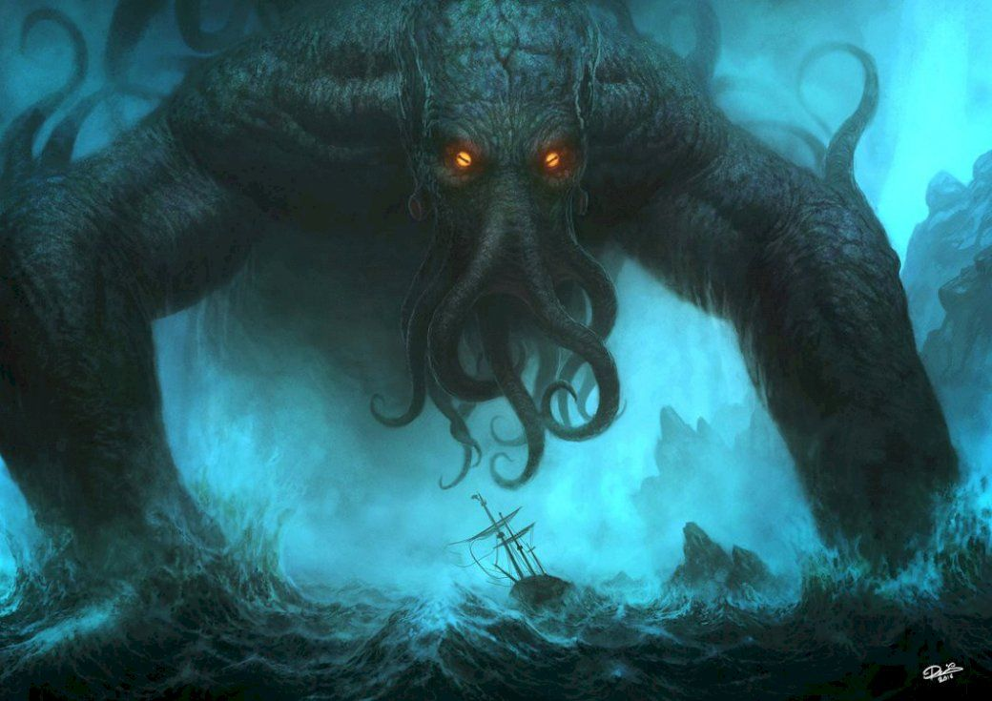
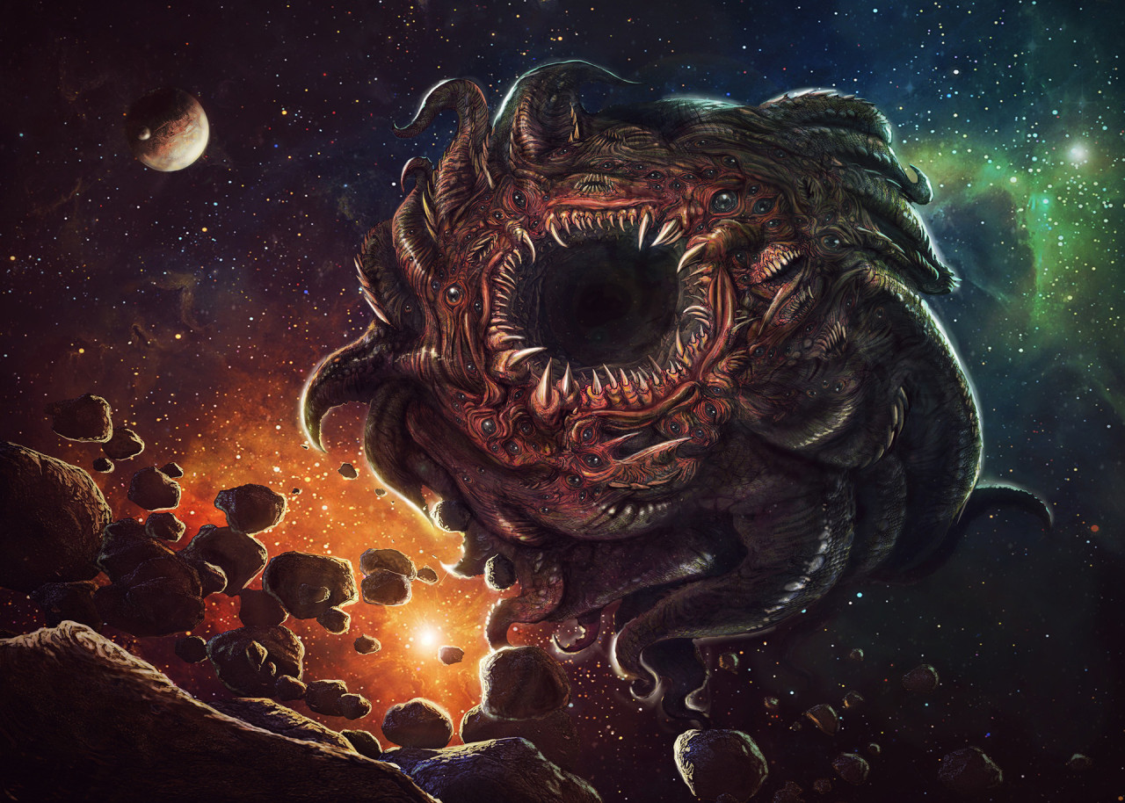
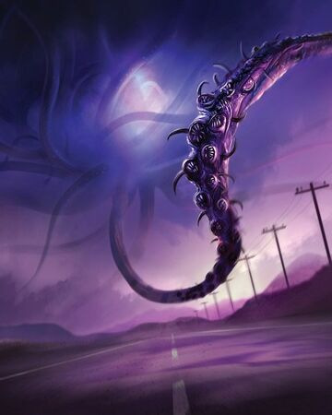
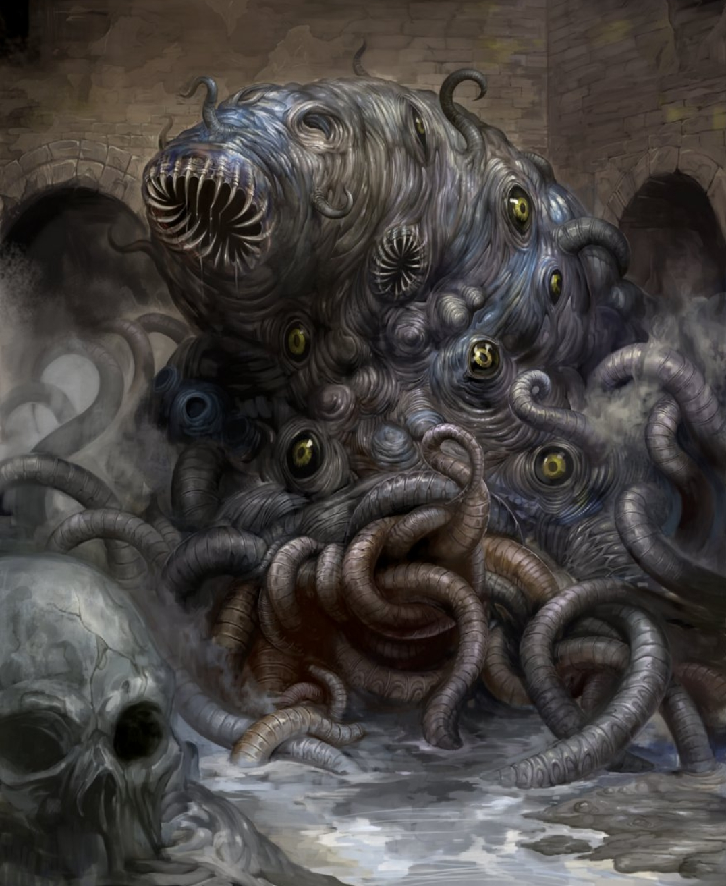
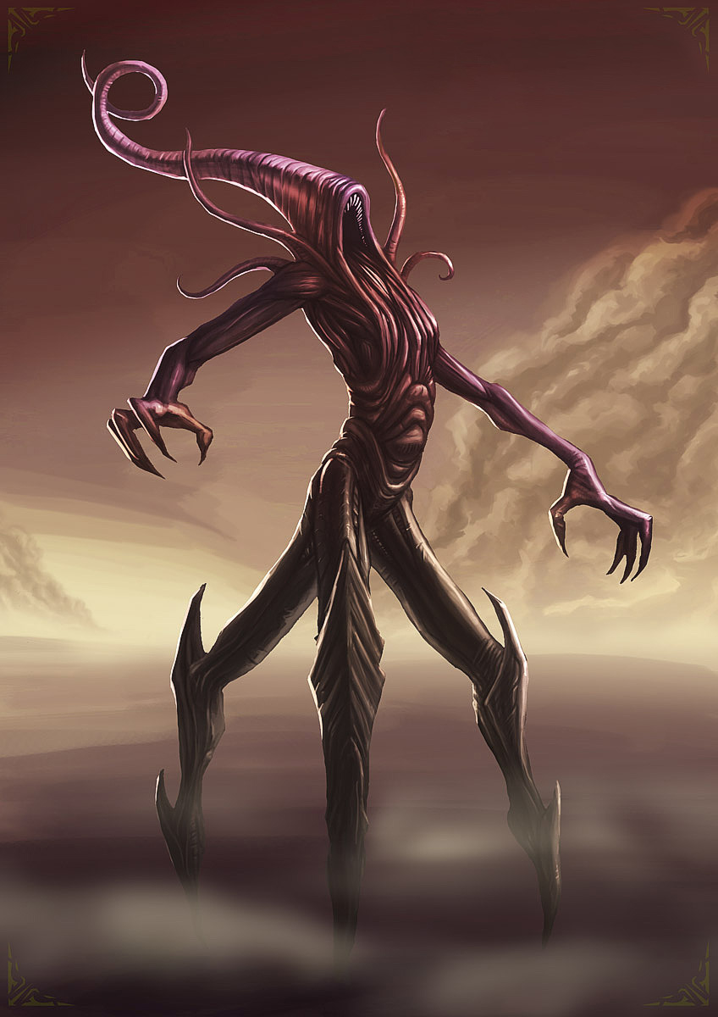
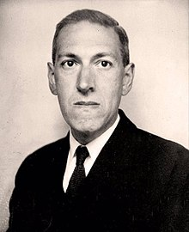
Inspirations 3/3
H.P Lovecraft – Writer
Monsters he created:
Cthulhu
Azathoth
Kassogtha
Shoggoth
Nyarlathotep

Slide 11
What I find scary notes
Ambiguity
Never Get an answer
Fear of the Unknown
The feeling of not knowing is scarier than knowing or learning to much
We are too curious to not want to learn more we crave answers
Darkness
Not able to see anything recognisable
Feeling of someone watching you
Hard to defend yourself
Believability
Never break your own rules
Anything can be scary if given the proper reason to fear it.
Characters do sensible choices
Unrecognize the recognisable
Hide the threat so its harder to locate and pay attention to it.
Masks, hair, and other objects can hide the face, losing emotion
Having body parts missing or have an abundance of to throw off
List of some common Fears
Fear of Darkness – Achluophobia
Fear of Heights – Aerophobia
Fear of Spiders – Arachnophobia
Fear of Being Alone – Autophobia
Fear of Confined spaces – Claustrophobia
Fear of Clowns – Coulrophobia
Fear of Insects – Entomophobia / insectophobia
Fear of Blood – Hemophobia
Fear of Death or dead things – Necrophobia

Slide 12
Next Step:
I will start designing three different monsters based on the three horrors, Paranormal, Creatures and Human like.
This will help me know what kind of story I would tell with them, how they would move (Walk cycles and/or storyboarding) and giving a interesting location for the scenes to take place.
Just as a lifeline and I am unable to achieve Three different animations with three different monsters Ill just stick to my favourite idea and work on that storyline and monster to create a solid short than multiple average horror shorts.

