Slide 1
VIVA VOCE
By William Foster

Slide 2
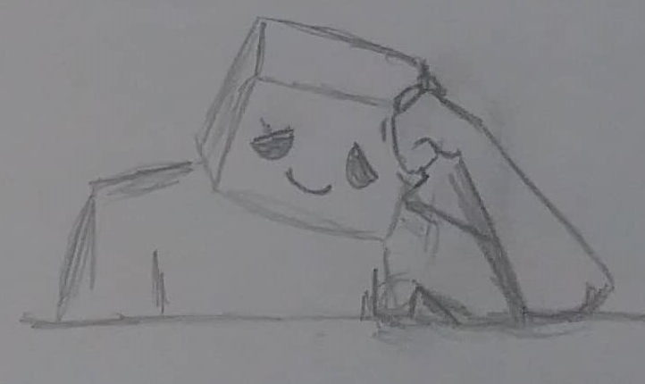
Synopsis
We follow a lonely character who is living day by day dealing with their own inner demons within their own room, they pass the days within their room doing mundane activity’s.
but things take a turn when their inner demon starts appearing and causes the character to become more and more depressed before the monster starts becoming real and start slowly tormenting them in reality.

Slide 3
Treatment
This animated film is a story about loneliness and depression.
With each new day a new problem would emerge, from no one wanting to talk to the character leading to them feeling lonely, to them being self-conscious about how they look, from looking in the mirror at themselves and being depressed due to this.
What's unique about this animation is that it will be set in one location, a bed room, in both 2D and Stop-motion, Both animation styles used together is unique enough to get people interested in watching both styles together.
This story can also be linked to the Covid pandemic since many people have experienced the dullness of waking up and being trapped inside and being unable to meet anyone.
I'm hoping for this animation to be between 3 to 4 minutes long.

Slide 4
Target Audience
This animation would be targeted towards early teens to late 20’s, But due to the subject matter can be understood by more.
The animation would also target people who also experience with this type of loneliness and depression, being able to relate to the lonely character and understand how they feel.

Slide 5
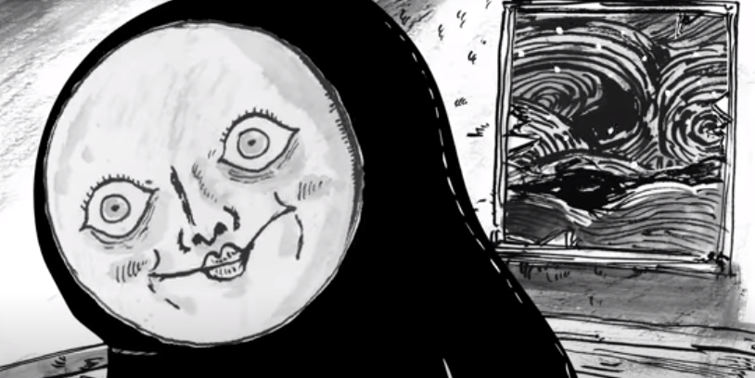
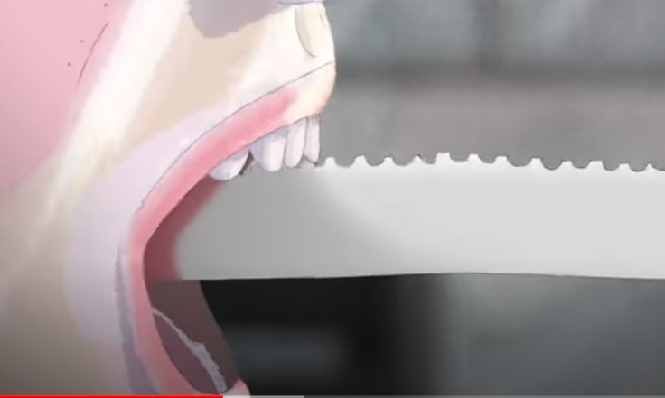
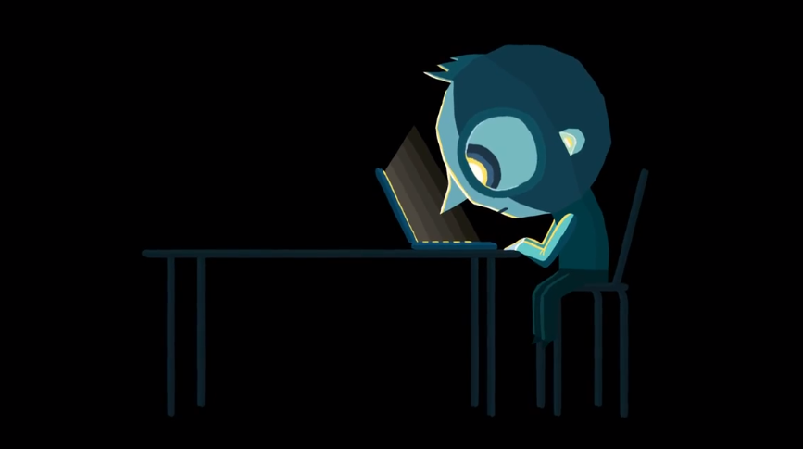
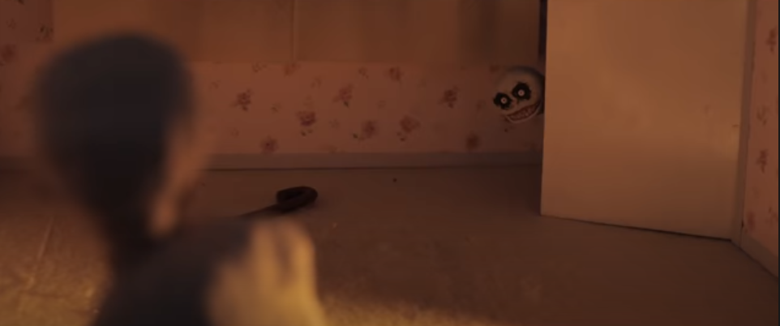
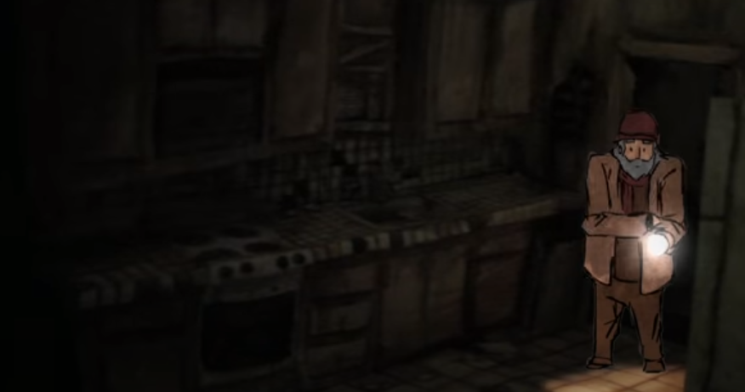
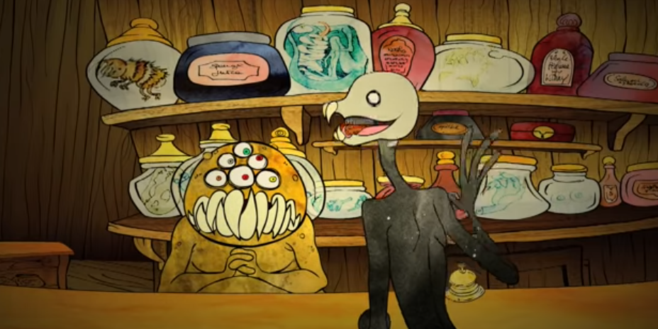
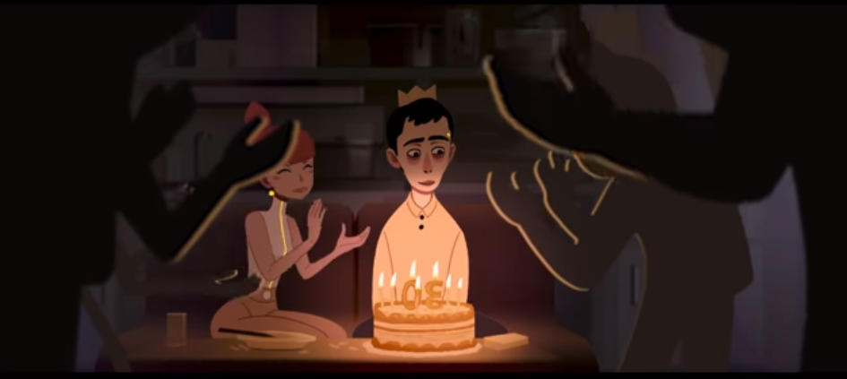
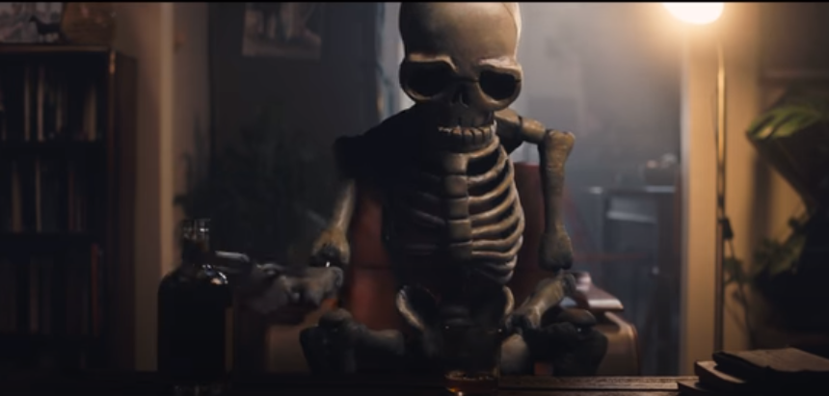
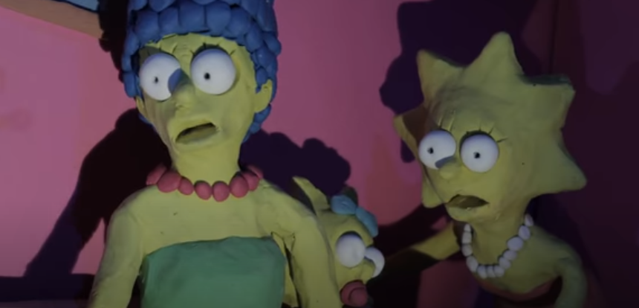
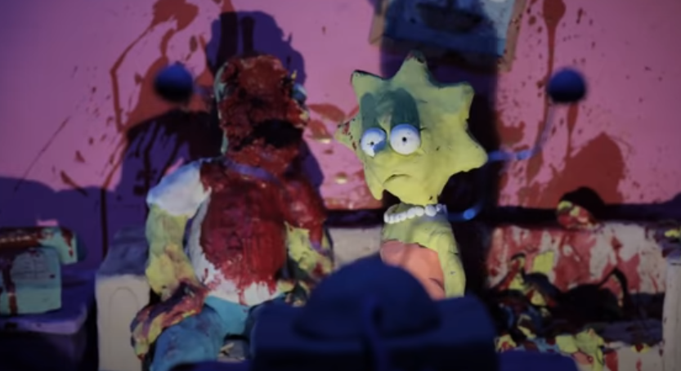

Slide 6
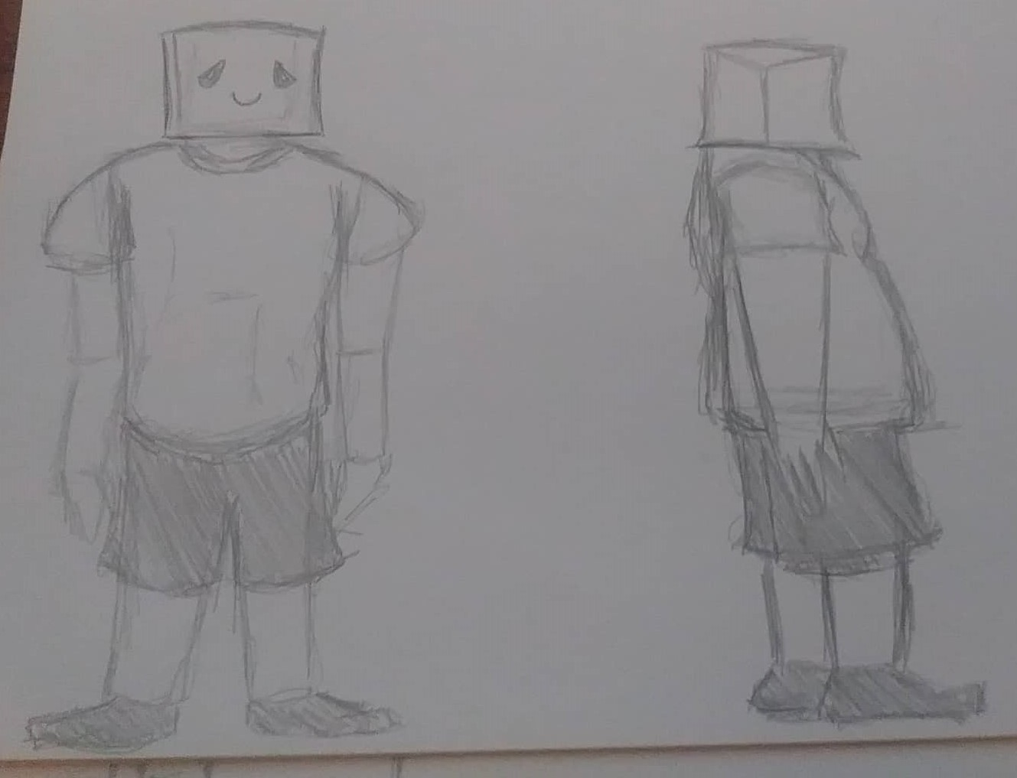
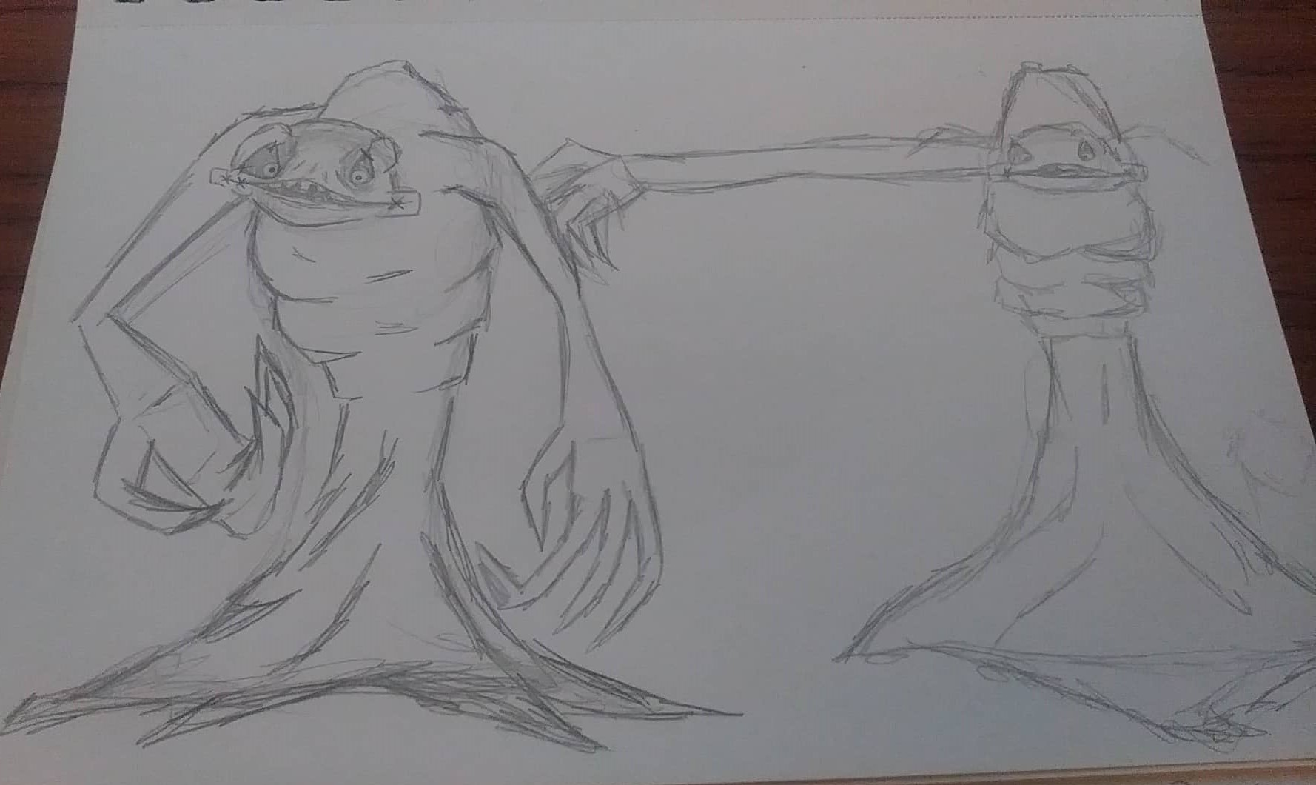
Characters
Lonely Character
This characters appearance is of a normal looking person but they have a box on their head,
this box has a smile but also sad looking eyes. The reason for the mask is to have a visual representation of them trying to hold it together, the smile isn’t a real one. It’s to hide
what's inside. Making sure others don’t worry about them.
They will be animated in 2D, this is to give a welcoming and trusting
feeling when we see the character.
Demon
This characters appearance is the representation of the characters wants and desires, but a corrupted ideal of what they wanted, the creature is tall and skinny and its face is stretched and pulled back eye lids, giving off a creepy expression.
They will be animated in Stop Motion, this gives the character an uncomfortable movements as well as being paired with the lonely character gives the audience the understanding that the Demon is more dominant than the Lonely character.

Slide 7
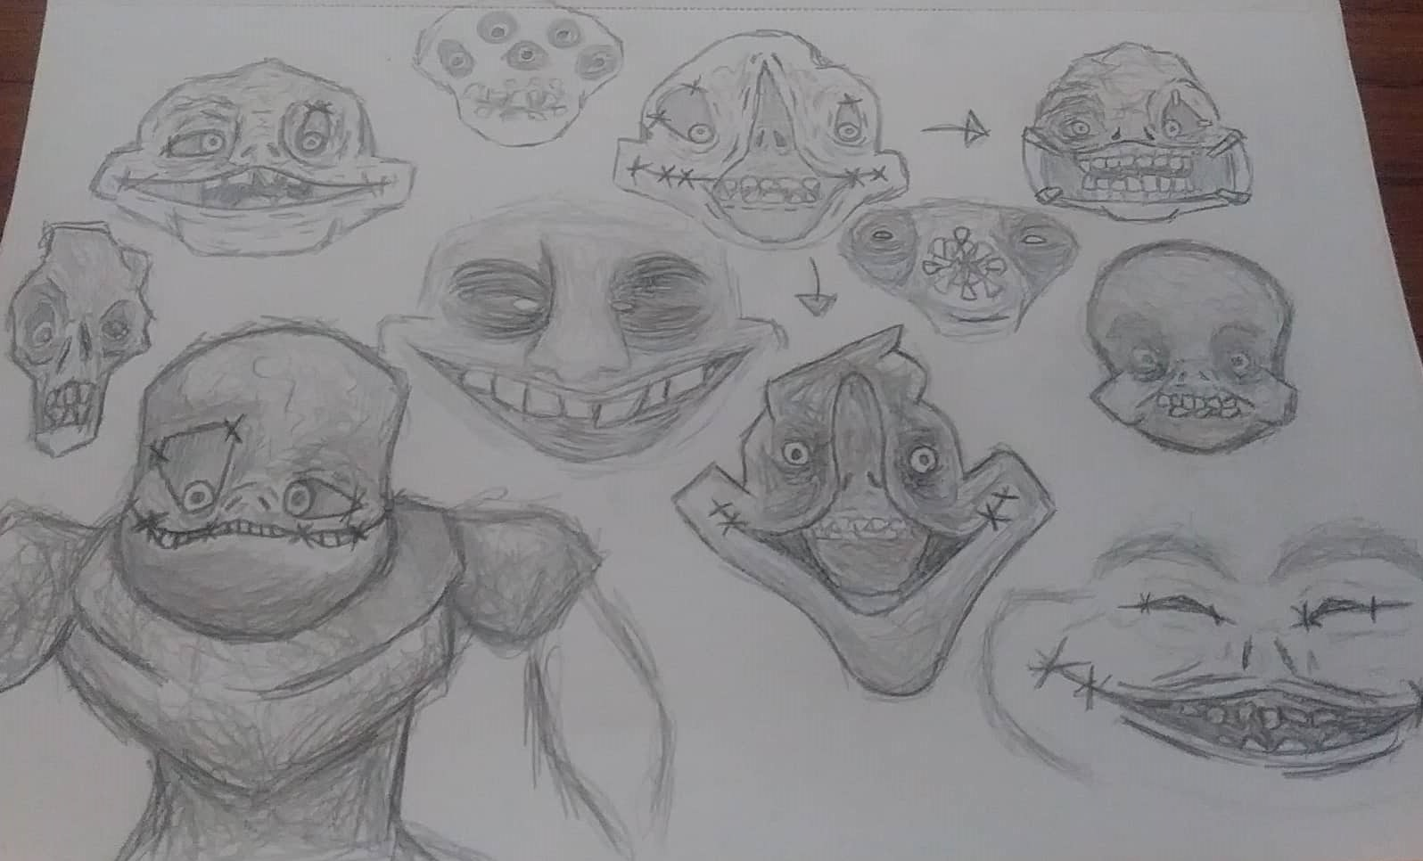
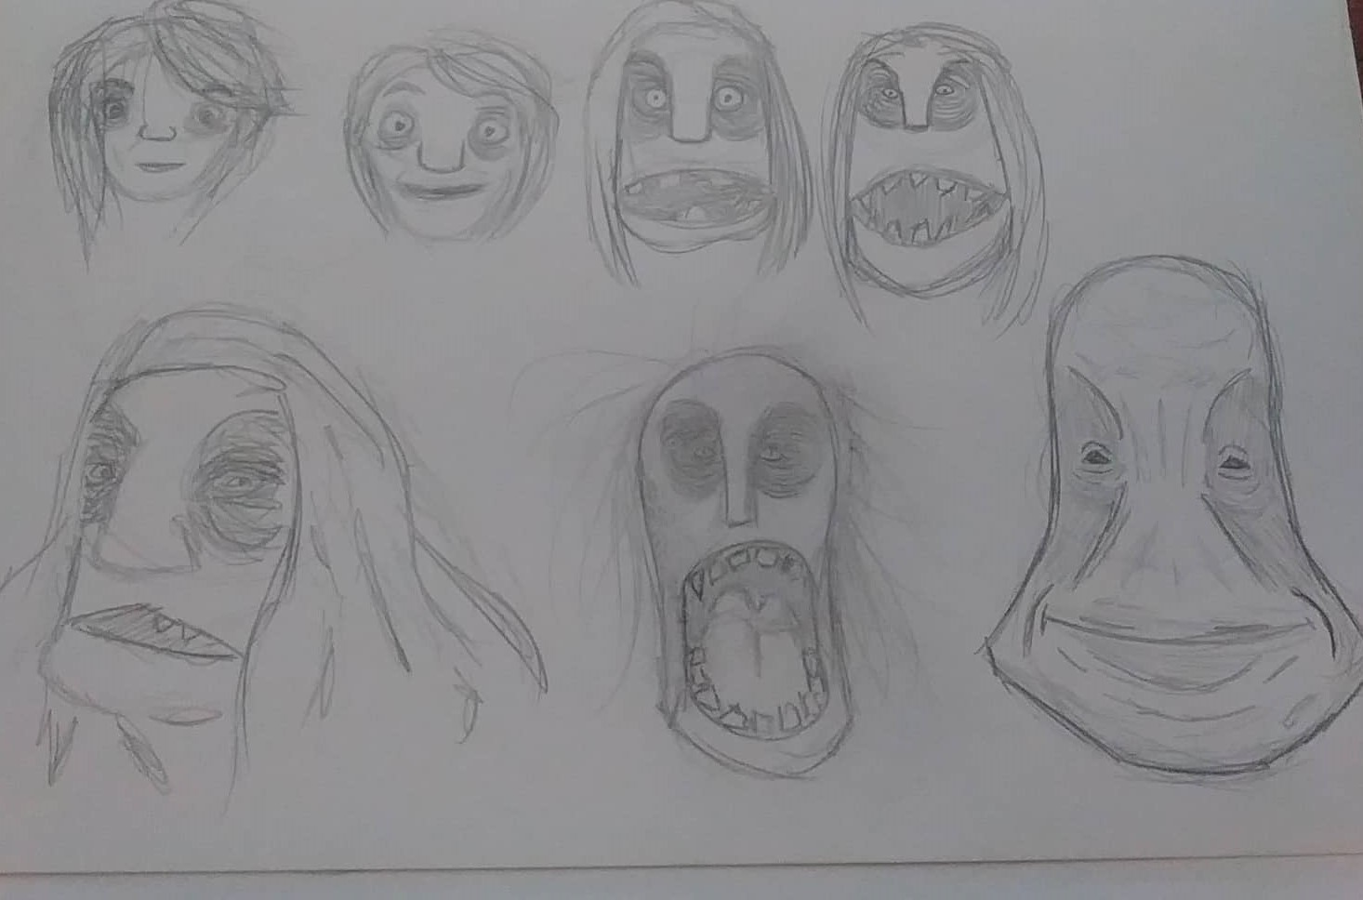
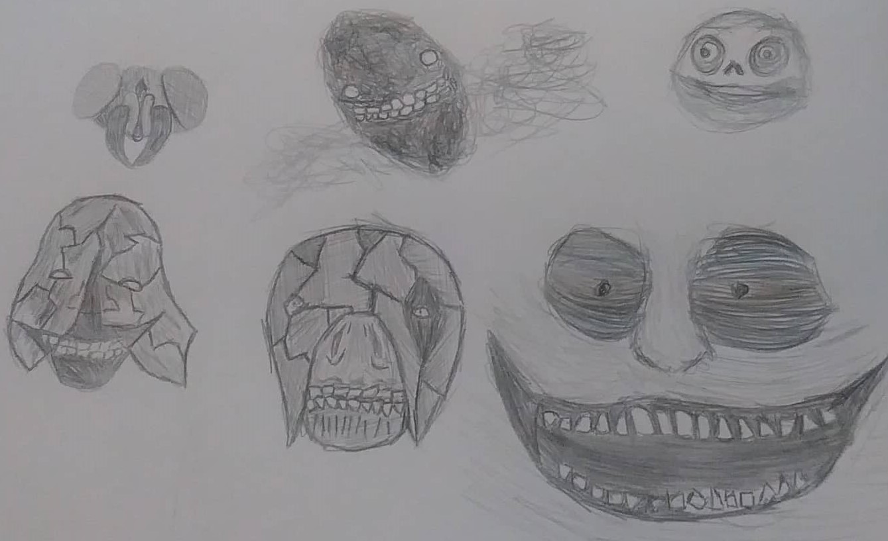
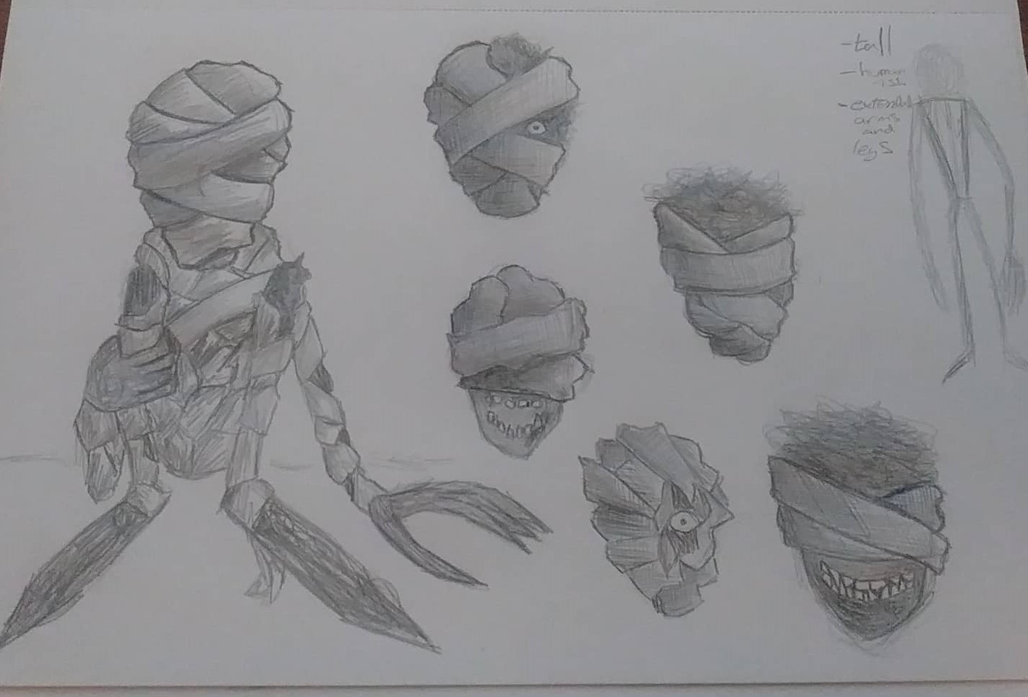
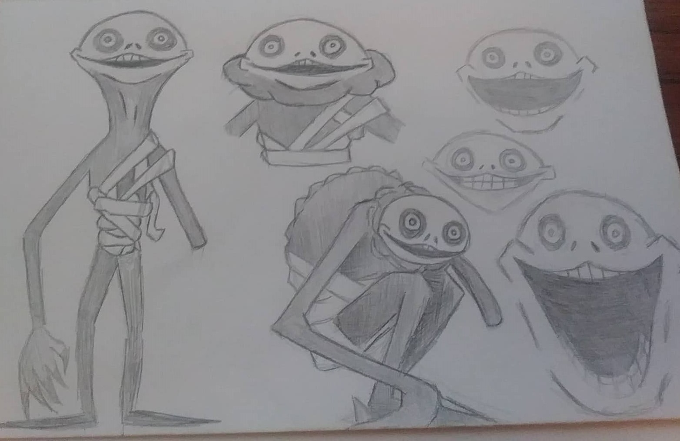
Character Designs

Slide 8
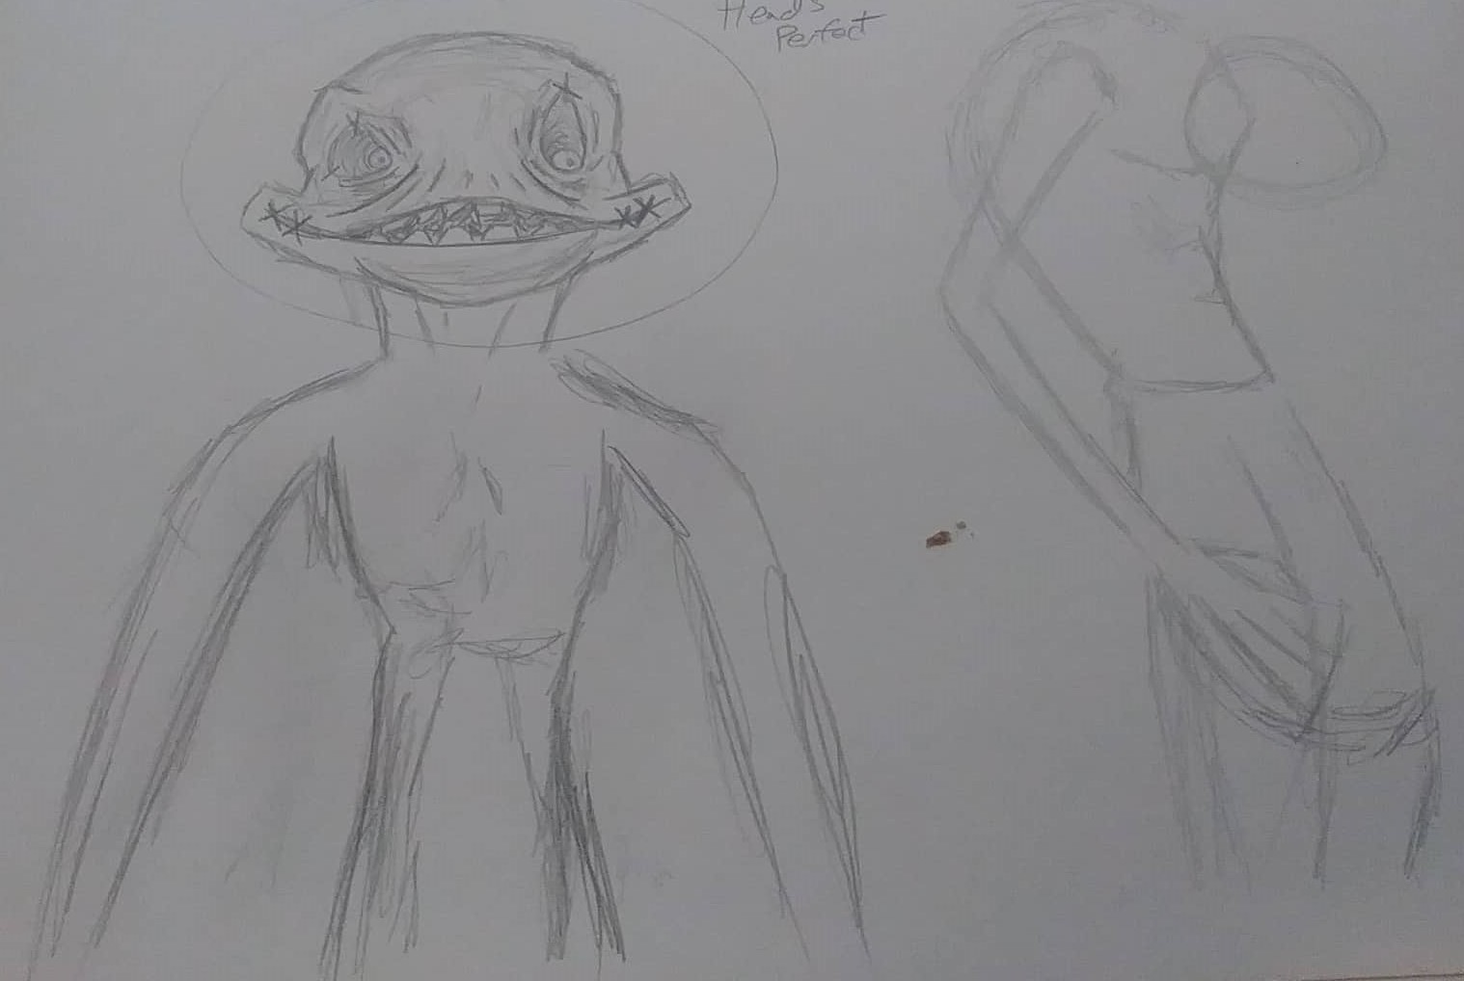
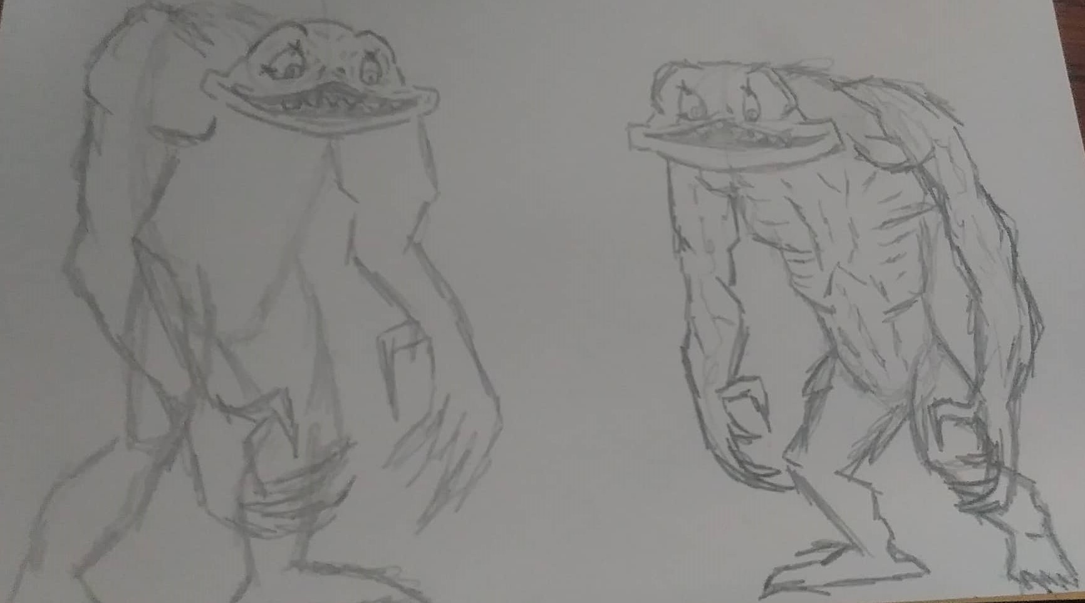
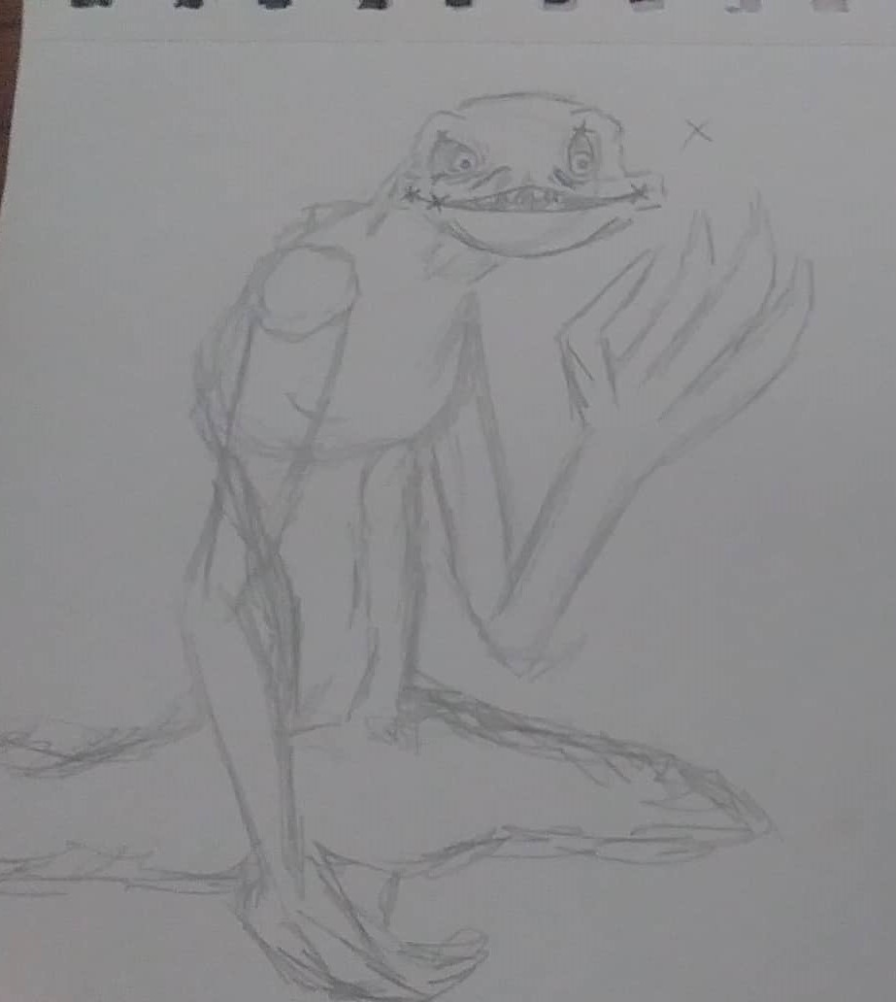

Slide 9
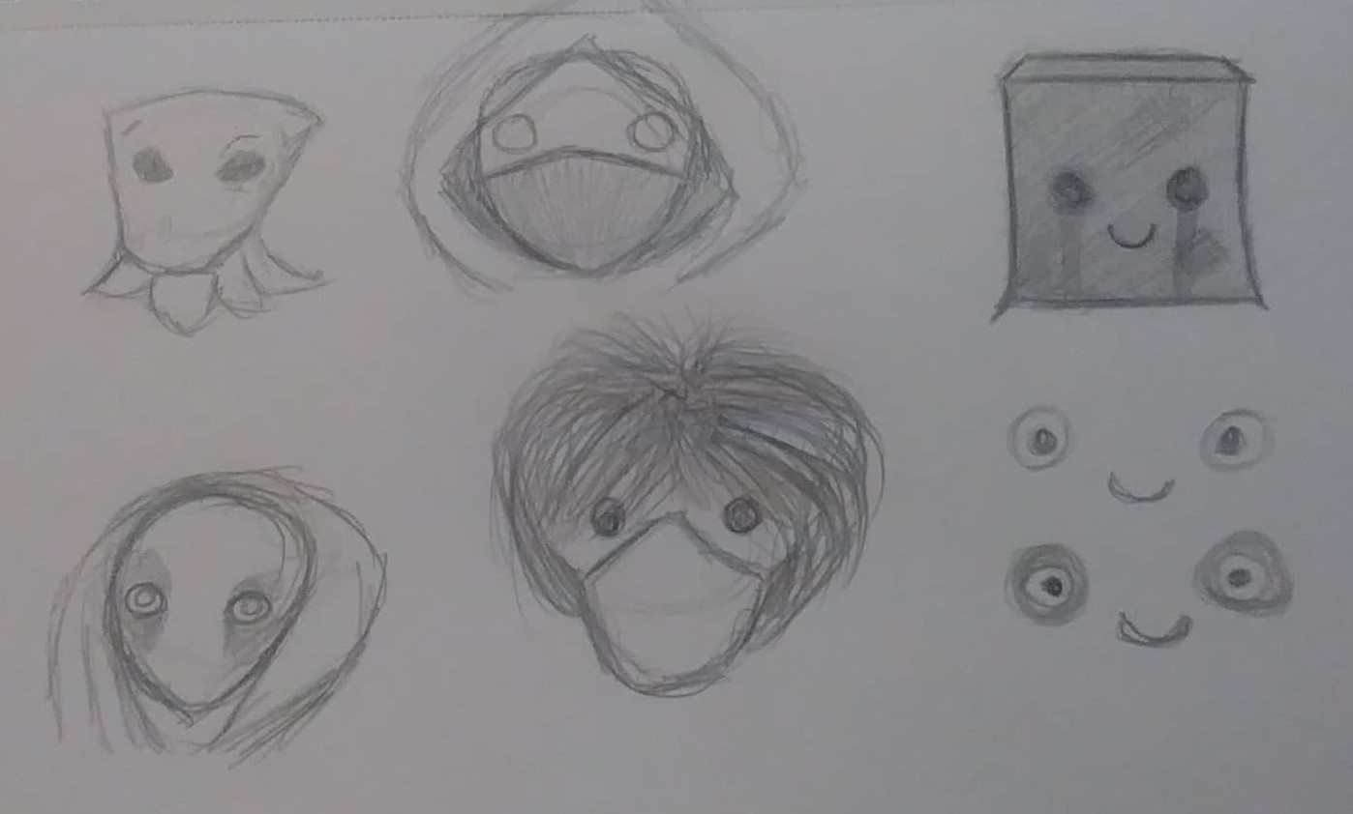
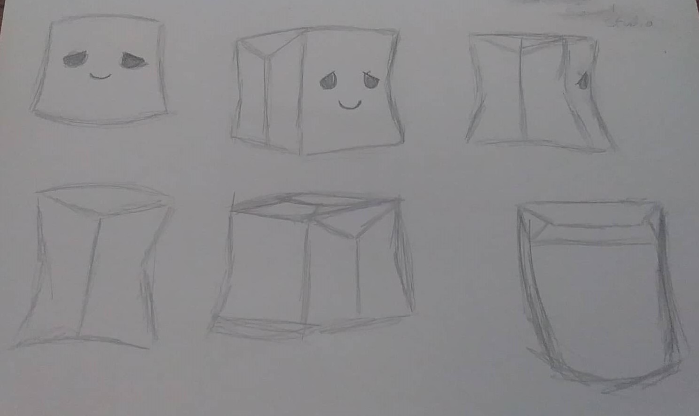
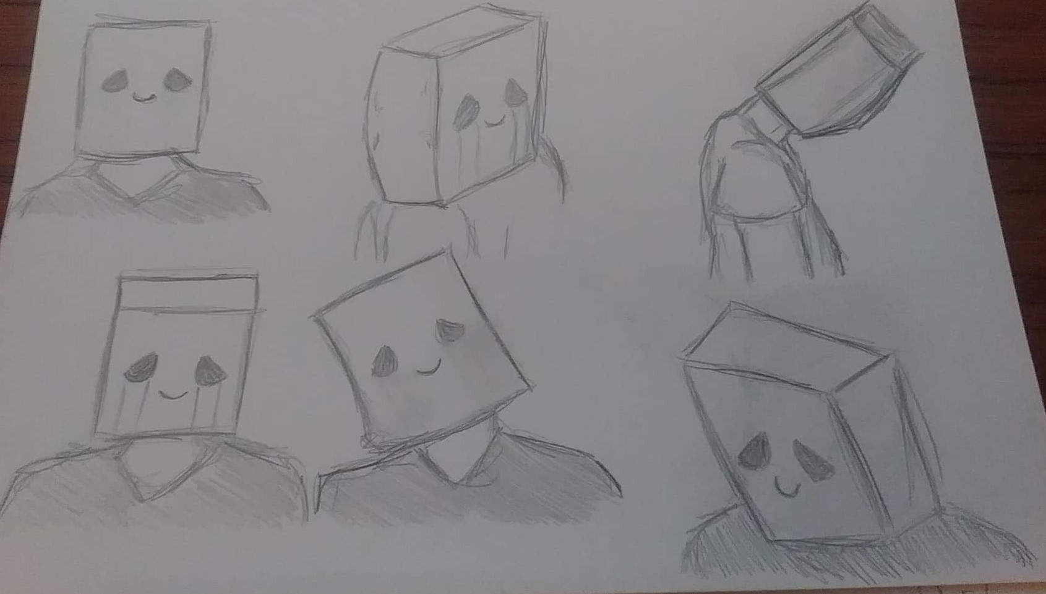

Slide 10
Schedule
09/Nov/20
Character designing - Done ( 16/Nov/20)
16/Nov/20
Storyboarding – Not Done (Should finish around 9/Dec/20)
7/Dec/20
Get in contact with Osian about music.
Build the Rig for stopmo (Should finish 10/Dec/20)
Animatic – not started (Should finish 16/Dec/20)
Note - remember send Osian the animatic to help with music
11/Jan/21
Start Animating
15/Feb/21
Review or get opinions on what ive made so far.
Make amendments if needed
Finish (Maybe) If not push back Schedule.
22/Feb/21
Audio work , get a recorder and make sounds for the clips (Finish 28/Feb/21)
3/MAY/21
HAND IN WEEK

Slide 11
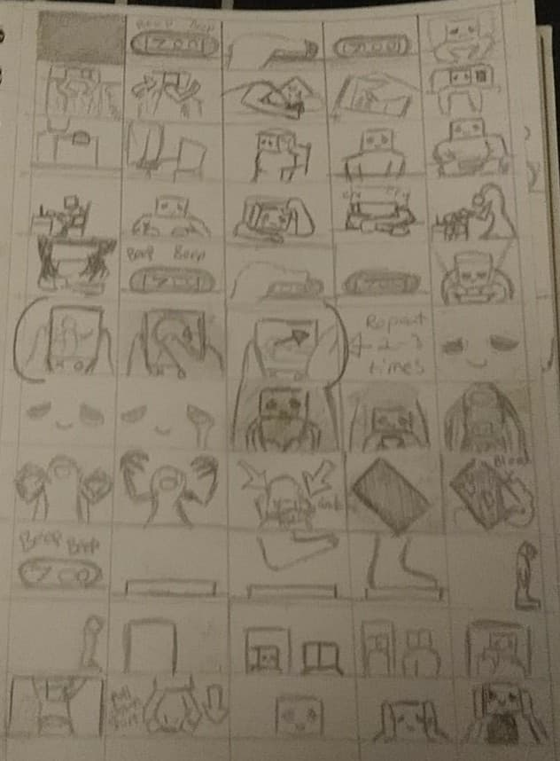
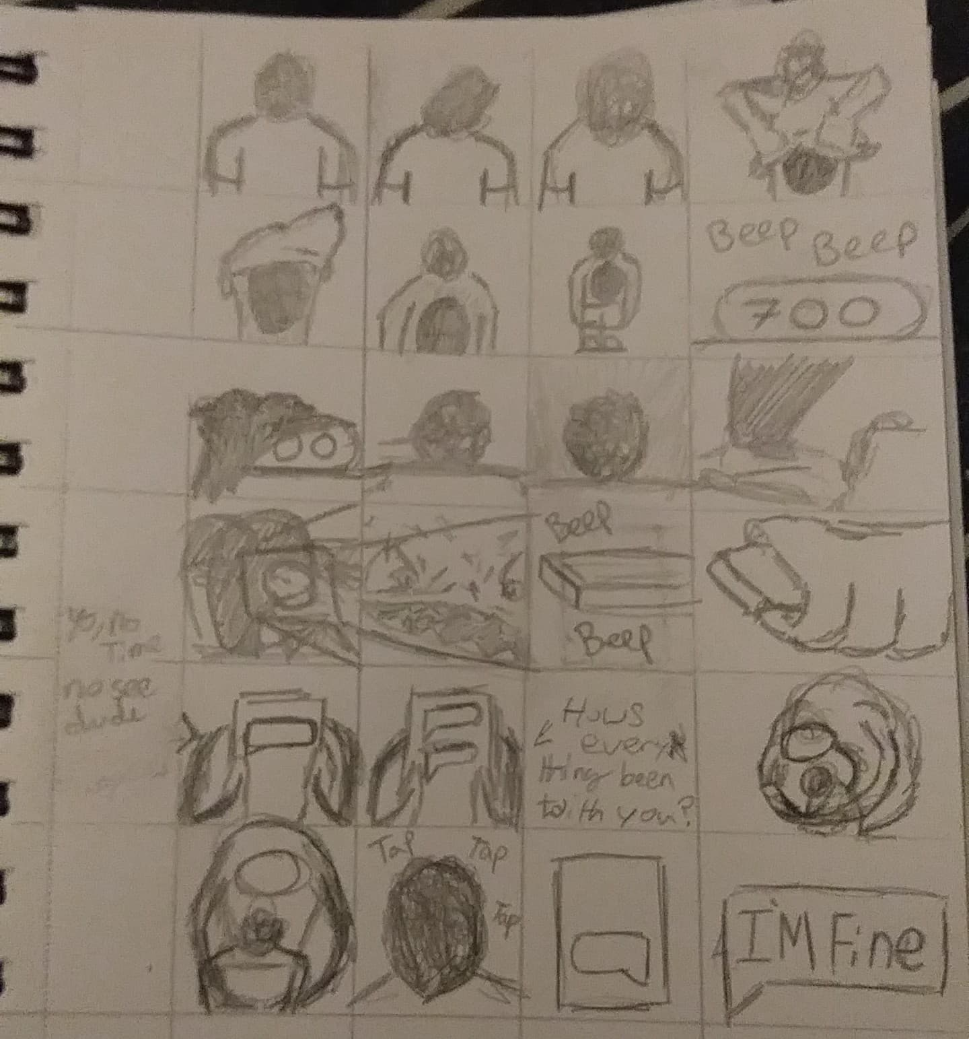

Slide 12
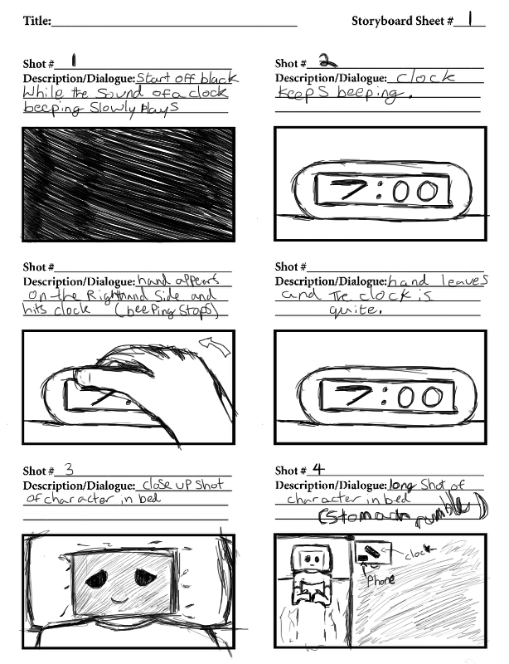
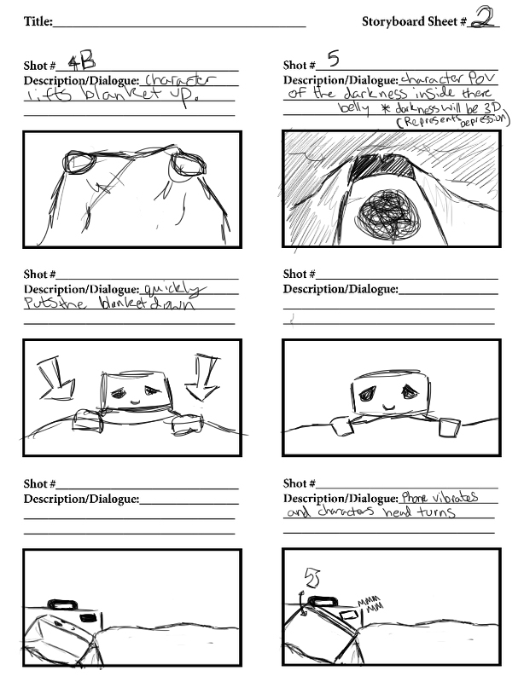
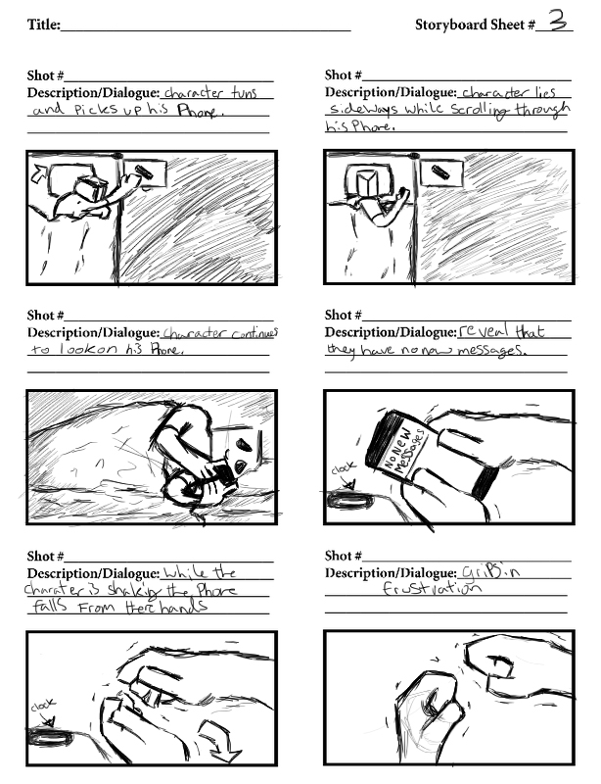
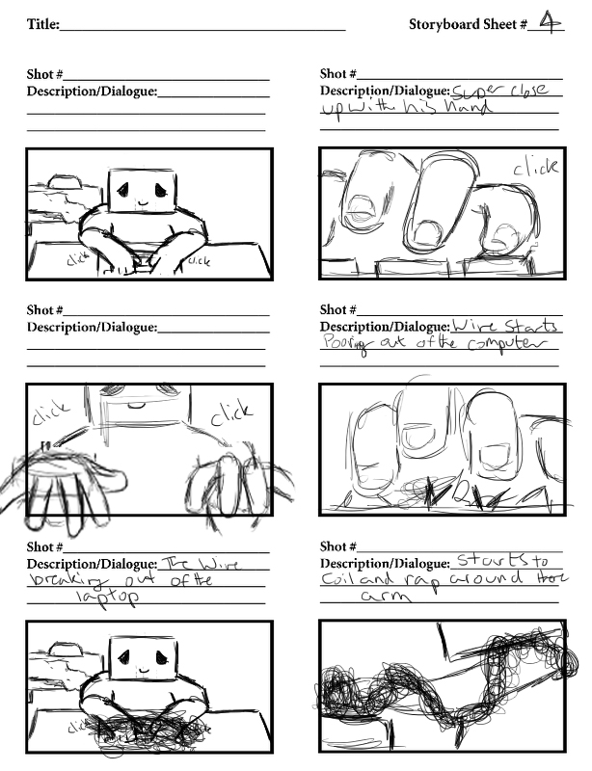
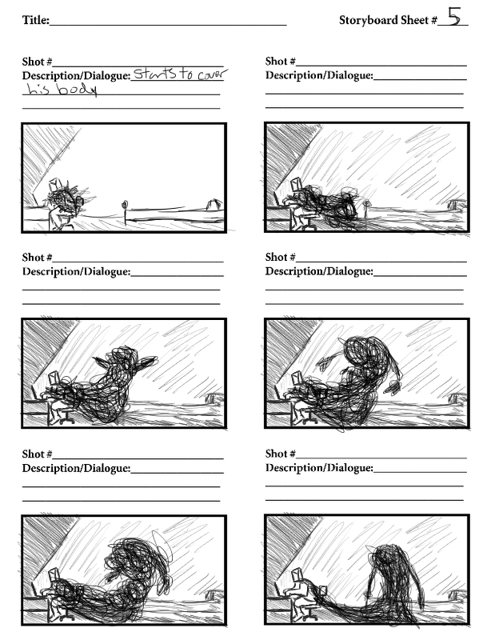
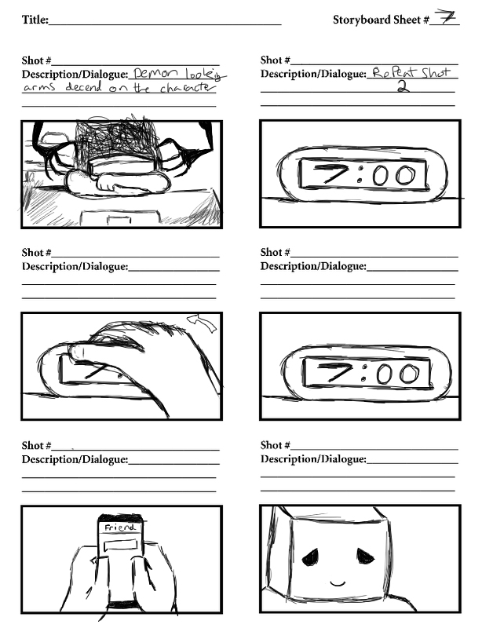
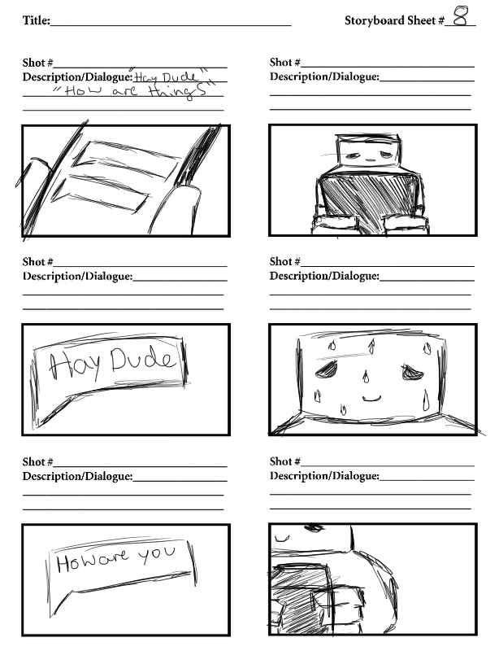
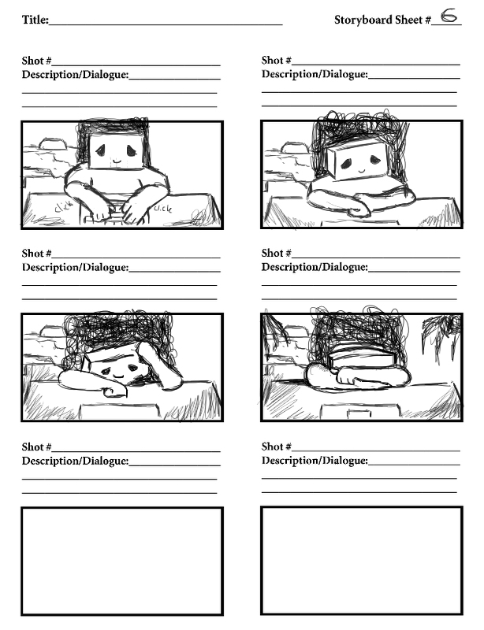

Slide 13
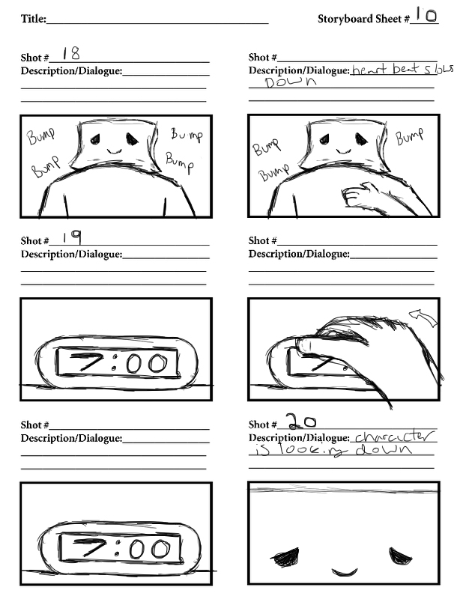
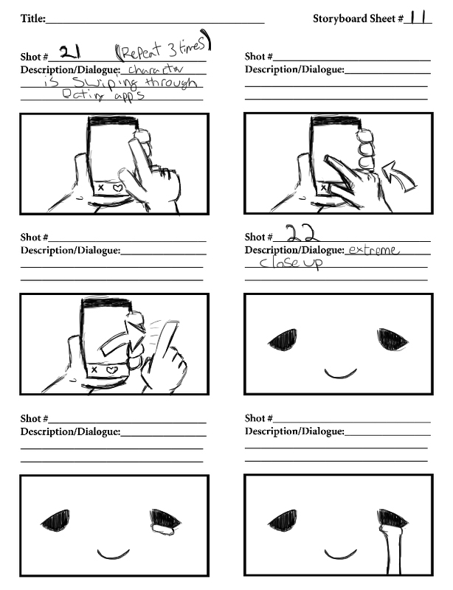
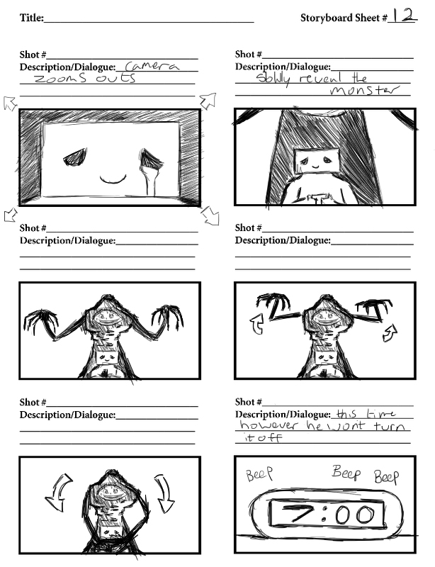
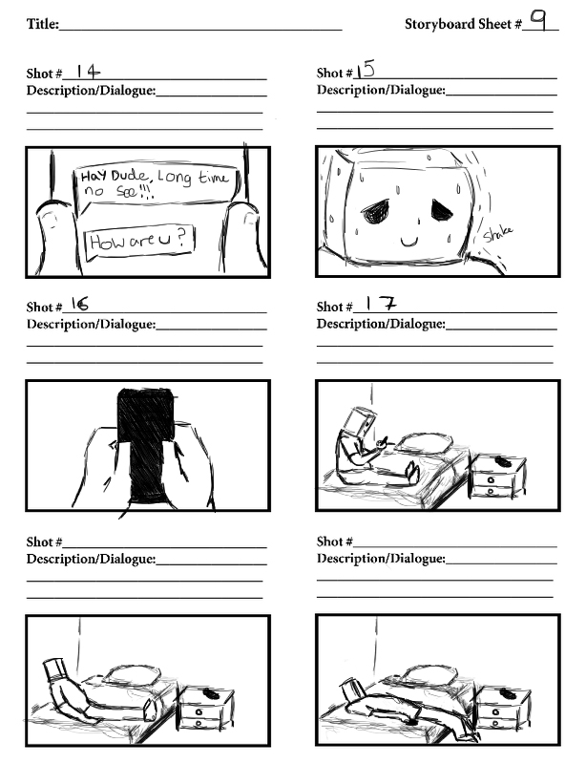
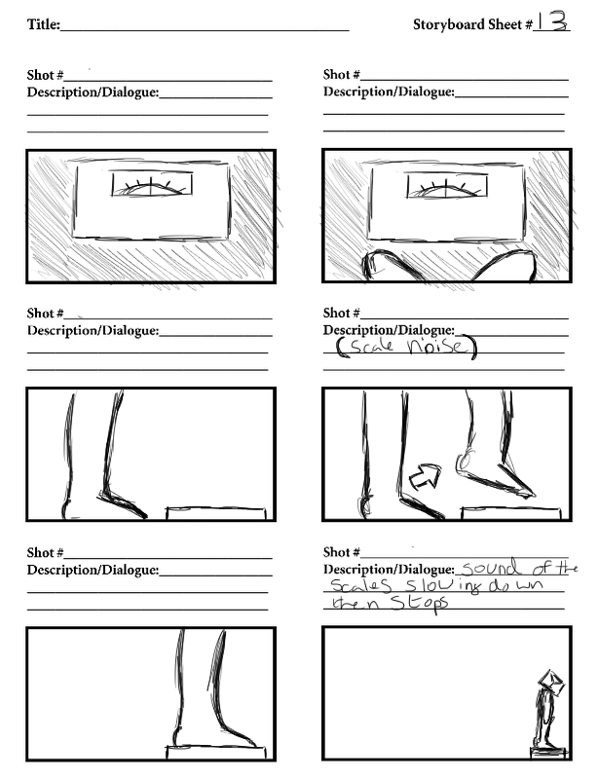
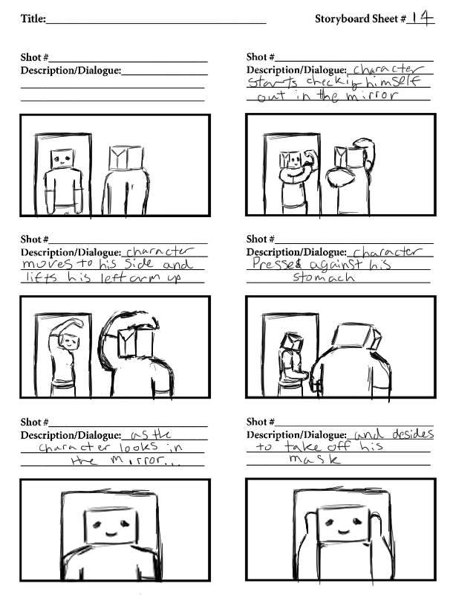
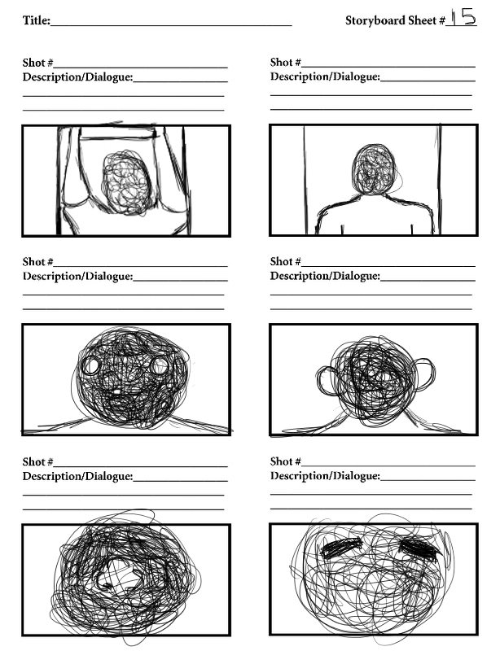
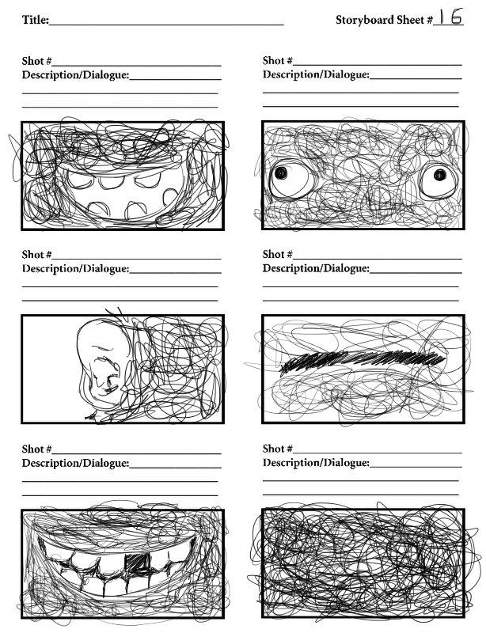

Slide 14
